Slide 1
CS6120: Lecture 12 Web Search Machine Translation
Kenneth Church
https://kwchurch.github.io/

Slide 2
Your Projects
Oral:
20-40 minutes
Written
5-20 pages
lots of references
Say everything three times
Winston: How to Speak
https://www.youtube.com/watch?v=Unzc731iCUY
Examples:
https://aclanthology.org/2022.acl-long.60
http://34.204.188.58/cgi-bin/similar?embedding=s2_recommendations&limit=20&search=An+Information-theoretic+Approach+to+Prompt+Engineering+Without+Ground+Truth+Labels
https://aclanthology.org/events/acl-2022/

Slide 3
Web Search & Information Retrieval
Information Retrieval
Web Search
Textbook
https://www-nlp.stanford.edu/IR-book/
Term-by-doc matrix: $M$
Similarity of terms: $M M^{T}$
Similarity of doc: $M^{T}M$
Index: Inverted file (postings)
Rows of $M$
Solitaire → Multiplayer Game
Solitaire: users lose to library (casino)
Multiplayer Game: Ecosytems
Readers, writers, advertizers, market makers
Left rail (algo) vs. right rail (ads)
Instant Answers
Crawl: wget
Seed URLs → sample of ``everything’’
Deep web
WayBack Machine
https://web.archive.org/
User logs: queries, clicks
Larger than crawls
Healthy ecosystem → more readers than writers
Behavioral signals
(super-important feedback)

Slide 4
Web Crawling https://nlp.stanford.edu/IR-book/pdf/20crawl.pdf
Expensive: Limited to a few large companies
Prioritize URLs by coverage of
Popular pages (estimates of demand)
Freshness (estimates of when the content is likely to differ from what is in cache)
How large is the web? Spider traps!
(Near duplicate pages & Approximate nearest neighbors)
Calendar pages are not spider traps, but…
Ads, view counters
https://www.wysiwygwebbuilder.com/phpcounter.html
https://www.geeksforgeeks.org/comparator-function-of-qsort-in-c/
Politeness (robots.txt): denial of service attacks
Bragging Rights
Our Index is bigger than yours → Race Conditions
How do you get seeds?
Toolbar, Gmail, Chrome, phones, Social Media, DNS (Domain Name System)
Security/privacy holes & DNS

Slide 5
Types of Answers
Left Rail: 10 blue links
algo search
learning to rank: https://en.wikipedia.org/wiki/Learning_to_rank
Right Rail: ads
auction: https://en.wikipedia.org/wiki/Sponsored_search_auction
Instant Answers
Internal groups compete for types of queries

Slide 6
Instant Answers

Slide 7
Instant Answers 10 Blue Links
Snippet

Slide 8
Ads

Slide 9
Evaluation
Extract sample of queries from query logs
Scrape 10 blue links from release candidates
(and competition)
(over time)
Send Queries and candidate URLs to human judges
score 1-5 (plus perhaps offensive)
perfect, excellent, good, fair, poor, offensive/illegal/irresponsible
Score scrapes with NDCG
Learning to Rank
Track scores over time
and hopefully get better and better over time
Issues
Judges prefer Google Brand
Even when the links are the same
Learning to rank → Cheating
Watermarking
Now that Google is a monopoly
Little incentive to improve
Web search may be degrading
(creating opportunity for chat bots)
SEOs (Search Engine Optimization)

Slide 10
Ad Auction https://moz.com/blog/understanding-google-ads-auction
Bid
Quality
Estimate of CTR (clicks)
Market maker (Google)
Maximizing benefit to
Readers
Writers
Advertisers
Economic Optimization
Different from learning to rank

Slide 12
Priors: Pr(URL) Query-independent
Page Rank
Prior: Pr(ULR)
Eigenvalue
Random Surfer Model
https://en.wikipedia.org/wiki/PageRank
ProNE: Fast and Scalable Network Representation Learning
https://en.wikipedia.org/wiki/Graph_neural_network
URL → Noisy Channel → Q
Pr(URL) = ARGMAX_U Pr(U) Pr(Q|U)
Prior: Pr(URL)
Channel: Pr(Q|URL)

Slide 14
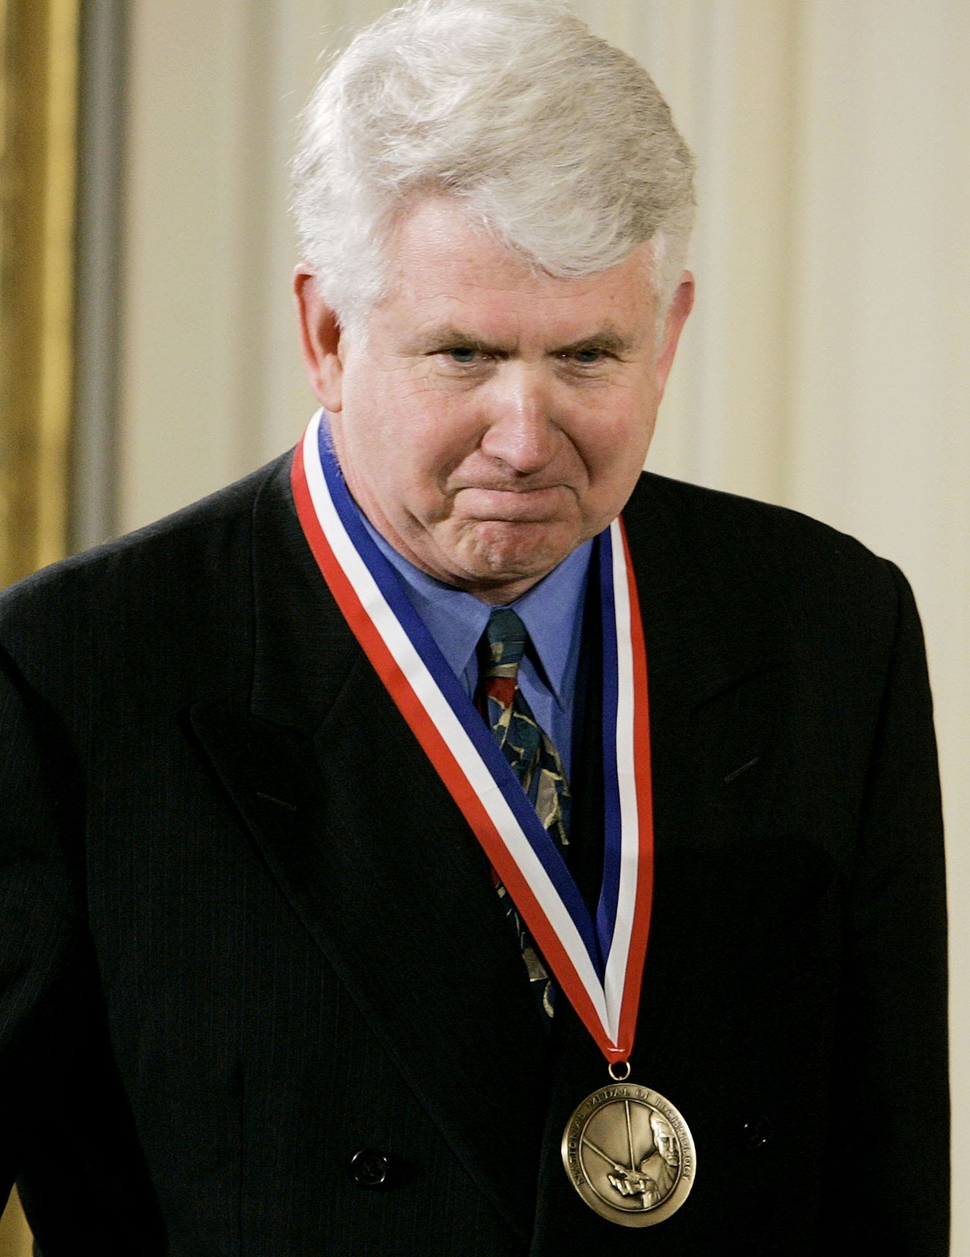
Metcalfe’s Law (Network Effects)
History: 3Com was selling small networks
3 = 1 printer + 2 computers
Metcalfe argued they should sell bigger networks
(and more 3Com products)
because of economies of scale
Economy of Scale:
Benefits scale faster than costs
Benefits: $\sim n^{2}$
Costs:$\sim n$
Law has been good for AT&T, Google, Social Media
Hypo: also good for Academic Search
Consequently, we should experiment with large graphs

Slide 15
Linear Algebra & Term-by-Document Matrices
Singular Value Decomposition (SVD)
Principal Component Analysis (PCA)
Dimension Reduction
Rotations
Approximate Nearest Neighbors (ANN)

Slide 16
Nearly Everything To Vectors (Embeddings) (VectorDB)
“Everything”
Words (Terms): word2vec
Documents (Text Strings):
doc2vec, BERT, Specter
Graphs (GNNs)
Example: citation graph
Semantics (“Meaning”)
All the world’s languages
Audio (Speech, Music)
Pictures and Videos
Embeddings
Similarity $≈$ Cosine
Similar documents
Word Overlap
Nearby in citation graph
Similar topics, venues, authors
Latent (Hidden) Dimensions
Computational Convenience
Dimension Reduction
Rotations
Approximate Nearest Neighbors

Slide 17
Salton’s Vector Space Model

Slide 18
Word2vec (Embeddings)
$M∈ℝ^{V×K}$ (tall-skinny matrix)
$V$: vocabulary size ($≈500$k)
$K$: hidden dimensions ($≈300$)
$MM^{T}= cos\left(w_{i},w_{j}\right) ∝PMI\left(w_{i},w_{j}\right)$
Similarity of all pairs of words in $V$
It might be infeasible to materialize $MM^{T}$
But there are approximations (ANNs)
that find many/most of the large values
Better for capturing collocations
Collocations: $w_{i} \& w_{j}$ appear near one another (more than chance)
Less appropriate for other notions of similarity
Both synonyms and antonyms appear near one another
(But they don’t mean the same thing)
Slide from JM3
For plotting purposes,
use dimension reduction
to reduce $K$ down to 2D

Slide 19
https://web.stanford.edu/~jurafsky/slp3/slides/7_NB.pdf

Slide 20
Information Retrieval (IR) notation Term Weighting: tf * IDF
t: term
d: document
D: # of documents in library
Interpretation:
Entropy: $H=−log⁡(P)$
where $P = {Pr⁡(t∈d)}^{count(t,d)}$
tf(t,d): term frequency
# of times that t appears in d
df(t): document frequency
# of documents that contain t
(at least once)
IDF(t): inverse doc frequency
$IDF\left(t\right)=−\log_{2}\frac{df(t)}{D}$
tf * IDF weighting
Assumes (too much) indep

Slide 21
Bellcore Example
Example of term by document matrix
A document $≈$ a bag of words
A word $≈$ a bag of documents
You shall know a word by the company it keeps
Example of SVD for dimension reduction
Suggestion: reducing dimensions → better separation of classes of interest
Motivate latent dimensions
as a method to embed both terms and documents
into a common (unified) vector space

Slide 22
Bellcore’s Example: Bag of Words + SVD http://wordvec.colorado.edu/papers/Deerwester_1990.pdf
c1 Human machine interface for Lab ABC computer applications
c2 A survey of user opinion of computer system response time
c3 The EPS user interface management system
c4 System and human system engineering testing of EPS
c5 Relation of user-perceived response time to error measurement
m1 The generation of random, binary, unordered trees
m2 The intersection graph of paths in trees
m3 Graph minors IV: Widths of trees and well-quasi-ordering
m4 Graph minors: A survey

Slide 23
Term by Documents Matrix
c1 | Human machine interface for Lab ABC computer applications
c2 | A survey of user opinion of computer system response time
c3 | The EPS user interface management system
c4 | System and human system engineering testing of EPS
c5 | Relation of user-perceived response time to error measurement
m1 | The generation of random, binary, unordered trees
m2 | The intersection graph of paths in trees
m3 | Graph minors IV: Widths of trees and well-quasi-ordering
m4 | Graph minors: A survey

Slide 24
Term by Document Matrix

Slide 25
Singular Value Decomposition (SVD)
$M ≈U D V^{T}$
$D$ is diagonal
Eigenvalues
Sorted from largest to smallest
$U$ and $V$ are Eigenvectors
Orthogonal and unit length
$U^{T}U=I$
$V^{T}V=I$
$\cos\left(M,M\right)= {MM}^{T}$
$U D V^{T}{\left(U D V^{T}\right)}^{T}$
$U D V^{T}{\left(V D U^{T}\right)}^{}$
$UD^{2}$ $U^{T}$
$M → UD$
Plus dimension reduction
Replace smaller Eigenvalues with 0

Slide 26
Dimension Reduction
Standard Recipe
Set smaller Eigenvalues to 0
Interpretation
L2 optimality (least squares)
Recall that Eigenvalues are sorted from largest to smallest
Motivation for dimension reduction
Computational resources:
Space
Specter:$M∈ℝ^{N×K}$
N is 200M documents
K is 768 (BERT hidden layer)
$MM^{T}∈ℝ^{N×N}$ (very large)
Time
Statistical convenience:
Smoothing (soft thesaurus)
Replace zeros with small values
Computational convenience:
Approximate nearest neighbors
https://pypi.org/project/annoy/

Slide 27
SVD and PCA
SVD (Singular Value Decomposition)
PCA (Principal Componenet Analysis)
$M ≈U D V^{T}$
$D$: Eigenvalues
$U$: Eigenvectors
$M$ need not be square
(just non-singular)
$Q∝ X^{T}X=WΛW^{T}$
$Q$ is square by construction
$Λ$: Eigenvalues
$W$: Covariances
Diagonal of $W$ are variances

Slide 28
Dimension Reduction in R $$bellcore ≈U D V^{T}$$
bellcore =
structure(.Data = c(1, 1, 1, 0, 0, 0, 0, 0, 0, 0, 0, 0, 0, 0, 1, 1, 1, 1, 1, 0, 1, 0, 0, 0, 0, 1, 0, 1, 1, 0, 0, 1, 0, 0, 0, 0, 1, 0, 0, 0, 2, 0, 0, 1, 0, 0, 0, 0, 0, 0, 0, 1, 0, 1, 1, 0, 0, 0, 0, 0, 0, 0, 0, 0, 0, 0, 0, 0, 0, 1, 0, 0, 0, 0, 0, 0, 0, 0, 0, 0, 0, 1, 1, 0, 0, 0, 0, 0, 0, 0, 0, 0, 0, 1, 1, 1, 0, 0, 0, 0, 0, 0, 0, 0, 1, 0, 1, 1),
.Dim = c(12, 9),
.Dimnames = list(c("human", "interface", "computer", "user", "system", "response", "time", "EPS", "survey", "trees", "graph", "minors"),
c("c1", "c2", "c3", "c4", "c5", "m1", "m2", "m3", "m4")))
b = svd(bellcore)
b2 = b$u[,1:2] %*% diag(b$d[1:2]) %*% t(b$v[,1:2])
dimnames(b2) = dimnames(bellcore)
par(mfrow=c(2,2))
plot(hclust(as.dist(-cor(bellcore))))
plot(hclust(as.dist(-cor(t(bellcore)))))
plot(hclust(as.dist(-cor(b2))))
plot(hclust(as.dist(-cor(t(b2)))))

Slide 29
SVD maps terms & docs into internal dimensions

Slide 30
$$bellcore ≈U D V^{T}$$

Slide 31
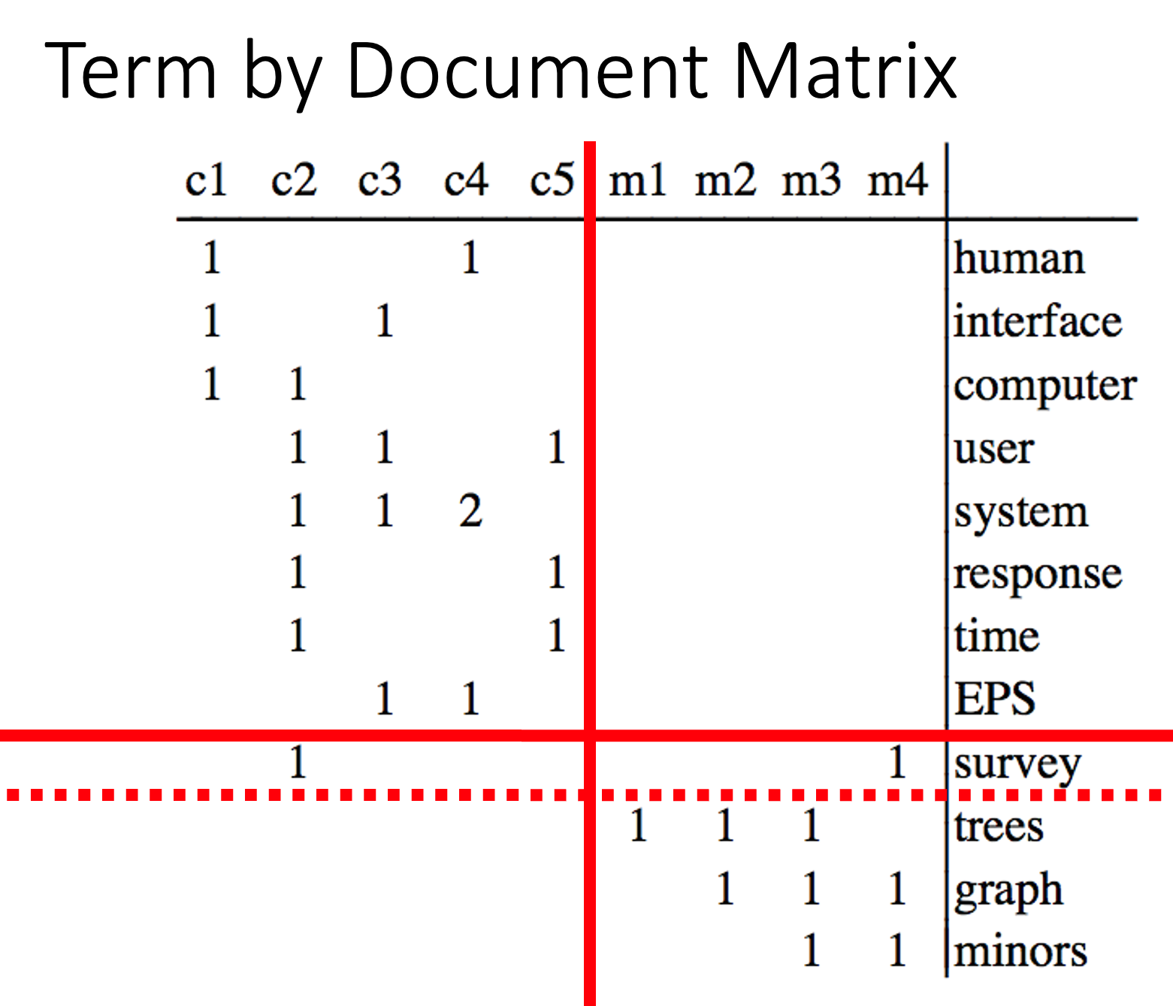
b = svd(bellcore)
b2 = b$u[,1:2] %*% diag(b$d[1:2]) %*% t(b$v[,1:2])
dimnames(b2) = dimnames(bellcore)
par(mfrow=c(2,2))
plot(hclust(as.dist(-cor(bellcore))))
plot(hclust(as.dist(-cor(t(bellcore)))))
plot(hclust(as.dist(-cor(b2))))
plot(hclust(as.dist(-cor(t(b2)))))

Slide 32
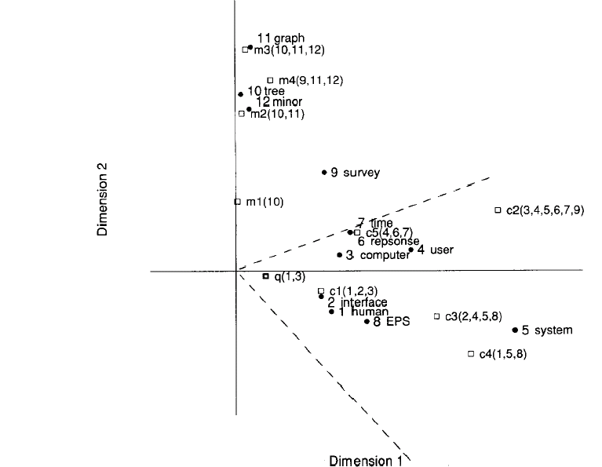
Latent concept vector space
• term
document
query
--- cosine > 0.9

Slide 33
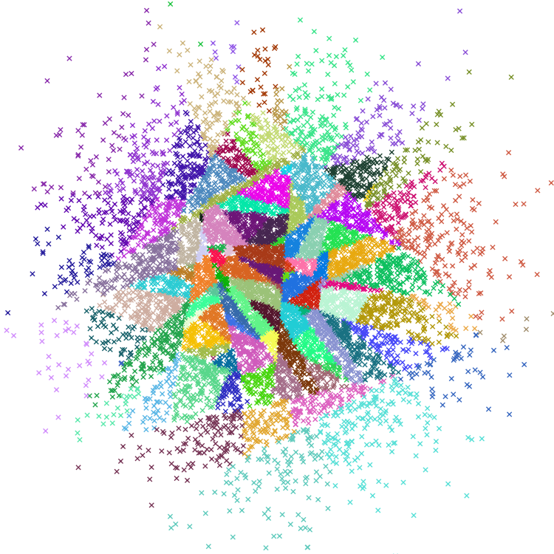
Approximate Nearest Neighbors (ANN)
Indexing time:
Input: Embedding $M∈ℝ^{N×K}$
Output: Indexes
Query time:
Input:
Embedding, Indexes, query
Query: $q∈ℝ^{K}$
Output: candidates, $c∈ℝ^{K}$
where $c$ is near $q$
sorted by $sim(q,c)$
https://radimrehurek.com/gensim/auto_examples/tutorials/run_annoy.html
https://pypi.org/project/annoy/

Slide 34
Machine Translation
https://web.stanford.edu/~jurafsky/slp3/13.pdf

