Slide 1
CS6120: Lecture 11 Topics that may become great (again)
Kenneth Church
https://kwchurch.github.io/

Slide 2
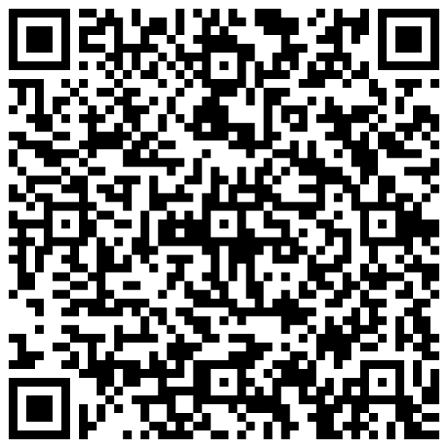
Your Projects
Oral:
20-40 minutes
Written
5-20 pages
lots of references
Say everything three times
Winston: How to Speak
https://www.youtube.com/watch?v=Unzc731iCUY
Examples:
https://aclanthology.org/2022.acl-long.60
http://34.204.188.58/cgi-bin/similar?embedding=s2_recommendations&limit=20&search=An+Information-theoretic+Approach+to+Prompt+Engineering+Without+Ground+Truth+Labels
https://aclanthology.org/events/acl-2022/

Slide 3
Say everything three times Winston: How to Speak
Introduction:
Say what you will say
Body:
Say it
Conclusion:
Say what you said
Promise
Delivery

Slide 4
Paper Outline https://aclanthology.org/2022.acl-long.60.pdf
Abstract
Introduction
Related Work
Methods
Task Definition
Mutual Information
Experimental Setup
Datasets
Models
Results
Template Selection Performance
Correlation between Template Mutual Information and Accuracy
Compared to Few Labeled Examples
Method Robustness and Ensembling
Transferability across Models
Conclusion
Ethics
Limitations (missing)
Acknowledgements
References
Appendices

Slide 5
References
Google Scholar
Semantic Scholar
JSALT-2023
http://34.204.188.58/similar.html
http://34.204.188.58/cgi-bin/similar?embedding=s2_recommendations&limit=20&search=An+Information-theoretic+Approach+to+Prompt+Engineering+Without+Ground+Truth+Labels
http://34.204.188.58/cgi-bin/similar?CorpusId=CorpusId:236493269&embedding=s2_recommendations&limit=20
http://34.204.188.58/cgi-bin/similar?CorpusId=CorpusId:236493269&embedding=proposed&limit=20

Slide 6
Foundation Models https://hai.stanford.edu/news/what-foundation-model-explainer-non-experts https://arxiv.org/pdf/2108.07258.pdf

Slide 7
The Easy, the Hard and the Ugly
Easy
Prompt Engineering
Inference (fit)
Fine-Tuning (predict)
Hard
Pre-training
Ugly (Responsible AI)
Bias
Toxicity
Misinformation
Hallucinations
Plagiarism

Slide 8
Agenda
Chomsky Hierarchy:
Generative Capacity
Parsing
(every way ambiguous structures)
PP-attachment & Conjunction
Speech
Prosody (Pitch, Duration, Energy)
Chinese Tone
Discourse
Rhetoric
Grice's Maxims
Interdisciplinary Collaboration
Linguistics
Lexicography
Psychology
Statistics
Medicine
Law

Slide 9
Chomsky Hierarchy

Slide 10
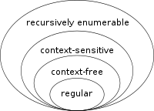
Chomsky Hierarchy
Language $≡$Set of Strings, $S$
Grammar $≡$ Set of Parse Trees, $G$
Automaton $≡$ Recognizer
Machine: $s → \{1, 0\}$
Is $s∈S?$
Equivalence: Strong vs. Weak
Weak: $S_{1}=S_{2}$
Strong: $G_{1}=G_{2}$

Slide 11
Examples:
Finite-State:
ngrams,
Markov Processes
grep
Context-Free:
parentheses
programming languages (syntax)
$ww^{R}$
Context-Sensitive: $ww$
Turing Machines:
Lambda Calculus
Programming languages
(including semantics)

Slide 12
Compilers https://www.lonelyscholar.com/knuth

Slide 13
Compilers & Interpreters
Compiler vs. Interpreter
C vs. python
Which is more valuable (according to a patent lawyer)?
Compiler: source code (foo.c) → object code (a.out)
Parse (step 1): source code → parse tree
Code generation (step 2): parse tree → object code
Intermediate representation: Parse Tree
https://www.cs.auckland.ac.nz/courses/compsci220s1t/archive/compsci220ft/lectures/GGlectures/220ch4_gramm.pdf

Slide 14
Agenda
Chomsky Hierarchy:
Generative Capacity
Parsing
(every way ambiguous structures)
PP-attachment & Conjunction
Speech
Prosody (Pitch, Duration, Energy)
Chinese Tone
Discourse
Rhetoric
Grice's Maxims
Interdisciplinary Collaboration
Linguistics
Lexicography
Psychology
Statistics
Medicine
Law

Slide 15
Example of Parsing: https://web.stanford.edu/~jurafsky/slp3/17.pdf
Grammar
Parse Tree
Non-Terminal
Phrase
Constituent
Terminal
Lexical Entry
Leaf

Slide 16
Should a Corpus be Balanced? Penn TreeBank: https://aclanthology.org/J93-2004.pdf

Slide 17
Syntactic Ambiguity
Programming Languages
(Considered Bad)
Natural Languages
(Reality or Academic Non-Issuue?)
if … then … else …
https://en.wikipedia.org/wiki/Dangling_else
if a then (if b then s) else s2
if a then (if b then s else s2)
I shot an elephant in my pajamas
I shot [an elephant in my pajamas]
I shot [ an elephant][in my pajamas]
Time flies like an arrow
Fruit flies like a banana
https://en.wikipedia.org/wiki/List_of_linguistic_example_sentences

Slide 18
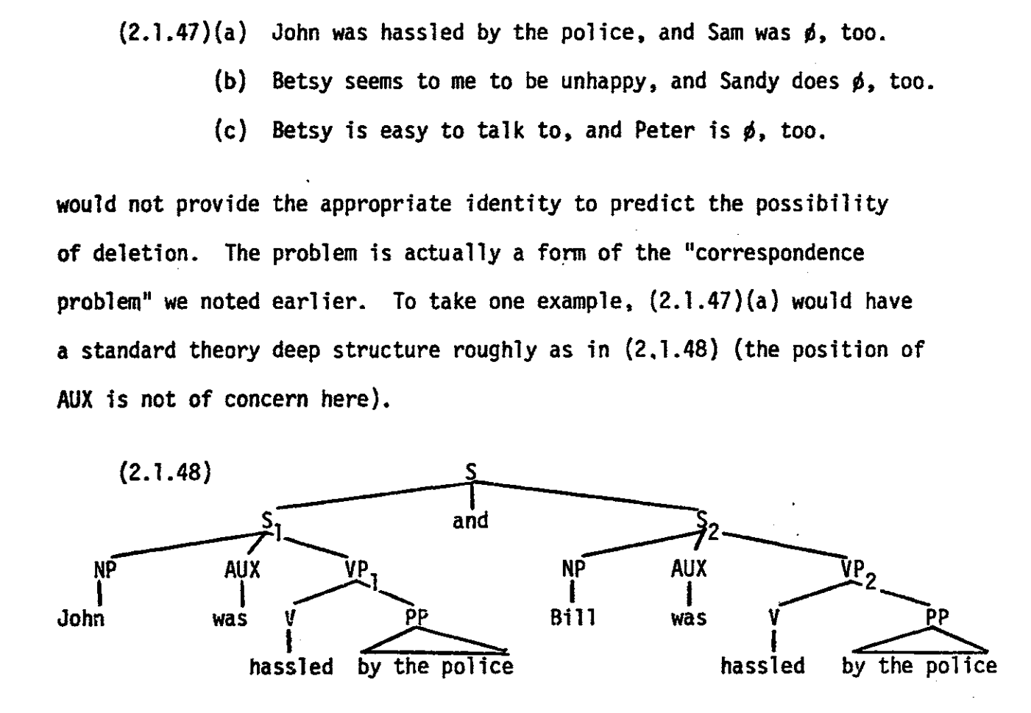
Constituency
Ivan Sag, 1976, PhD Thesis
Conjunction:
$X → X \& X$
NP → NP & NP
S → S & S
Wh-movement
I saw an elephant
What did I see?
Wh(t) [ I saw t]
https://web.archive.org/web/20220120200245/https://dspace.mit.edu/bitstream/handle/1721.1/16401/03491413.pdf?sequence=1

Slide 20
https://en.wikipedia.org/wiki/Sloppy_identity

Slide 21
Ivan Sag, 1976, PhD Thesis
https://web.archive.org/web/20220120200245/https://dspace.mit.edu/bitstream/handle/1721.1/16401/03491413.pdf?sequence=1

Slide 22
Conjunction & Prosody
Contrastive Stress
Phrase Final Lengthening
Accents
Practical Opportunity
Books on Tape
https://www.openslr.org/12
Construct parallel corpus of speech and text
Use constraints from both to annotate conjunctions

Slide 23
Agenda
Chomsky Hierarchy:
Generative Capacity
Parsing
(every way ambiguous structures)
PP-attachment & Conjunction
Speech
Prosody (Pitch, Duration, Energy)
Chinese Tone
Discourse
Rhetoric
Grice's Maxims
Interdisciplinary Collaboration
Linguistics
Lexicography
Psychology
Statistics
Medicine
Law

Slide 25
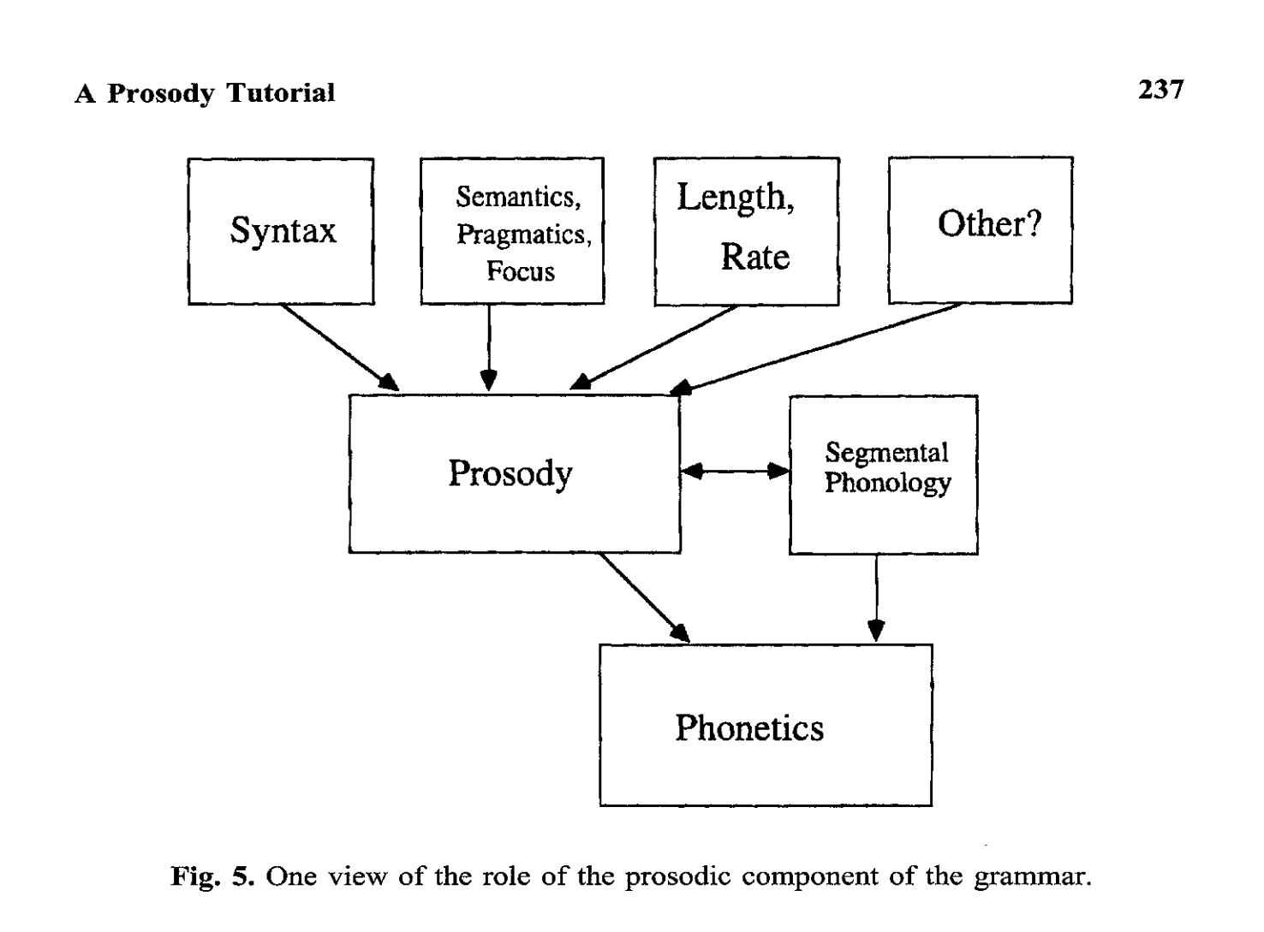

Slide 26
Prosody in Speech
Prosody → Pitch, Duration, Energy
Prosodic Constraints involving Constituents
English: Stress, Phrase Final Lengthening
Chinese: Tone (https://en.wikipedia.org/wiki/Tone_sandhi)

Slide 27
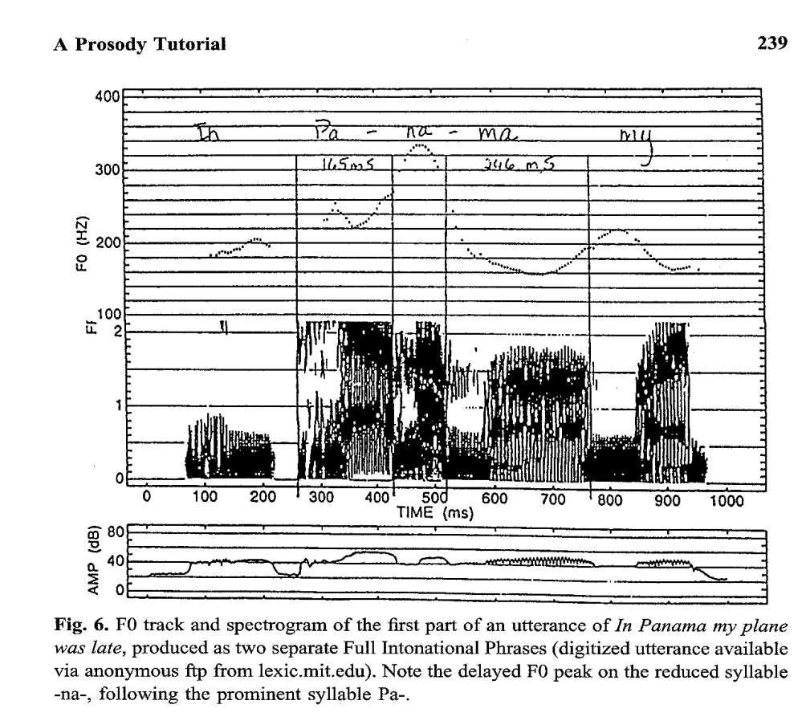

Slide 28
https://aclanthology.org/W16-6008.pdf
Diarization
Diarization

Slide 29
Speech: JM16
Speech-to-Text (STT): Recognition (ASR)
Text-to-Speech (TTS): Synthesis

Slide 30
Agenda
Chomsky Hierarchy:
Generative Capacity
Parsing
(every way ambiguous structures)
PP-attachment & Conjunction
Speech
Prosody (Pitch, Duration, Energy)
Chinese Tone
Discourse
Rhetoric
Grice's Maxims
Interdisciplinary Collaboration
Linguistics
Lexicography
Psychology
Statistics
Medicine
Law

Slide 31
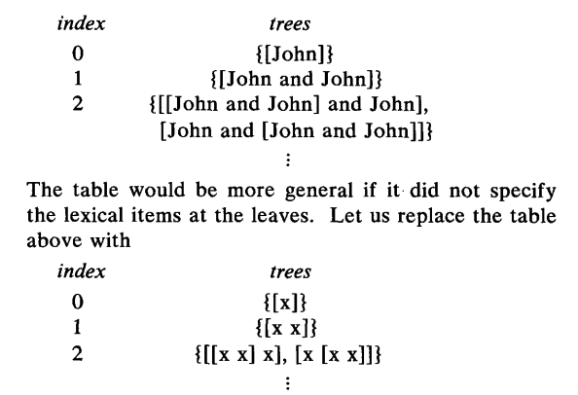
Catalan Numbers: Everyway ambiguous https://aclanthology.org/J82-3004.pdf

Slide 32
Conjunction ACC = argument cluster coordination; RNR = right node raising
Beavers, John, & Sag, Ivan A. (2004). Coordinate Ellipsis and Apparent Non-Constituent Coordination

Slide 33
Argument for Non-Standard Constituents $$X → X and X$$

Slide 34
Agenda
Chomsky Hierarchy:
Generative Capacity
Parsing
(every way ambiguous structures)
PP-attachment & Conjunction
Speech
Prosody (Pitch, Duration, Energy)
Chinese Tone
Discourse
Rhetoric
Grice's Maxims
Interdisciplinary Collaboration
Linguistics
Lexicography
Psychology
Statistics
Medicine
Law

Slide 35
Grice's Maxims
The maxim of quantity, where one tries to be as informative as one possibly can, and gives as much information as is needed, and no more.
The maxim of quality, where one tries to be truthful, and does not give information that is false or that is not supported by evidence.
The maxim of relation, where one tries to be relevant, and says things that are pertinent to the discussion.
The maxim of manner, when one tries to be as clear, as brief, and as orderly as one can in what one says, and where one avoids obscurity and ambiguity.

Slide 36
Genre: Texts have beginning, Middle & End
Academic Writing:
Say everything three times
Promise (intro): Say what you will say
Delivery (conclusion): Say what you said
Body: Say it (connect dots between promise and delivery)
News:
Lead with lead
No conclusion (your article will get cut to fit space constraints)
Who-done-it
No lead (don’t spill the punch line)
First suspect never did it
Conclusion (punch line)
Greek tragedy
Tragic hero starts out with a tragic flaw that ultimately leads to his tragic downfall
Character arc

Slide 37
Writing 101: The 12 Literary Archetypes https://www.masterclass.com/articles/writing-101-the-12-literary-archetypes
Lover: The romantic lead who’s guided by the heart.
Strengths: humanism, passion, conviction
Weaknesses: naivete, irrationality
Example: Romeo and Juliet
The Hero: The protagonist who rises to meet a challenge and saves the day.
Strengths: courage, perseverance, honor
Weaknesses: overconfidence, hubris
Example: Achilles (The Iliad)
The Magician: A powerful figure who has harnessed the ways of the universe to achieve key goals.
Strengths: omniscience, omnipotence, discipline
Weaknesses: corruptibility, arrogance
Example: Darth Vader (Star Wars)
The Outlaw: The rebel who won’t abide by society’s demands.
Strengths: independent thinking, virtue, owes no favors
Weaknesses: self-involved, potentially criminal
Example: Batman (The Dark Knight)
The Explorer: A character naturally driven to push the boundaries of the status quo and explore the unknown.
Strengths: curious, driven, motivated by self-improvement
Weaknesses: restless, unreliable, never satisfier
Odysseus (The Odyssey)
The Sage: A wise figure with knowledge for those who inquire. The mother figure or mentor is often based on this archetype.
Strengths: wisdom, experience, insight
Weaknesses: cautious, hesitant to actually join the action
Athena (The Odyssey)
The Innocent: A morally pure character, often a child, whose only intentions are good.
Strengths: morality, kindness, sincerity
Weaknesses: vulnerable, naive, rarely skilled
Example: Tiny Tim (A Christmas Carol)
The Creator: A motivated visionary who creates art or structures during the narrative.
Strengths: creativity, willpower, conviction
Weaknesses: self-involvement, single-mindedness, lack of practical skills
Example: Zeus (The Iliad)
The Ruler: A character with legal or emotional power over others.
Strengths: omnipotence, status, resources
Weaknesses: aloofness, disliked by others, out of touch
Example: Tony Soprano (The Sopranos)
The Caregiver: A character who continually supports others and makes sacrifices on their behalf.
Strengths: honorable, selfless, loyal
Weaknesses: lacking personal ambition or leadership
Example: Mary Poppins (Mary Poppins)
The Everyman: A relatable character who feels recognizable from daily life.
Strengths: grounded, salt-of-the-earth, relatable
Weaknesses: lacking special powers, often unprepared for what’s to come
Example: Bilbo Baggins (The Hobbit)
The Jester: A funny character or trickster who provides comic relief, but may also speak important truths.
Strengths: funny, disarming, insightful
Weaknesses: can be obnoxious and superficial
Example: King Lear’s Fool

Slide 38
Formal Linguistics
Constituency
Predicate-Argument Structure
Subject-Verb-Object Relations
Raising / Control (Equi)
Logical Form (Binding Theory)
https://en.wikipedia.org/wiki/Government_and_binding_theory
Wh-movement
Quantifier Scope
Pronoun Binding (Co-reference)
Sound & Meaning
But not:
Spelling
Lexicography
Historical Linguistics
Sociolinguistics
Distribution
(PMI, Word2vec, BERT, perplexity)
Psycholinguistics
(Reaction Times, Memory Limitations, Errors)
Education
Statistics

Slide 39
Raising vs. Control https://www.ling.upenn.edu/courses/ling150/ch9.html#idiom-chunks
Idiom chunks:
The cat is out of the bag
The cat seems to be out of the bag
The cat wants to be out of the bag
Implications
Want $⇒$ There exists a cat
Seems $⇏$There exists a cat
Lexical entries
Want: $f(subj, pred)$
Seems: $f(S)$

Slide 40
Semantics & Phonology
Sound & Meaning
But not:
Spelling
Lexicography
Historical Linguistics
Sociolinguistics
Distribution
(PMI, Word2vec, BERT, perplexity)
Psycholinguistics
(Reaction Times, Memory Limitations, Errors)
Education
Statistics

Slide 41
Competence vs. Performance
https://en.wikipedia.org/wiki/Linguistic_competence
https://en.wikipedia.org/wiki/Linguistic_performance
In linguistics, linguistic competence is the system of unconscious knowledge
that one knows when they know a language.
It is distinguished from linguistic performance,
which includes all other factors that allow one to use one's language in practice.
The term linguistic performance was used by Noam Chomsky in 1960 to describe
"the actual use of language in concrete situations".

Slide 42
https://dl.acm.org/doi/pdf/10.1145/2483691.2483693

Slide 43
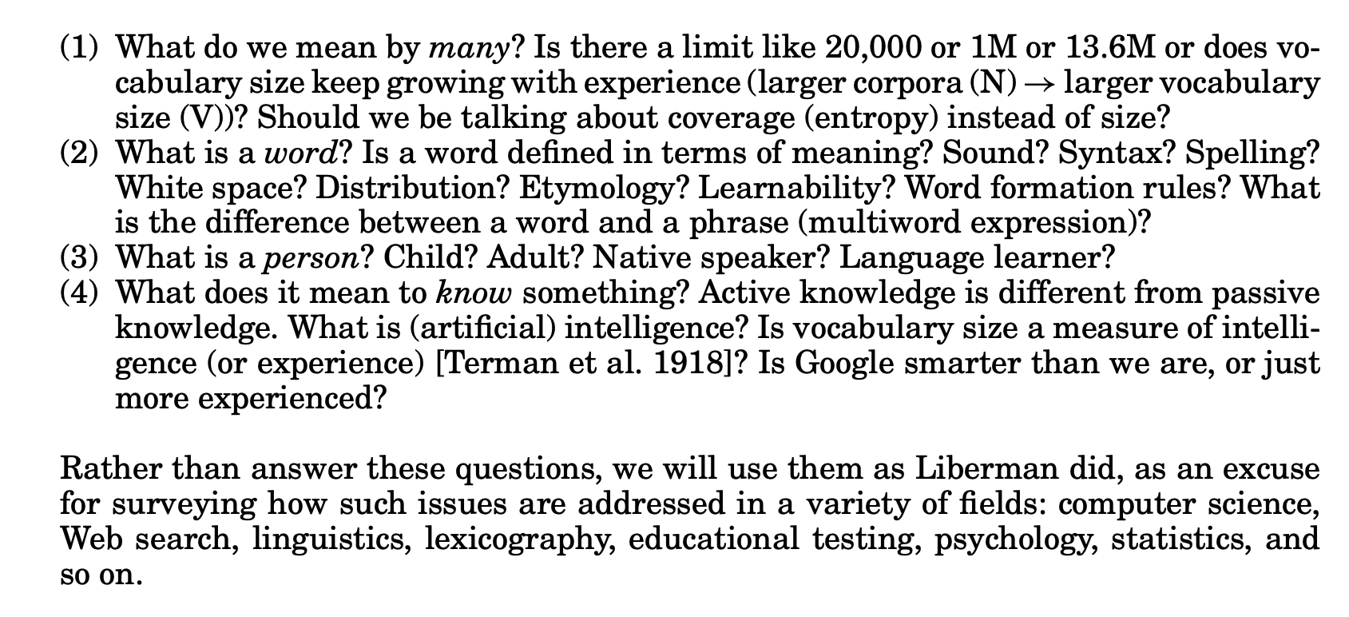

Slide 44
Lexicography Perspective
General Vocabulary
Technical Terminology
Regionalisms
Gazetteers

Slide 46
Statistics

Slide 47
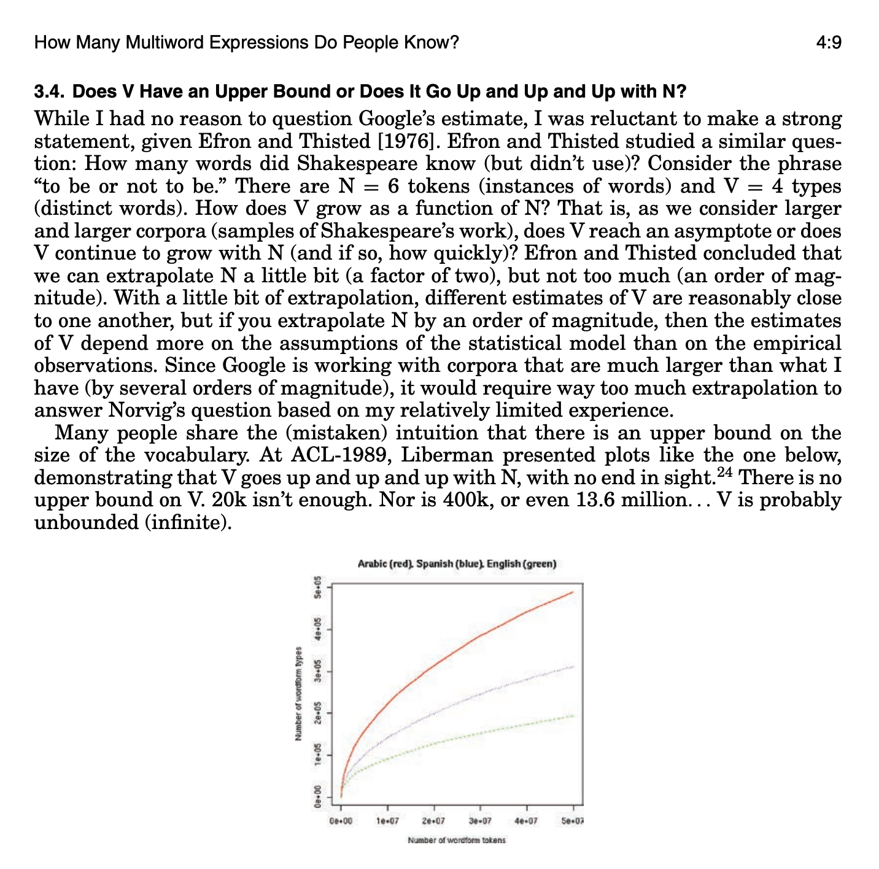
to be or not to be
4 types
6 tokens
http://itre.cis.upenn.edu/~myl/languagelog/archives/005514.html

Slide 50
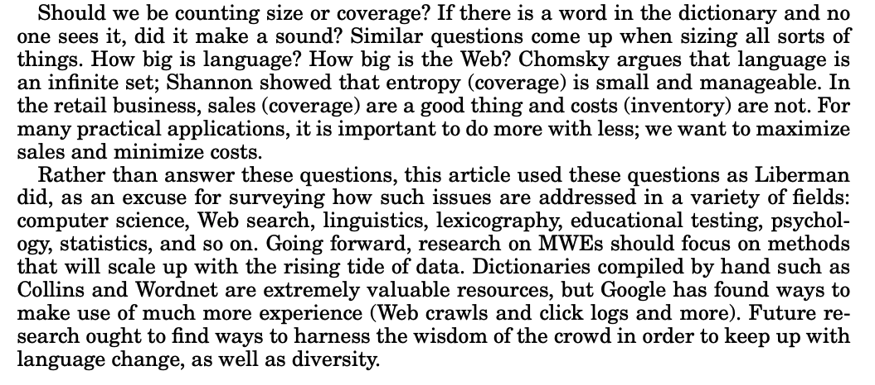

Slide 51
Agenda
Chomsky Hierarchy:
Generative Capacity
Parsing
(every way ambiguous structures)
PP-attachment & Conjunction
Speech
Prosody (Pitch, Duration, Energy)
Chinese Tone
Discourse
Rhetoric
Grice's Maxims
Interdisciplinary Collaboration
Linguistics
Lexicography
Psychology
Education
Statistics
Medicine
Law

