Slide 1
CS6120: Lecture 10 Lexical Semantics
Kenneth Church
https://kwchurch.github.io/

Slide 2
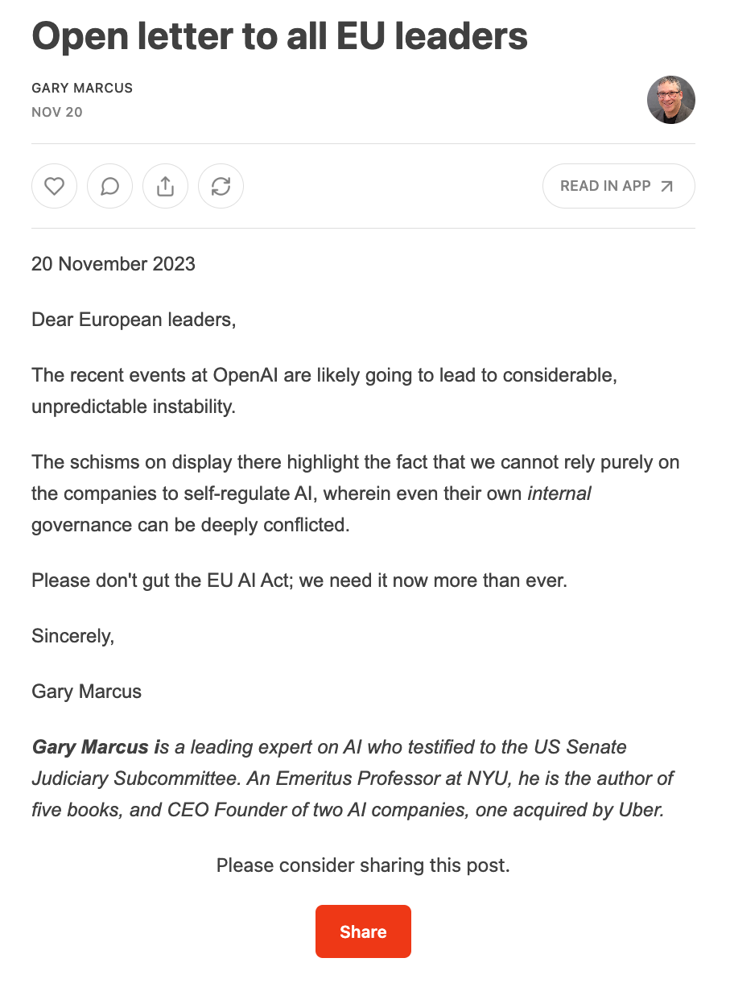

Slide 3
Commercial Applications: Lexical Semantics
Ad for Ground News: https://youtu.be/nPZPrs2Uf_g?t=1137
BOTUS: https://www.npr.org/sections/money/2017/04/07/522897876/meet-botus-planet-money-s-stock-trading-twitter-bot

Slide 4
Knowledge Acquisition Bottleneck: Bar-Hillel (1960) Word-Sense Disambiguation (WSD) is “AI Complete”
A method for disambiguating word senses in a large corpus (Gale, Church & Yarowsky, 1991)

Slide 5
Paths Forward
Tasks:
Word-Sense Disambiguation, Metaphor
Idioms
NER (Named Entity Recognition)
Linking
…
Rules
Assume productive processes (e.g., compositionality)
Lexical Resources
Dictionaries,
Ontologies (WordNet, Cyc)
Corpora
Large Language Models (LLMs)

Slide 6
house → maison | Chambre

Slide 7
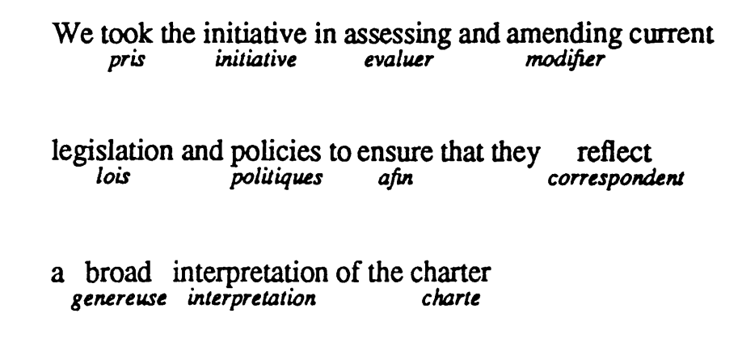
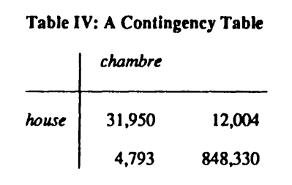

Slide 9
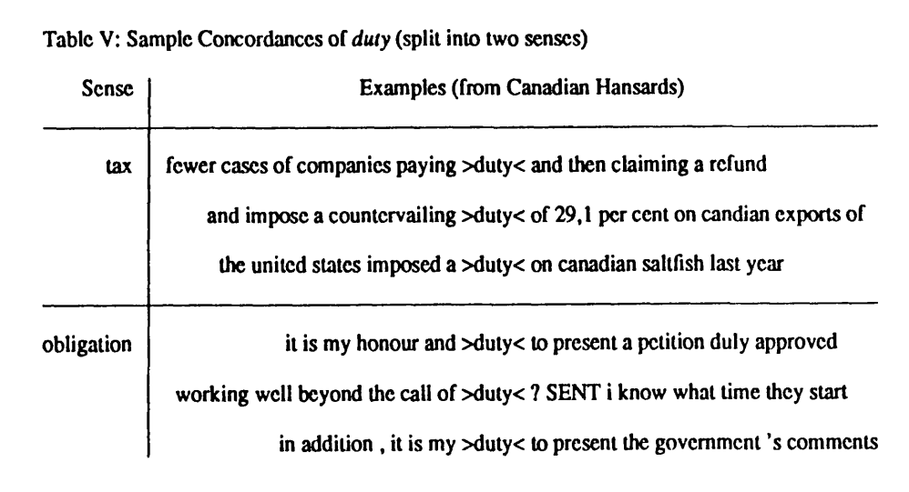

Slide 10
Metaphor: Classic Hard Problem in NLP
Stereotypes: Get Smart
Considerable literature
Carbonell (1980) https://aclanthology.org/P80-1004
Fass & Wilks (1983) https://aclanthology.org/J83- 3004
Martin (1990) A Computational Model of Metaphor Interpretation
Hobbs (1992) Metaphor and Abduction
Gedigian et al (2006) https://aclanthology.org/W06-3506
Krishnakumaran and Zhu (2007) https://aclanthology.org/W07-0103
Lakoff (2008) Women, Fire and Dangerous Things
Lakoff and Johnson (2008) Metaphors to Live By
Shutova (2010) https://aclanthology.org/P10-1071
Mohammad et al (2016) https://aclanthology.org/S16-2003
cover all the bases
drop the ball
dunk
fumble
get on base
hit a home run
out in left field
punt
ragging the puck
run out the clock
sticky wicket
strike out

Slide 11
Repositories
HuggingFace
LDC (Linguistic Data Consortium)
NLTK

Slide 12
WordNet: An Example of an Ontology
https://en.wikipedia.org/wiki/WordNet
https://aclanthology.org/2021.emnlp-main.501.pdf

Slide 13
MeSH

Slide 14
JM23

Slide 15
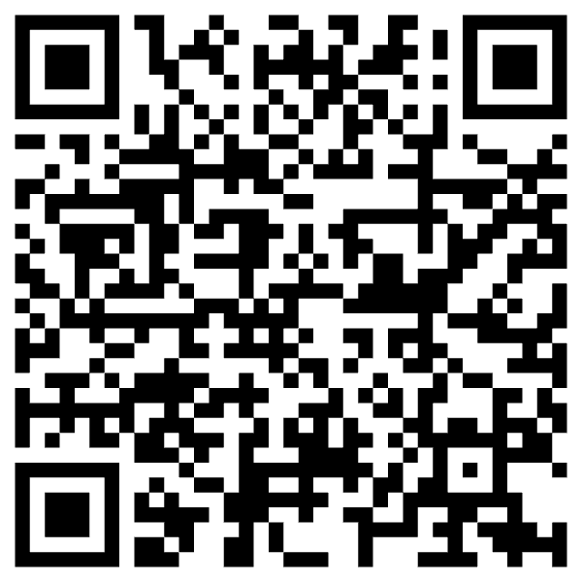
Tasks
Word Sense Disambiguation
bank → ``money’’ bank vs. ``river’’ bank
NER (Named Entity Recognition)
Find spans
Linking: Add hypertext links from texts to resources
Wikipedia
Pubtator
Co-reference
Which nouns refer to which nouns?
Pronoun resolution → Winograd Schema
Stance, Sentiment, Synonyms vs. Antonyms, Negation

Slide 16
Pubtator

Slide 17
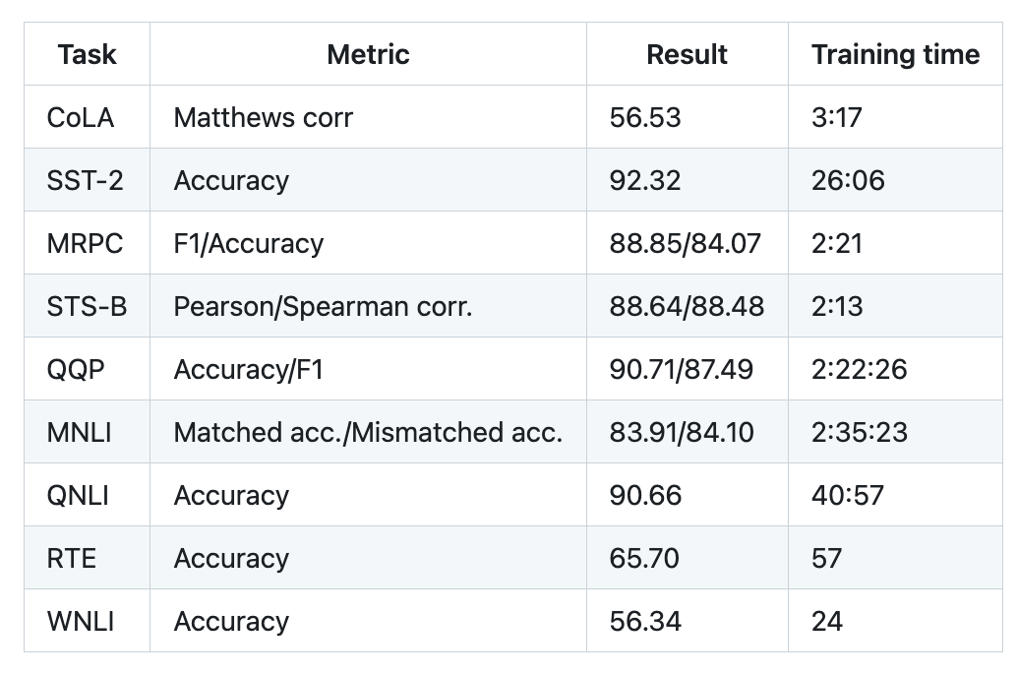
Winograd Schema (GLUE WNLI)
The trophy doesn't fit in the brown suitcase
because it is too large/small.
What is too large?
A. The trophy
B. The suitcase
Not much better than chance
from: https://doi.org/10.1016/j.artint.2023.103971

Slide 18
Winograd Schema (GLUE WNLI)

Slide 19
Training on Lexical Resources https://aclanthology.org/2022.lrec-1.676.pdf

Slide 20
scipy dendrogram

Slide 21
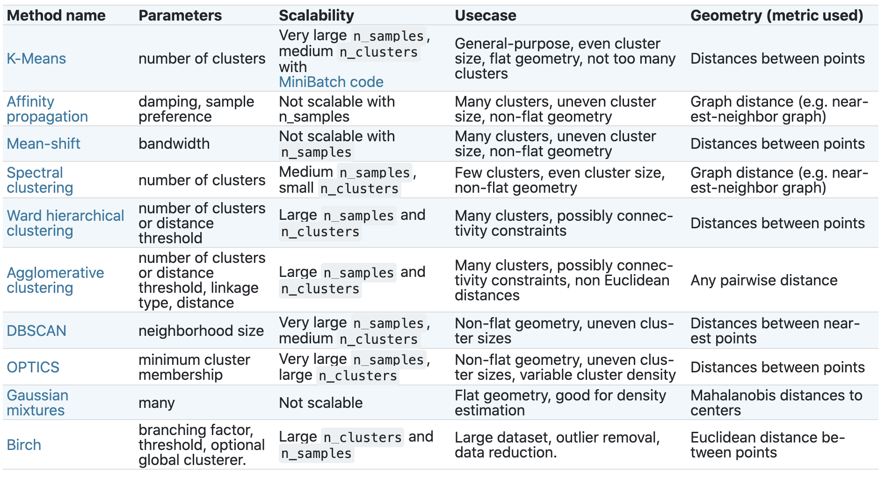
Clustering in Scikit-Learn
https://en.wikipedia.org/wiki/Hierarchical_clustering
https://en.wikipedia.org/wiki/K-means_clustering
https://scikit-learn.org/stable/modules/clustering.html

Slide 22
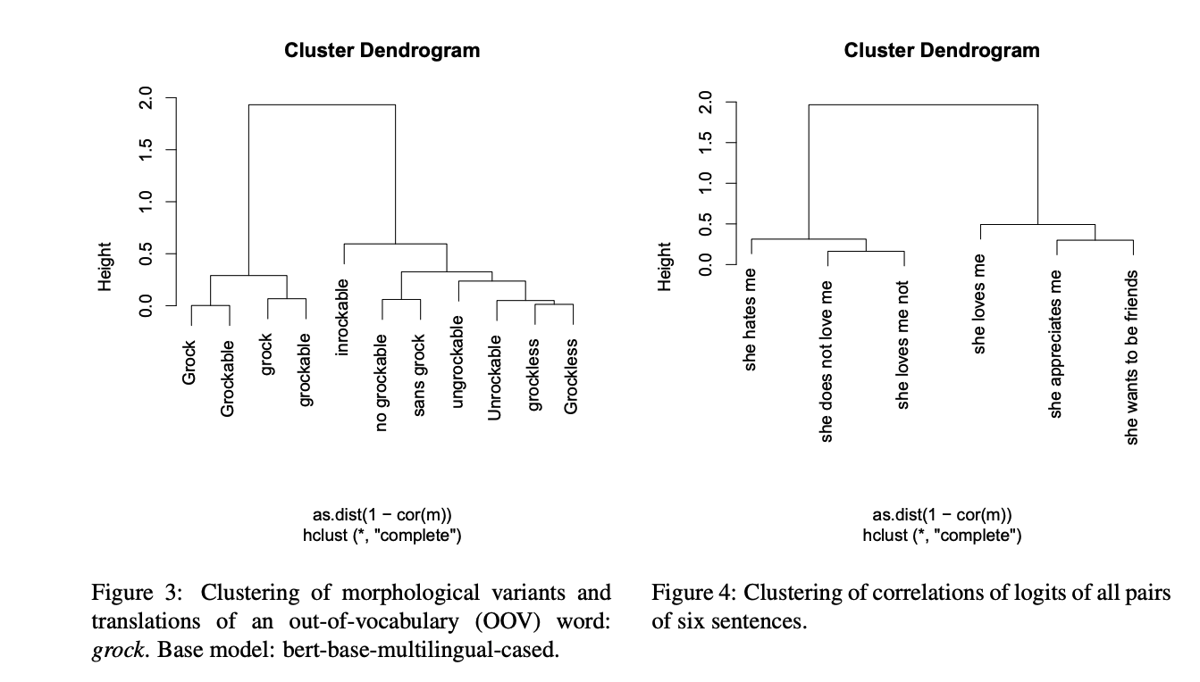

Slide 23
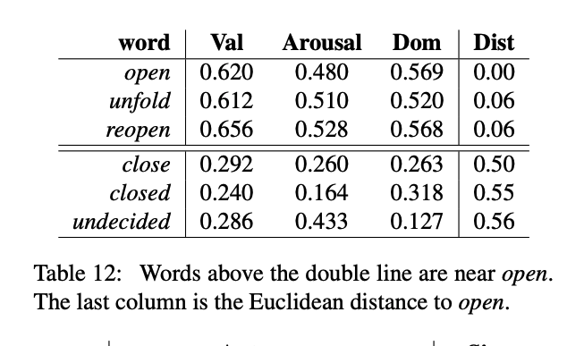
https://saifmohammad.com/WebPages/nrc-vad.html
https://saifmohammad.com/WebDocs/VAD-talk.pdf

Slide 24
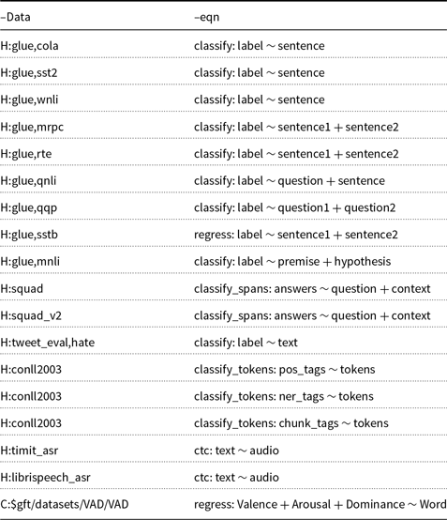
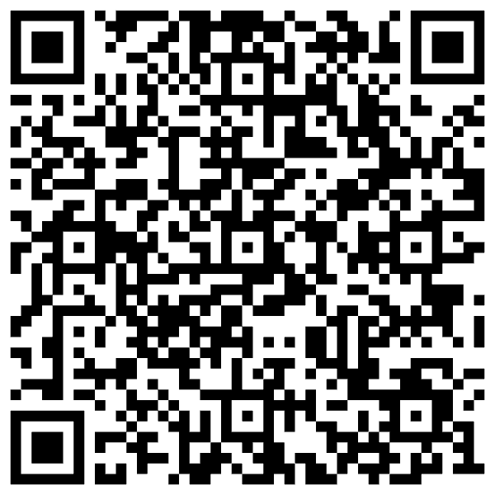
Church et al.,
Emerging trends:
General fine-tuning (gft)
Natural Language Engineering,
28(4), 519-535. doi:10.1017/S1351324922000237

Slide 25
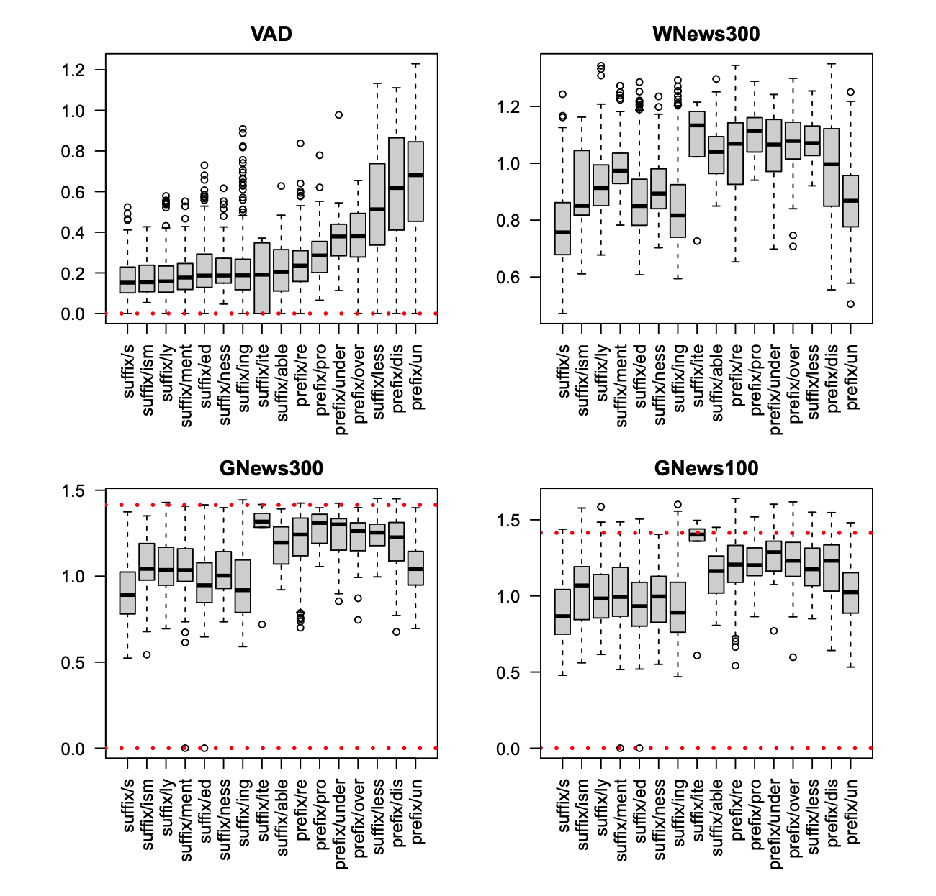

Slide 26
Lexical Resources International Conference on Language Resources and Evaluation (LREC)
Corpora
Non-parallel:
Brown, Penn Treebank, Wikitext
Parallel:
Hansards, Europarl
Ontologies
WordNet
MeSH (Medical Subject Headings)
Dictionaries
CMU Dict
Thesaurus
Roget’s
Synonyms and Antonyms
NRC-VAD
Knowledge Graphs
<head, relation, tail>
FreeBase (FB15k)
WordNet (WN18RR)

Slide 27
Example of Parallel Corpus https://youtu.be/1jeDPcWEYX0?t=80

Slide 28
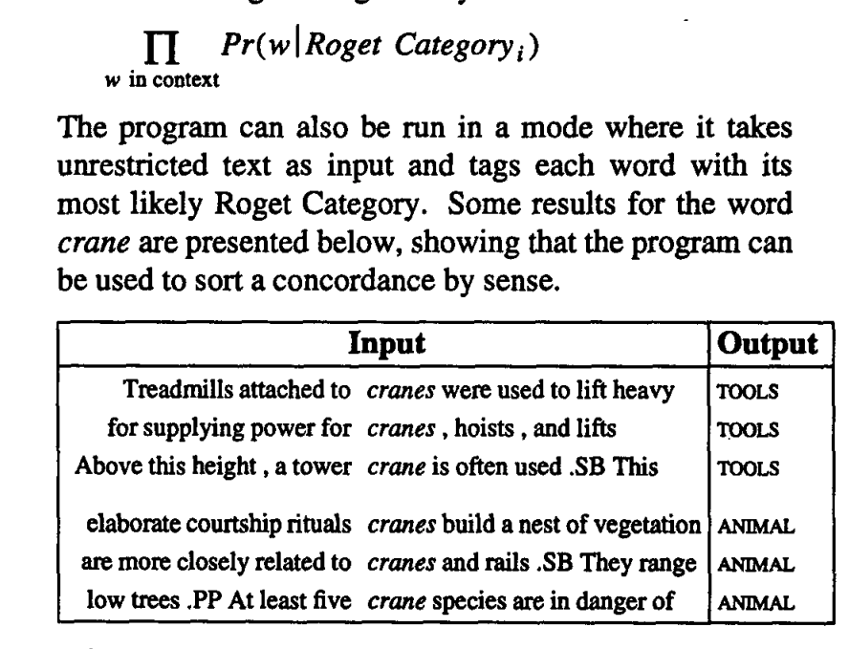
Applications for Parallel Corpora
Machine Translation
Word Sense Disambiguation
https://aclanthology.org/P92-1032.pdf

Slide 29
https://aclanthology.org/J93-1004.pdf

Slide 30
Co-Reference
Slides from last term
JM26
Two Noriegas

