Slide 1
CS6120: Lecture 7
Jiaji Huang
https://jiaji-huang.github.io

Slide 2
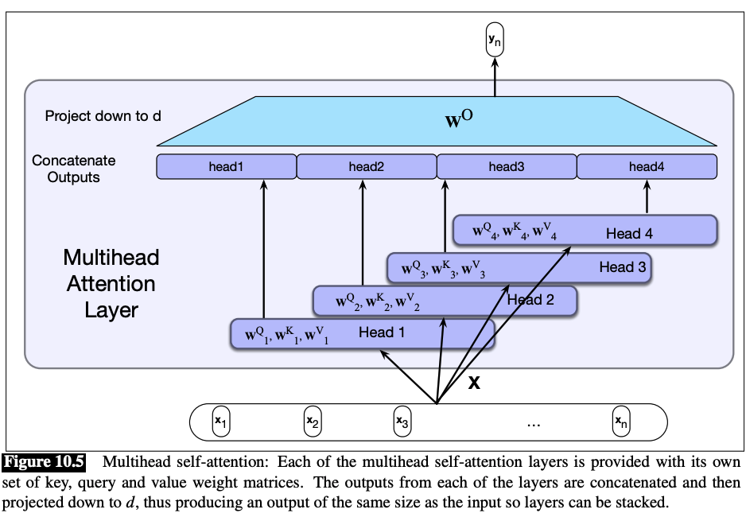
Recap: Transformer
Illustration from https://web.stanford.edu/~jurafsky/slp3/10.pdf

Slide 3
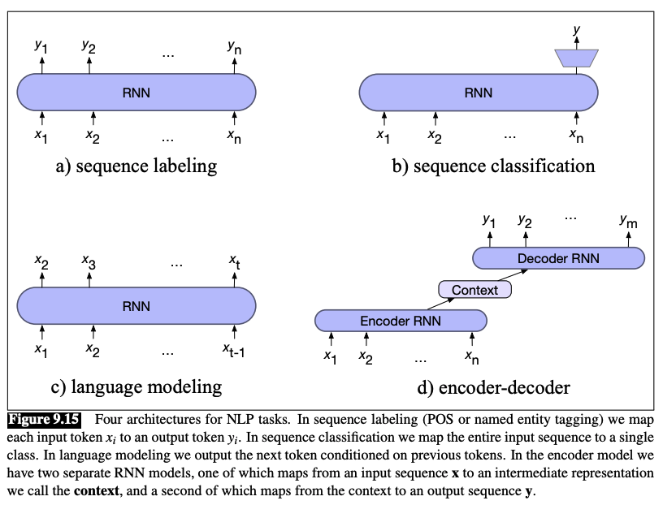
Recap: Typical Architectures
Illustration from https://web.stanford.edu/~jurafsky/slp3/9.pdf

Slide 4
Agenda
Applications
Translation
Question Answering
Other Modality
Speech to text
Text to Speech
Vision

Slide 5
Machine Translation is Hard
Because of linguistic divergences
Morphology
Syntax
semantics
Linguistic typology: studies cross-linguistic similarities and differences

Slide 6
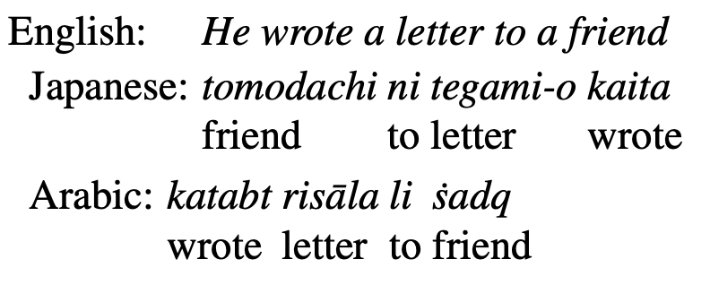
Word Order Typology
SVO: German, French, English, Mandarin
SOV: Hindi, Japanese
VSO: Irish, Arabic
Illustration from https://web.stanford.edu/~jurafsky/slp3/13.pdf

Slide 7
Lexical Divergences
En-> Es
bass -> lubnia/bajo
En->Zh
Brother -> 哥/弟
Word Sense Disambiguation
Lexical Gap
Zh -> En: 孝 -> ?
Examples from https://web.stanford.edu/~jurafsky/slp3/13.pdf

Slide 8
Morphological Topology
Base form: run
Present tense: Running, past tense: ran
Isolating languages: Vietnamese (1 morpheme per word)
Polysynthetic language: Siberian Yupik (many morphemes per word)

Slide 9
Classical Approach
Statistical Machine Translation
Bayesian Rule
$$T^{∗}=arg\max_{T}{P\left(T | S\right)=arg\max_{T}{P\left(S | T\right)P(T)}}$$
$P\left(S | T\right)$: translation model, faithfulness
$P(T)$: language model, fluency
IBM models:
Alignment $a$
$P\left(S | T\right)=\sum_{a}{P(S, a|T)}$

Slide 10
Alignment
Illustration from https://courses.grainger.illinois.edu/CS447/fa2020/Slides/Lecture14.pdf

Slide 11
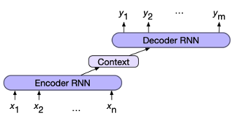
Modern Approach
Encoder-Decoder Model

Slide 12
On the $x_{i}$’s and $y_{i}$’s
Option1: Word, too huge vocabulary, cannot handle OOV
Option2: character, too long input, inferior performance
Option3: subwords
Several methods to obtain
Byte-pair encoding (BPE)
Wordpiece
Sentencepiece

Slide 13
Byte Pair Encoding (BPE)
Merge the most frequent pair of tokens
Example from https://web.stanford.edu/~jurafsky/slp3/13.pdf

Slide 14
Byte Pair Encoding (BPE)
Example from https://web.stanford.edu/~jurafsky/slp3/13.pdf

Slide 15
Drawback of BPE
Small non-meaningful subwords
Example from https://web.stanford.edu/~jurafsky/slp3/13.pdf

Slide 16
Wordpiece
Initialize with a set of all characters
Repeat till there are $V$ wordpieces
Train an n-gram language model, using the current set
Consider concatenating two word pieces, so that the resulting n-gram has biggest likelihood increase

Slide 17
SentencePiece
A library implementing BPE and another method called Unigram
How Unigram works
Fix token set, learn probabilistic split of words (into these tokens), via EM
Prune away subwords with low probabilities
Example from https://web.stanford.edu/~jurafsky/slp3/13.pdf

Slide 18
What about Chinese
Languages without space separating words
Run segmenter first, e.g.,

Slide 19
Architecture
Illustration from https://web.stanford.edu/~jurafsky/slp3/13.pdf

Slide 20
Zoom in for cross-attention
Illustration from https://web.stanford.edu/~jurafsky/slp3/13.pdf

Slide 21
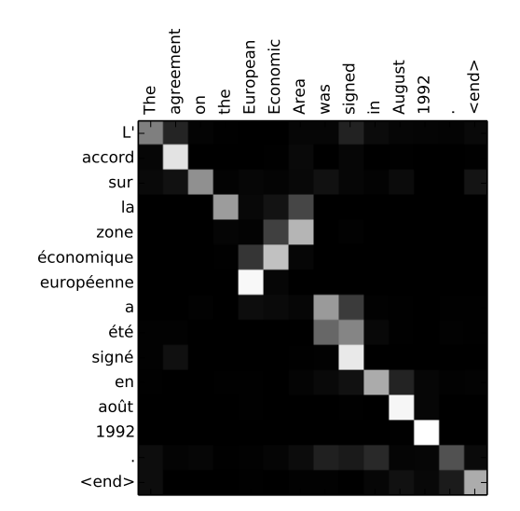
Cross Attention is alignment
target
Note the alignment is neither diagonal, nor triangular!
source

Slide 22
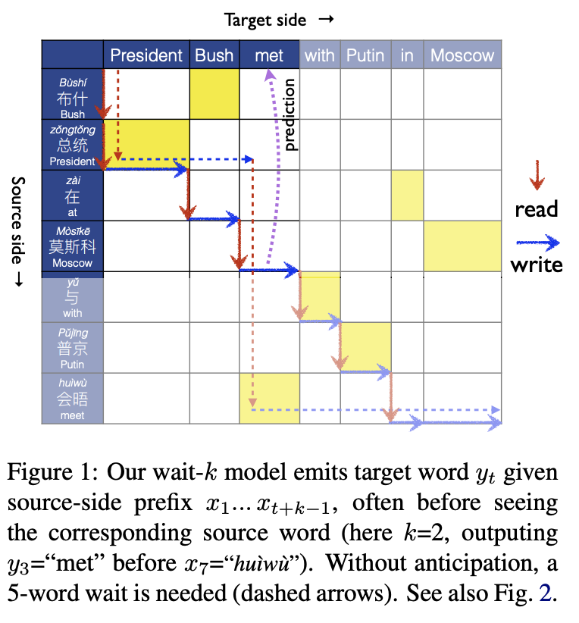
Extensions
Simultaneous Translation

Slide 23
Extensions
Multilingual Translation
Language encoding token: $l_{s}$ , $l_{t}$

Slide 24
Extensions
Unsupervised Machine Translation
Source and target text has no correspondence
Method
Initialize: Word-to-word translation (bilingual lexicon induction)
Train encoder-decoder by
Sample source sentence $x$, translation $y$ using current model
Train as if supervised case, using ($x$, $y$)

Slide 25
Agenda
Applications
Translation
Question Answering
Other Modality
Speech to text
Text to Speech
Vision

Slide 26
Paradigms of QA
Open domain QA
Knowledge-based QA
Language Model, e.g., ChatGPT

Slide 27
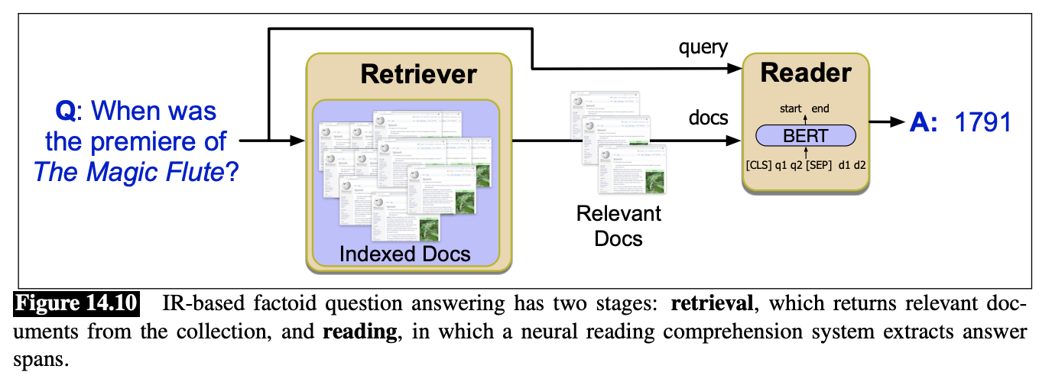
Open domain QA Setup
Information Retrieval (IR)
Reading Comprehension: extract a range of text as answer
Examples from https://web.stanford.edu/~jurafsky/slp3/14.pdf

Slide 28
Information Retrieval

Slide 29
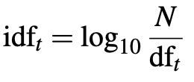
IR based on tf-idf
Encode each document using tf-idf
Recap for tf-idf
Score(q, d) = cos(q, d), where q, d are tf-idf vectors for query and document

Slide 30
IR based on Deep nets
Drawback of tf-idf approach:
Query words must overlap with those in document
Instead, we could encode with dense vectors
Examples from https://web.stanford.edu/~jurafsky/slp3/14.pdf

Slide 31
Reading Comprehension
In the retrieved doc, Find span of text as answer
Example setup:
Input:
Question: How tall is Mt. Everest?
Passage: “… Reaching 29,029 feet at its summit, Mt. Everest stands …”
Return:
29,029 feet
Formulated into span labeling problem

Slide 32
Span labeling
Span start embedding S
Span end embedding E
Training loss

Slide 33
Paradigms of QA
Open domain QA
Knowledge-based QA
Language Model, e.g., ChatGPT

Slide 34
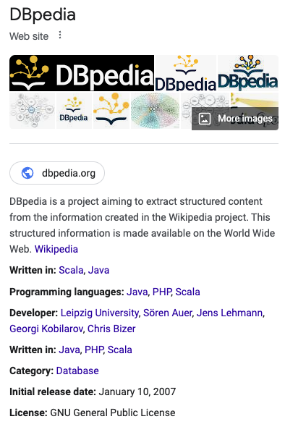
Knowledge-based QA
Setup:
Input:
Question: where is Golden Gate Park?
RDF (Resource Description Framework) triples, e.g.,
Subject predicate object
Golden Gate Park location San Francisco
Return:
San Francisco

Slide 35
Knowledge-based QA
How do we know which triple can answer the question?
“where is Golden Gate Park?”
Entity linking
Link “Golden State park” to relevant triples
Relation Linking
Link “where” to a triple with ”location” as predicate

Slide 36
Entity Linking
Illustration from https://web.stanford.edu/~jurafsky/slp3/14.pdf

Slide 37
Relation Linking
Encode the question via an encoder
Trainable vectors $\{r_{i}\}$ for each relation
Compute score
Choose the relation with softmax probability

Slide 38
Paradigms of QA
Open domain QA
Knowledge-based QA
Language Model, e.g., ChatGPT

Slide 39
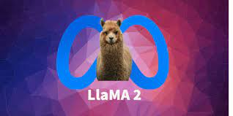
Large Language Model (LLM) for QA
Trained on huge corpora, LLM’s store knowledge
Many open API’s

Slide 40
Risks and Concerns
Factuality
Stochastic Parrot, fluent but false
Harmfulness
Question: “How to make a bomb?”

Slide 41
Agenda
Applications
Translation
Question Answering
Other Modality
Speech to text
Text to Speech
Vision

Slide 42
Two Tasks
Automatic Speech Recognition (ASR)
Speech synthesis, or Text-to-Speech (TTS)
ASR
It’s time for lunch
It’s time for lunch
TTS

Slide 43
Word Error Rate (WER) on WSJ eval92
Image from https://paperswithcode.com/sota/speech-recognition-on-wsj-eval92

Slide 44
End-to-end ASR
Illustration from https://web.stanford.edu/~jurafsky/slp3/16.pdf

Slide 45
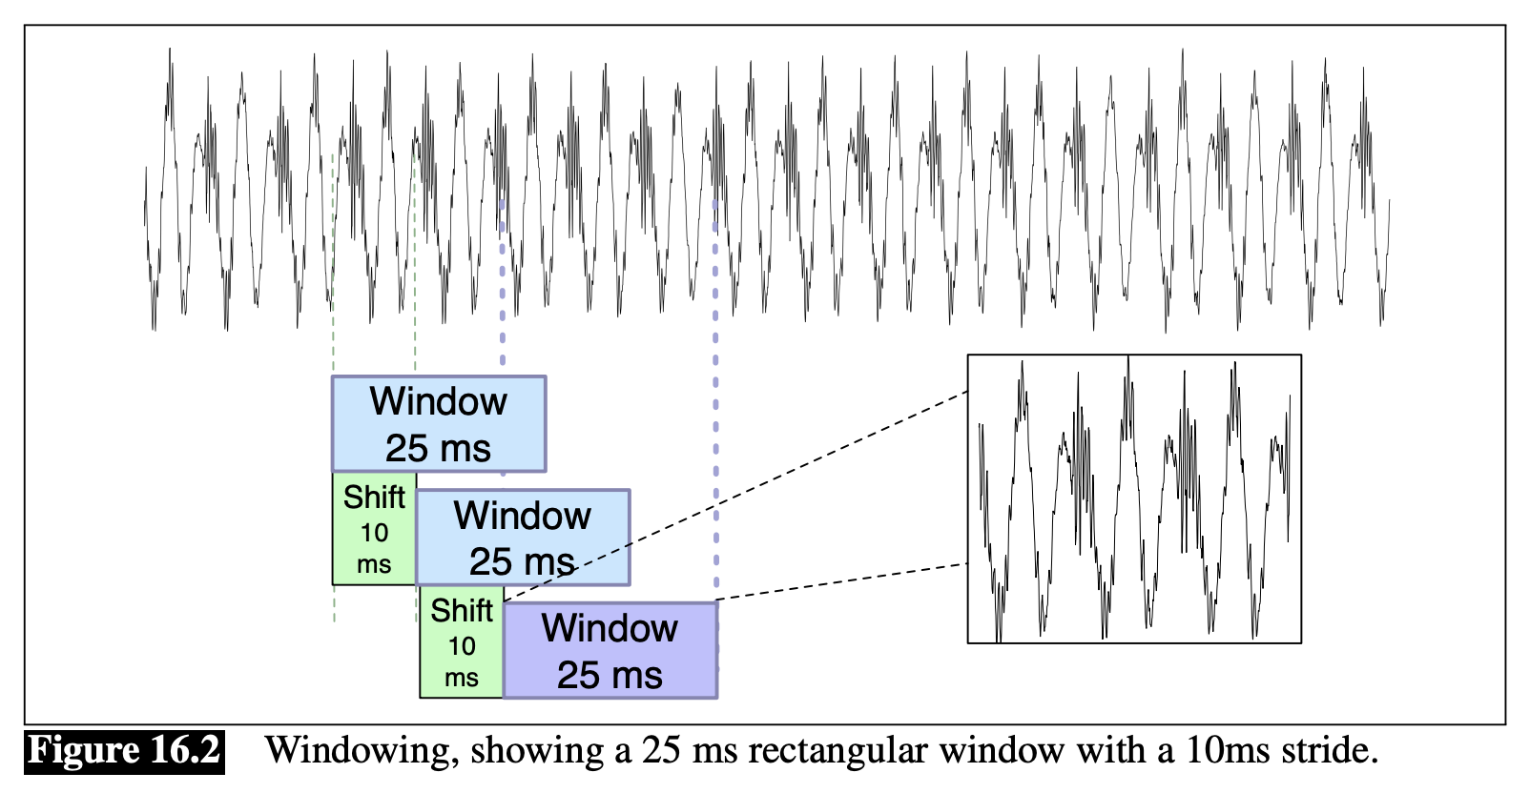
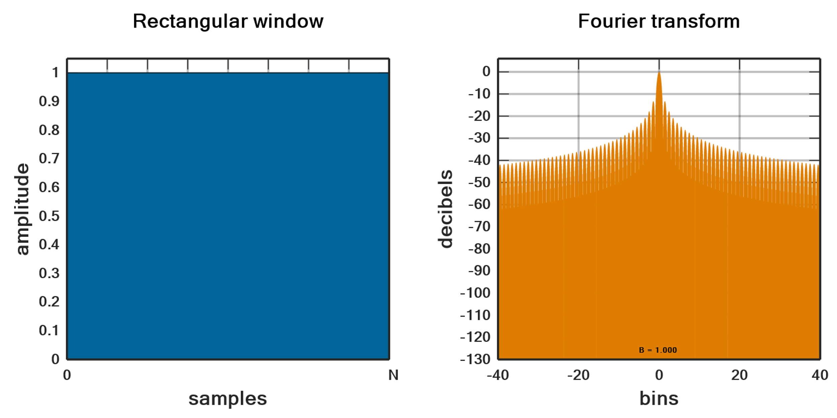
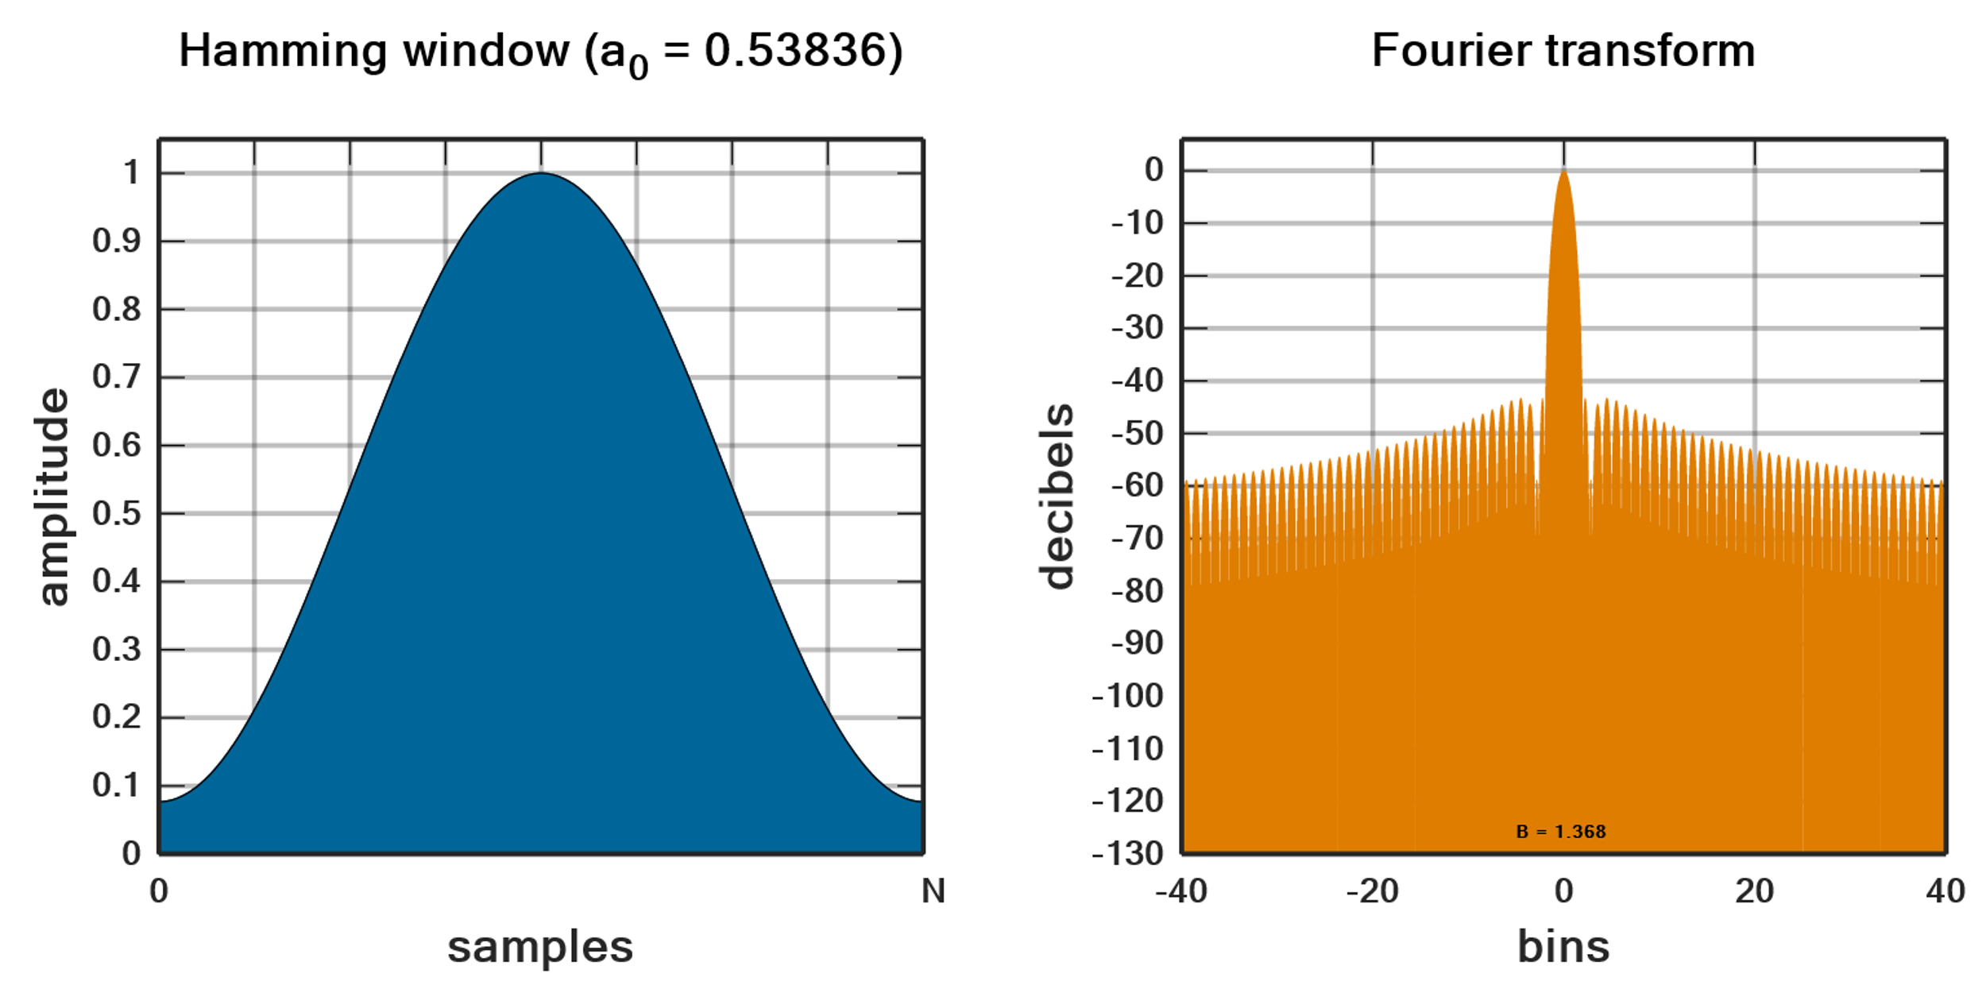
Feature Computation
Windowing
Rectangular window
Gibbs phenomenon
Hamming window
Illustration from https://web.stanford.edu/~jurafsky/slp3/16.pdf and https://en.wikipedia.org/wiki/Window_function

Slide 46
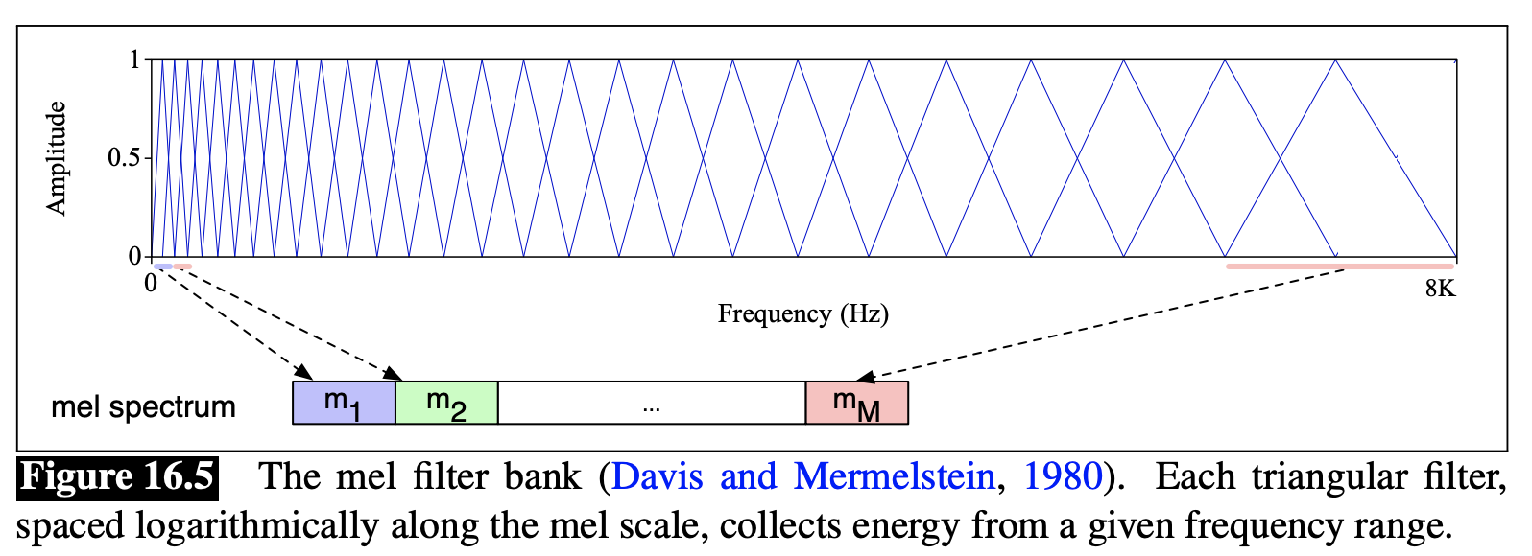
Convert to Frequency domain
Apply FFT inside each window
Apply Mel Filter banks
Why? Human hearing is less sensitive at higher frequency
Illustration from https://web.stanford.edu/~jurafsky/slp3/16.pdf

Slide 47
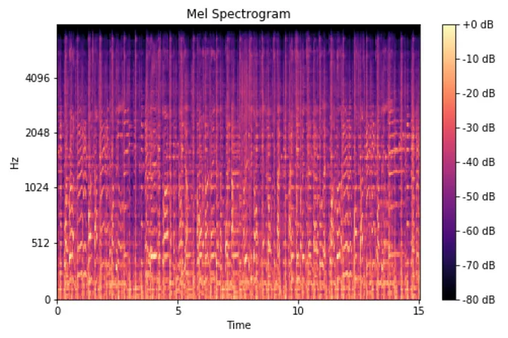
Before and after Mel
Illustration from https://medium.com/analytics-vidhya/understanding-the-mel-spectrogram-fca2afa2ce53

Slide 48
End-to-end ASR
Illustration from https://web.stanford.edu/~jurafsky/slp3/16.pdf

Slide 49
Subsampling
Input is very long sequence, e.g.,
2s audio is 200 frames, assuming 10ms stride at windowing
Ways to lower the frame rate:
Stack adjacent frames
1D filter along time axis

Slide 50
End-to-end ASR
Illustration from https://web.stanford.edu/~jurafsky/slp3/16.pdf

Slide 51
What are the y’s
Characters
Words, less common
Subwords, popular now

Slide 52
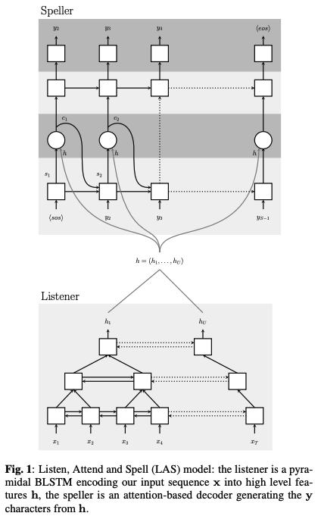
LSTM based Encoder-Decoder

Slide 53
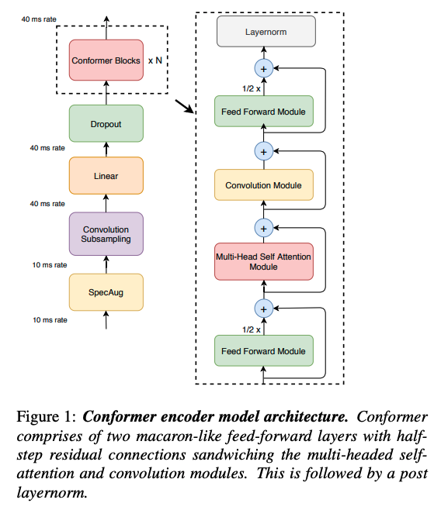
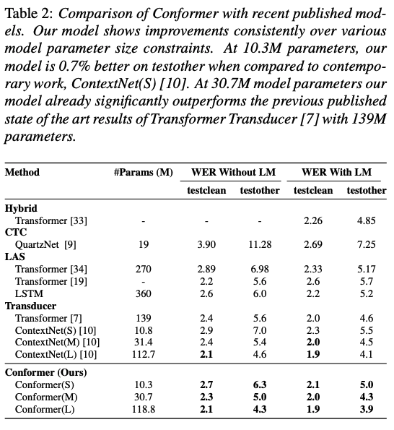
Transformer based Encoder-Decoder

Slide 54
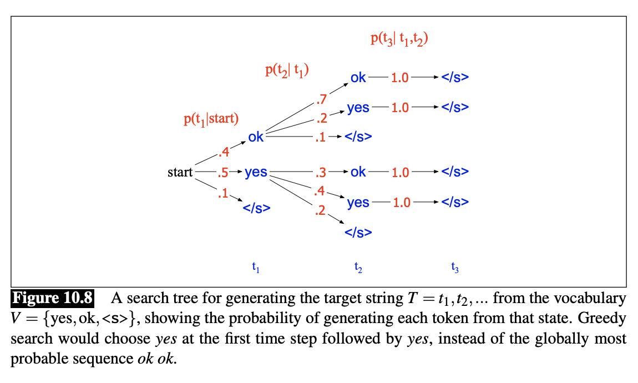
Decoding At Inference Time
Greedy
Each time step take the most likely token and input to next step
Beam Search
Recap
Illustration from https://web.stanford.edu/~jurafsky/slp3/10.pdf

Slide 55
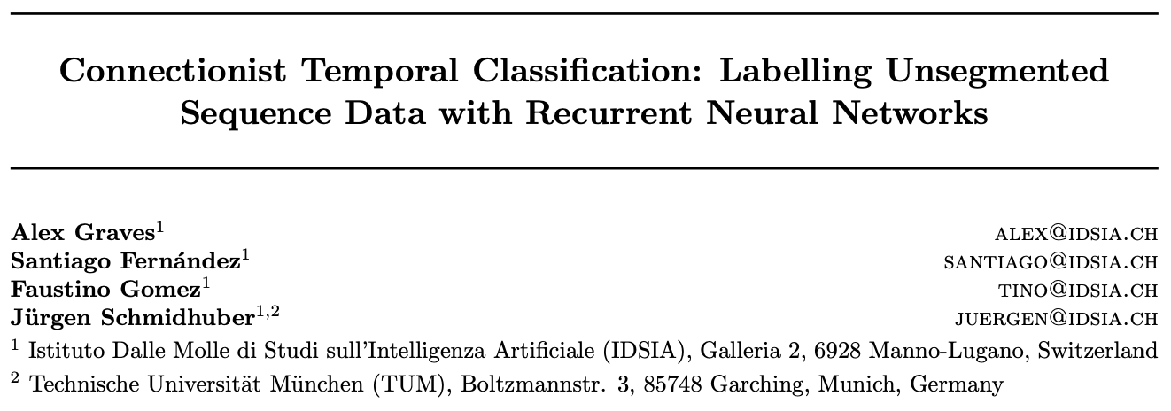
Connectionist Temporal Classification (CTC)
Drawback of enc-dec architecture
Causal decoder is slow
Number of Input speech frames >> Number of output tokens

Slide 56
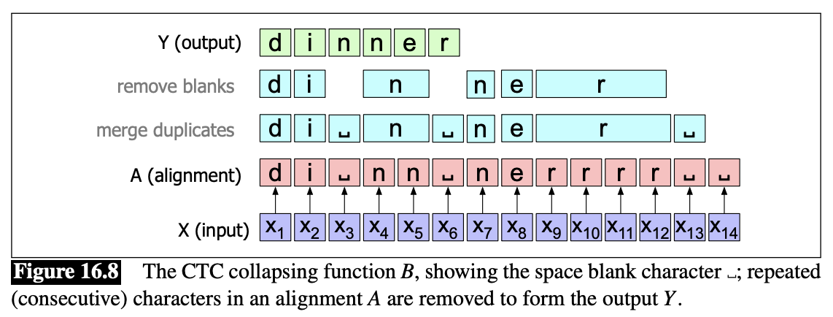
Connectionist Temporal Classification (CTC)
Introduce blank token “␣” for silence
Same token could last for multiple frames
Illustration from https://web.stanford.edu/~jurafsky/slp3/16.pdf

Slide 57
Connectionist Temporal Classification (CTC)
Alignment $A=[a_{1},…, a_{T}]$
Independence assumption
Training loss on ($X$, $Y$)
$$−\log{\sum_{A:collapse\left(A\right)=Y}{P_{CTC}(A|X)}}$$

Slide 58
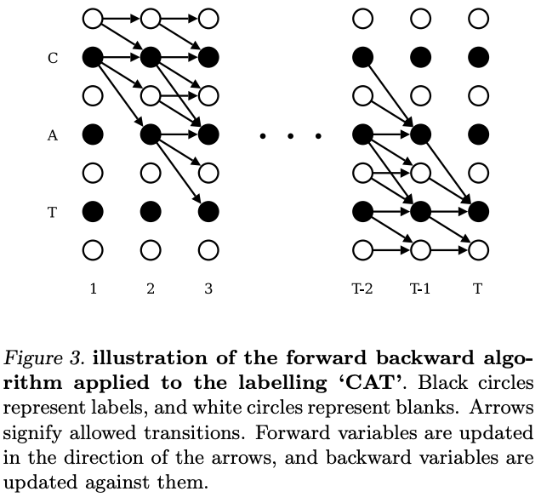
Training with CTC
Enumerating all alignments is infeasible
Illustration from Graves et. al, 2006

Slide 59
Decoding with CTC
Illustration from https://web.stanford.edu/~jurafsky/slp3/10.pdf

Slide 60
Other decoding issues
Beam search can be applied
Use a lexicon Trie to avoid obvious spelling errors

Slide 61
Discussion
What are the key differences between CTC loss and enc-dec model?

Slide 62
Use Language Model
“two” and “to” sounds alike
How to make sure we decode the right one?
Use Language Model
Easy way: rescoring N-best list
Hard way: add LM score at decoding
We can finetune the language model for ASR

Slide 63
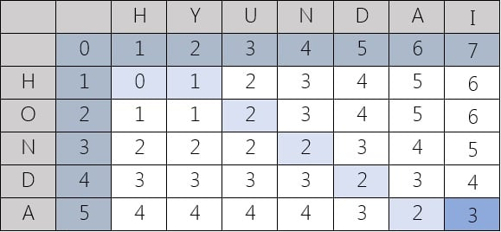
Evaluation Metric: Word Error Rate
Edit (Levenshtein) distance between reference and decoded
Implementation based on Dynamic programming
Example from https://www.cuelogic.com/blog/the-levenshtein-algorithm

Slide 64
Agenda
Applications
Translation
Question Answering
Other Modality
Speech to text
Text to Speech
Vision

Slide 65
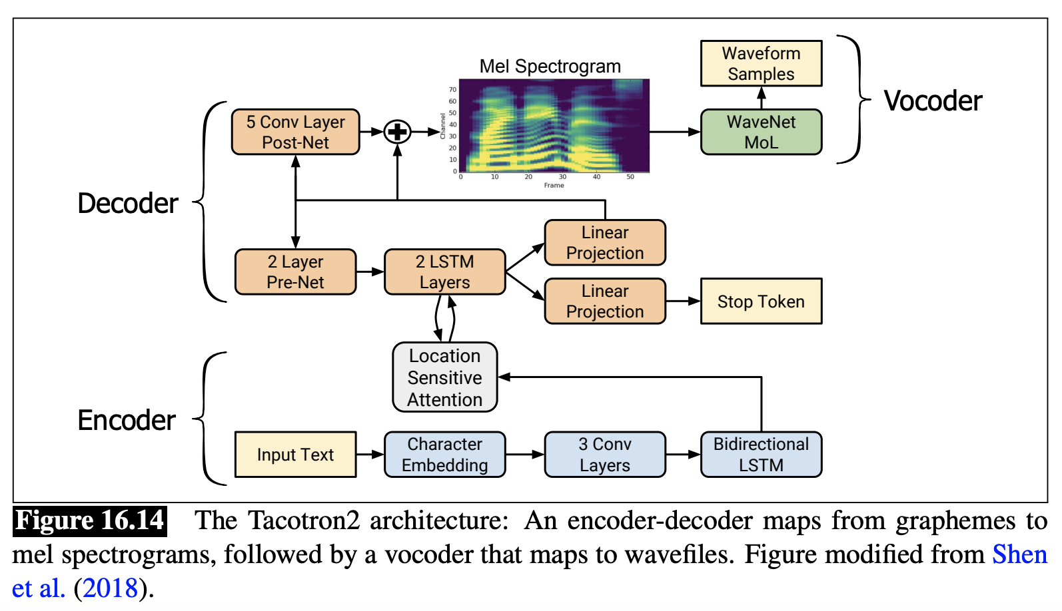
Text to Speech
Two steps:
Text to mel spectrum
mel spectrum to audio
Illustration from https://web.stanford.edu/~jurafsky/slp3/16.pdf

Slide 66
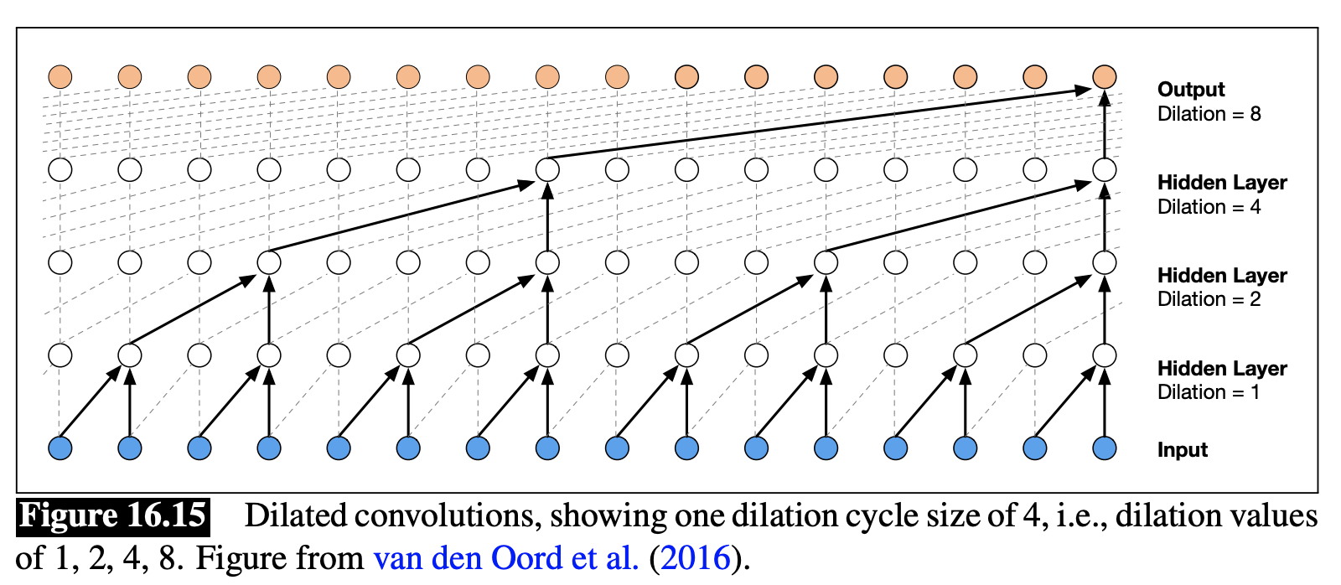
Vocoder
Input: mel spectrogram
Output: 8-bit mu-law audio samples
Illustration from https://web.stanford.edu/~jurafsky/slp3/16.pdf

Slide 67
Agenda
Applications
Translation
Question Answering
Other Modality
Speech to text
Text to Speech
Vision

Slide 68
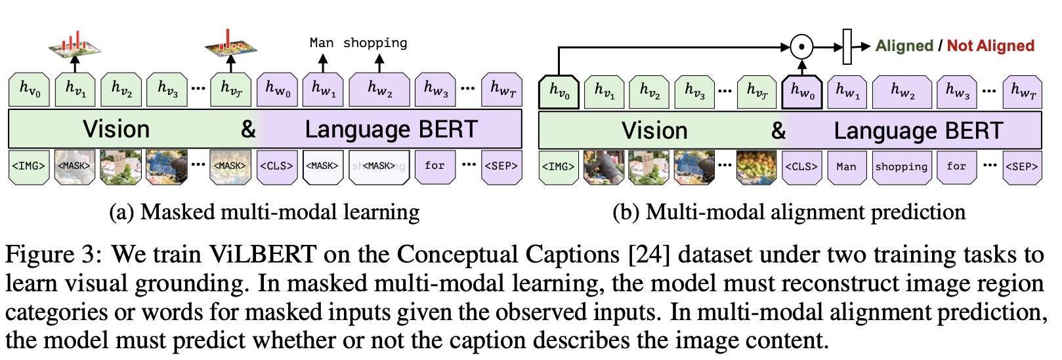
Joint modeling of Text and Images

Slide 69
Co-attention

Slide 70
On Perplexity

Slide 71
Perplexity
N classes, predicted probabilities ${\left\{{\hat{p}}_{i}\right\}}_{i=1}^{N}$
Groundtruth probabilities ${\left\{p_{i}\right\}}_{i=1}^{N}$
Cross entropy loss $ℓ=−\sum_{i=1}^{N}{p_{i}\ln{{\hat{p}}_{i}}}$
Perplexity $e^{ℓ}$
Perplexity $≥1$ as $ℓ≥0$
Higher perplexity, less accurate the model

Slide 72
Questions
In a 3-way classification problem
What would be the perplexity of worst classifier?
If we know the 3rd class occurs twice more often the the 1st and 2nd class
Can we build a classifier that reduces the perplexity, without any training data?

