Slide 1
CS6120: Lecture 7 Prompting
Kenneth Church
https://kwchurch.github.io/

Slide 2
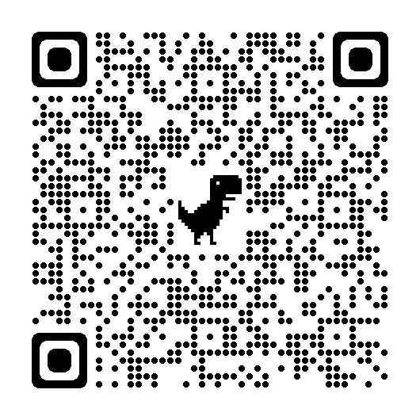
Homework

Slide 3
Prompt Engineering (and disintermediating web-search)
Super-Popular (100+ million users)
Most successful (rapid) adoption of any web app ever
Super-Easy
Easier than Fine-Tuning (and Inference)
Use Cases
“Helping” with homework:
Cheating (?)
Documentation:
Alternative to stack overflow

Slide 4
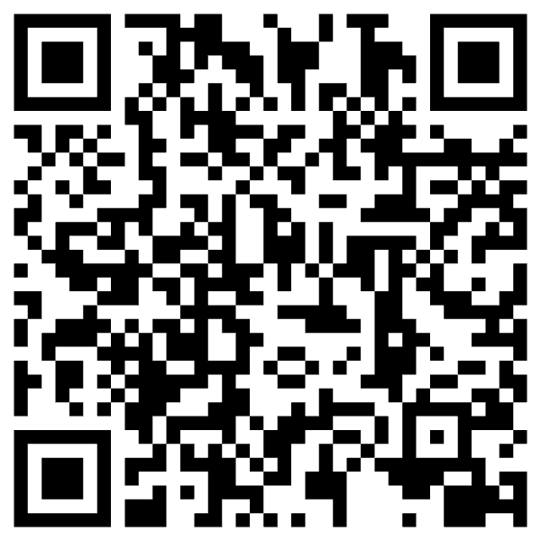
“Helping” with homework: Cheating (?)
Collaborate with students on essays
You have no idea how much we’re using ChatGPT
Cheating?
ChatGPT is better for some tasks
Good: thesis statements, outlines
Bad: capture student’s voice
Worse: quotes
Learning opportunity:
How to decompose writing to subtasks
Collaboration is great,
but student is responsible for end-product

Slide 5
Disintermediating Google
Google → Stack Overflow → Instant Answers → ChatBot

Slide 7
Replacing Stack Overflow with ChatGPT

Slide 8
I may be old-fashioned, but I still use Stack Overflow…
Advantages of Stackoverflow
Behavioral signals: logs, votes
Wisdom of the crowd
Feedback to developers
Bug Reports
with stats (prioritization)
and workarounds (with votes)
Web search
Solitaire
Multi-player game (auction)
If we lose stackoverflow
Developers will suffer
Where does ChatGPT get its content?
Stackoverflow?

Slide 9
Decomposing a big problem into subtasks

Slide 11
Limitations
Decomposing Problems
Hypothetical
Chain-of-Thought Prompting
works because...
ChatGPT needs help decomposing problems into subtasks
Suppose ChatGPT
can add two small numbers
But for large numbers,
it makes up answers
After each release,
“small” gets “bigger”
(We will return to this later)

Slide 12
Test of time: Inference is cool (for now)
https://youtu.be/rLl9XBg7wSs

Slide 13
Test of time: Inference is cool (for now) Will you still love me when I’m Sixty-Four?
https://www.youtube.com/watch?v=wUDRIC5RSX4

Slide 14
Shameless Plug: Smooth-Talking Machines

Slide 15
Challenge: Fluency $≠$ Trustworthiness
A number of articles on ChatGPT
lead with amazing successes
that seem too good to be true,
and end with back-peddling
ChatGPT has
amazing strengths (fluency)
as well as
amazing weaknesses (trustworthiness)
Many people assume
Fluency $≈I$ntelligence
IQ testing:
Measure vocabulary size
Large vocabulary → Fluent
Fluency is particularly important
on first impression
But eventually → disappointment
Weaknesses will become clear
What is the difference between
a hallucination and a con?

Slide 16
What should we do next?
Three paths forward:
Low road:
Give up (hallucinations)
Middle road:
Fact-checking with search
High road:
Revive rationalism (“AI Complete”)
Minsky & Chomsky
Recommendations
Short-term:
Middle Road: Search
“Good apps for Crummy MT”
Find apps for what we have
given strengths and weaknesses
Long-term:
High road may be necessary
But it is very ambitious
Inclusiveness:
Interdisciplinary Collaboration
Growth opportunities
(Low Resource Languages)

Slide 17
Hypothesis: NLP History → Strengths & Weaknesses
Deep Nets are
more fluent
than trustworthy
Pendulum Swung Too Far (2011)
Empiricism (1950s)
Rationalism (1970s)
Empiricism (1990s)
Deep Nets (2010s)
Truth
Fluency
Fluency
Fluency

Slide 18
Massive Growth → Mistaken Impression that everything is new (and there is no history)
Scientific Literature doubles every 9 years (90% written since I started PhD)
What’s new
The world is taking notice (in AI)
Fluency is much improved
What’s not new
Chatbots (and much of the tech)
SOTA-Chasing
New/better shiny objects
(with same old quality?)
Does SOTA-Chasing → Progress?
Trustworthiness is still wide open

Slide 19
Personal History
Strengths (fluency) and weaknesses (trustworthiness)
may be a consequence of choices we made in 1990s
We started EMNLP in 1990s for pragmatic reasons
Field had been attempting to do too much
and was accomplishing too little
(during a funding winter)
We chose to stop working on hard problems
(trustworthiness)
in order to make relatively quick progress on fluency
by reviving empirical methods from the 1950s
(Shannon, Skinner, Firth)
Deep Nets are
more fluent
than trustworthy
Pendulum Swung Too Far (2011)
Empiricism (1950s)
Rationalism (1970s)
Empiricism (1990s)
Deep Nets (2010s)
Fluency
Fluency
Fluency
Truth

Slide 20
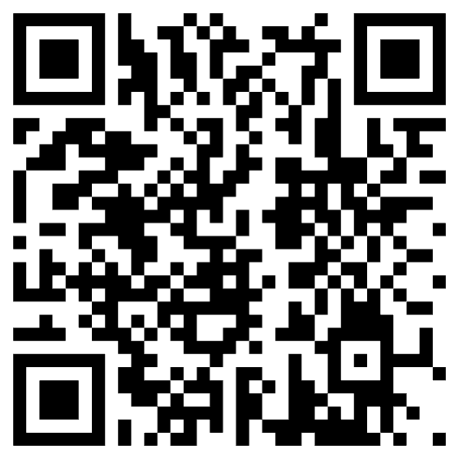
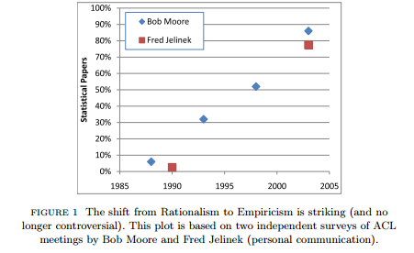
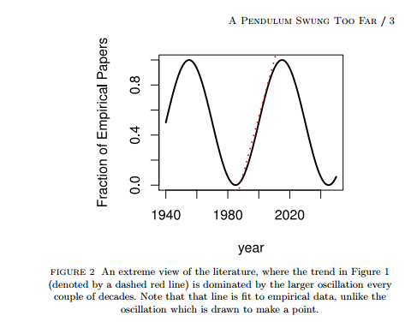
Pendulum Swung Too Far ChatGPT’s strengths (fluency) and weaknesses (trustworthiness) may be a consequence of choices we made in 1990s
Mechanism
We started EMNLP

Slide 21
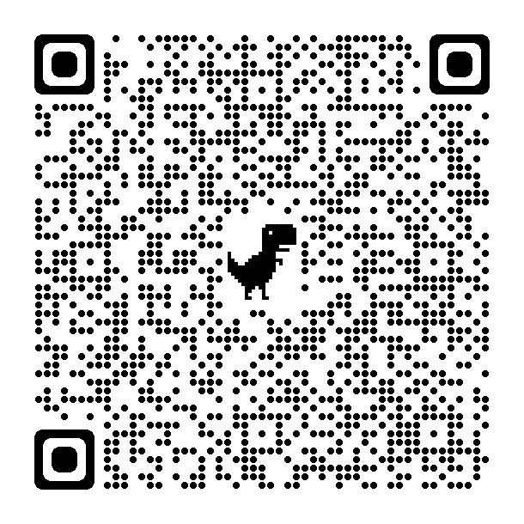
History does not repeat itself (but it rhymes)
Recent article in Guardian
Compared ChatGPT and Weizenbaum's ELIZA
https://www.theguardian.com/technology/2023/jul/25/joseph-weizenbaum-inventor-eliza-chatbot-turned-against-artificial-intelligence-ai
As a TA for Weizenbaum (1978),
I know just how horrified he was
by how seriously people took ELIZA
Responsible AI
His views were not popular at MIT
at the time

Slide 22
How Hard are Hallucinations? Yogi Berra
Possible answers:
Soon: “See next release”
Eventually, but not soon:
“Next Year in Jerusalem”
History of Machine Translation (MT)
When will MT be practical?
Prediction from 1950s: 5 years
Never
Assuming ChatGPT’s strengths & weaknesses
are a consequence of our choices from 1990s
and it took three decades to do well on fluency
and fluency $≪$ trustworthiness
then not soon

Slide 23
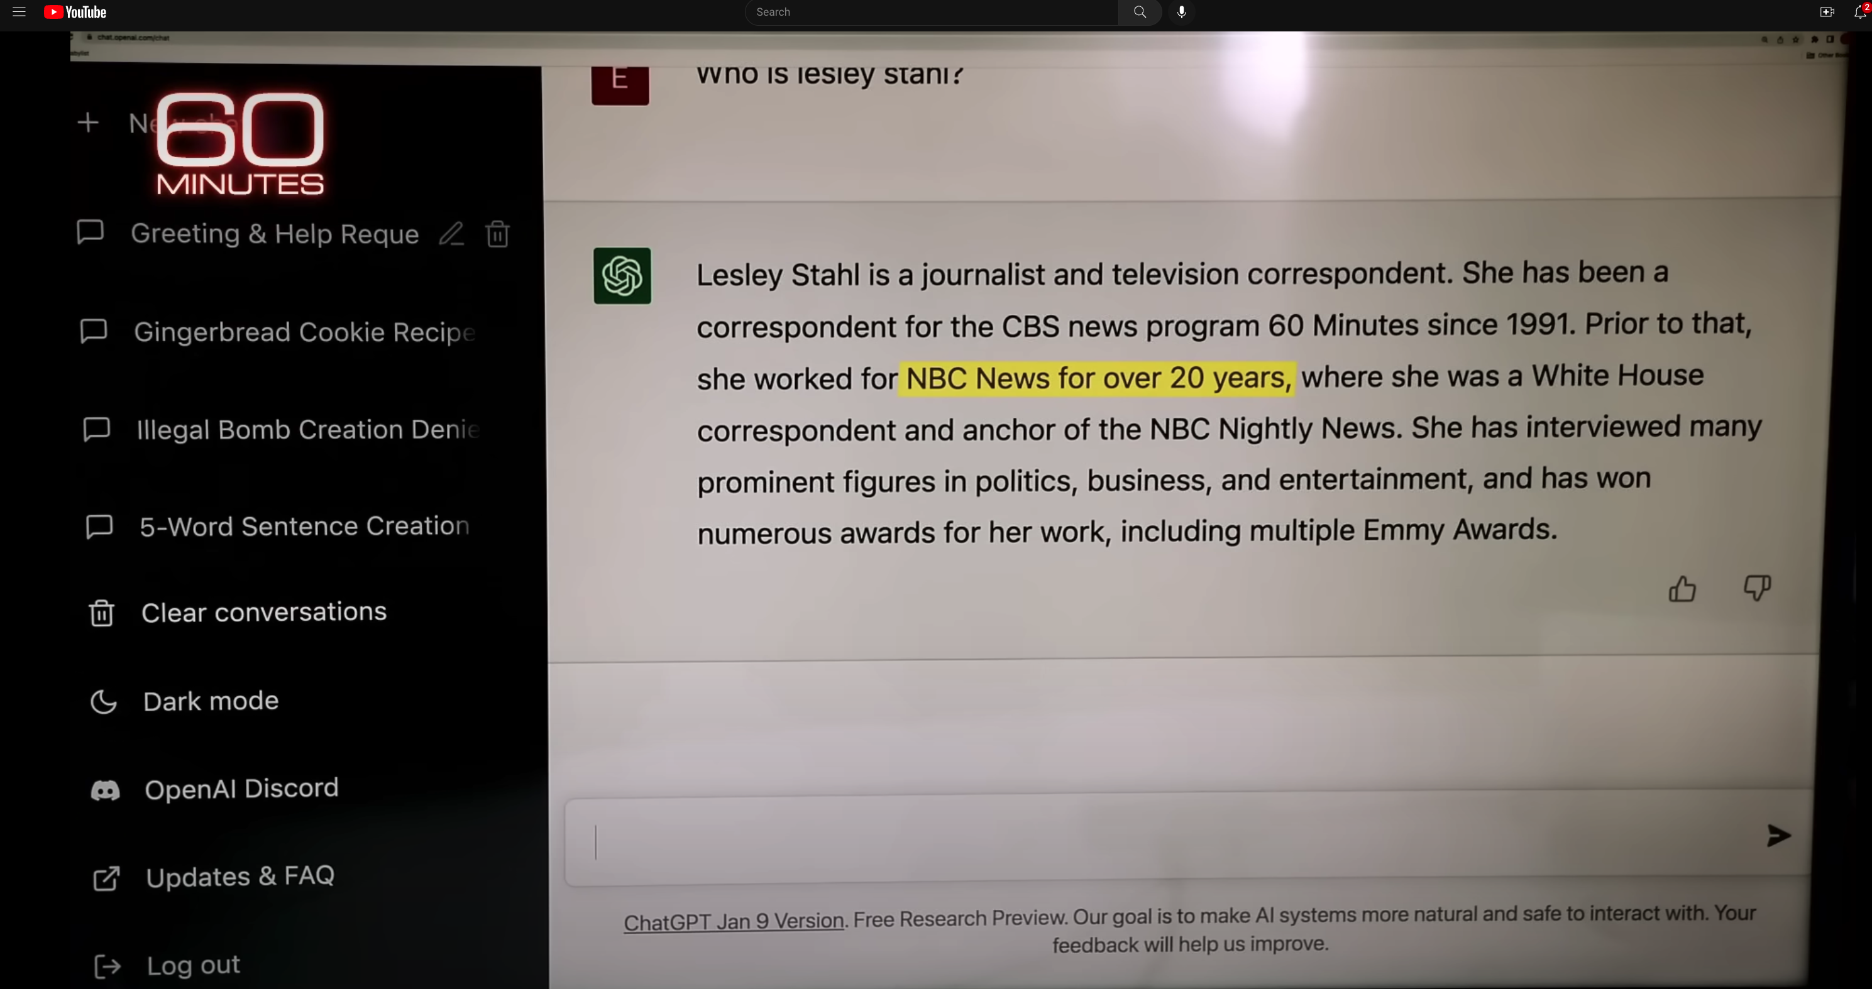
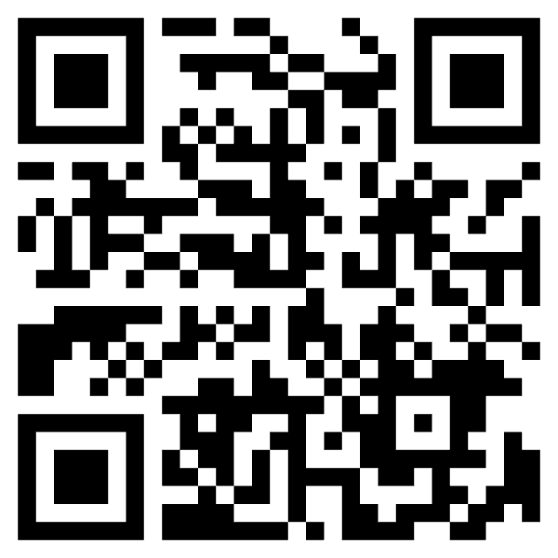
ChatGPT Hallucinates on CBS ``60 Minutes’’ https://www.youtube.com/watch?v=1wzPr4cUoMQ&t=463s
Prompt
Hallucination
https://github.com/kwchurch/ACL2022_deepnets_tutorial
23

Slide 24
Constructive Suggestions for Hallucinations
Query: Lesley Stahl works for which company
Low Road:
Give up
Middle Road
Fact-checking with search
High Road
Revive Rationalism
CBS

Slide 25
Challenges for Fact-Checking
Which claims need to be checked?
How do we create queries?
When we get search results, then what?

Slide 26
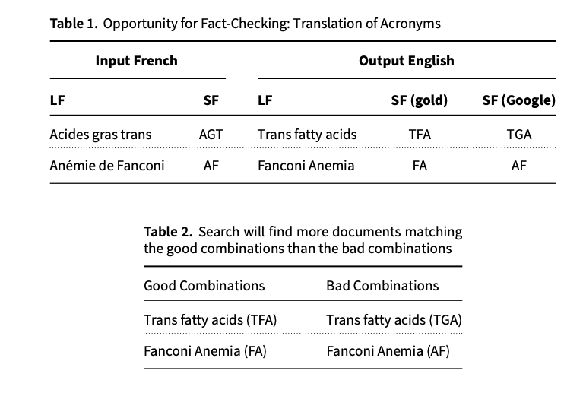
Acronyms: A Simple Case for Fact-Checking
Acronyms are easier
Google Translate is better on long forms (LFs) than short forms (SFs)
Use Google to translate LFs to target language (English)
Generate candidate SFs in target
Use search to verify candidates
Co-author (Richard Yue)
used to be a professional translator
Metrics matter:
Terminology:
important to translators
(But less so for BLEU)
De nombreux facteurs de risque participent au développement de cette pathologie, parmi lesquels les acides gras trans (AGT).
... une diminution d’expression de 12 gènes mutés dans l’anémie de Fanconi (AF)

Slide 27
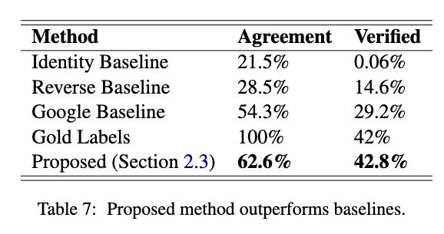
Fact-Checking Take-Aways
Short-term patch for hallucinations
Acronyms:
Easy special case of hallucinations
Don’t re-invent the wheel
Re-use existing tools: Search
Standard Loss/Metrics
Insufficient Penalty for Fatal Errors
Terminology
Responsible AI
Agreement:
hyp = gold
Verification:
Search finds 2+ examples in publications

Slide 28
Simple Example: Arithmetic (Chomsky: Capturing Relevant Generalizations)
Hypothetical
Is this progress?
Suppose ChatGPT
can add two small numbers
But for large numbers,
it makes up answers
After each release,
“small” gets “bigger”
Empiricism
According to SOTA-Chasing,
Yes
Rationalism
According to Minsky & Chomsky,
No
ChatGPT is not mastering concepts
“Stochastic Parrots”

Slide 29
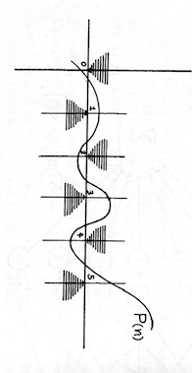
Perceptron: “Can’t Compute Parity” (Capturing Relevant Generalizations)
All Cases in
$O\left(1\right)$ Space
0
0
1
Some Cases in
$Ω\left(n\right)$ Space
Even
Odd
1
Minsky rejects deep nets (1969)
Regression: $n^{th}$ order poly requires $n$ parameters

Slide 30
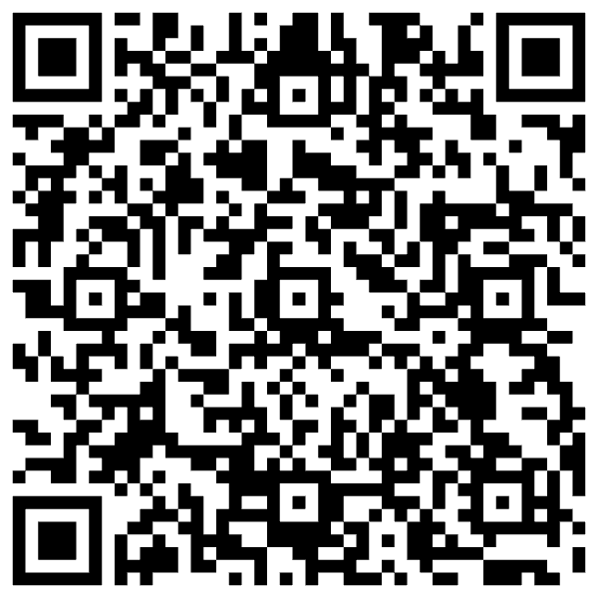
N. Chomsky, "Three models for the description of language," in IRE Transactions on Information Theory, vol. 2, no. 3, pp. 113-124, September 1956, doi: 10.1109/TIT.1956.1056813
Minsky rejects deep nets (1969)
Introduced Chomsky Hierarchy:
Finite State → Turing Machines

Slide 31
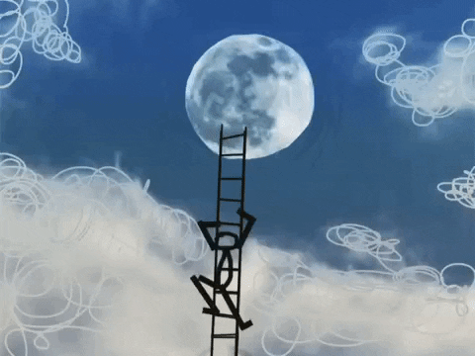
Capturing Generalizations Argument
Pros
Cons
Long-Term Focus
Can’t get to moon by
Incremental short-term local optimization
Dismisses Short-term Progress
Sometimes it is useful
to solve some simple special cases
(addition of small numbers)
Not constructive:
“MIT School of Negativity”

Slide 32
The Easy, the Hard and the Ugly
Easy: Exciting Eco-system
Prompting
Inference (fit)
Fine-Tuning (predict)
Hard: Large Companies
Pre-training
Ugly (Responsible AI)
Bias
Toxicity
Misinformation
Hallucinations
Plagiarism

Slide 33
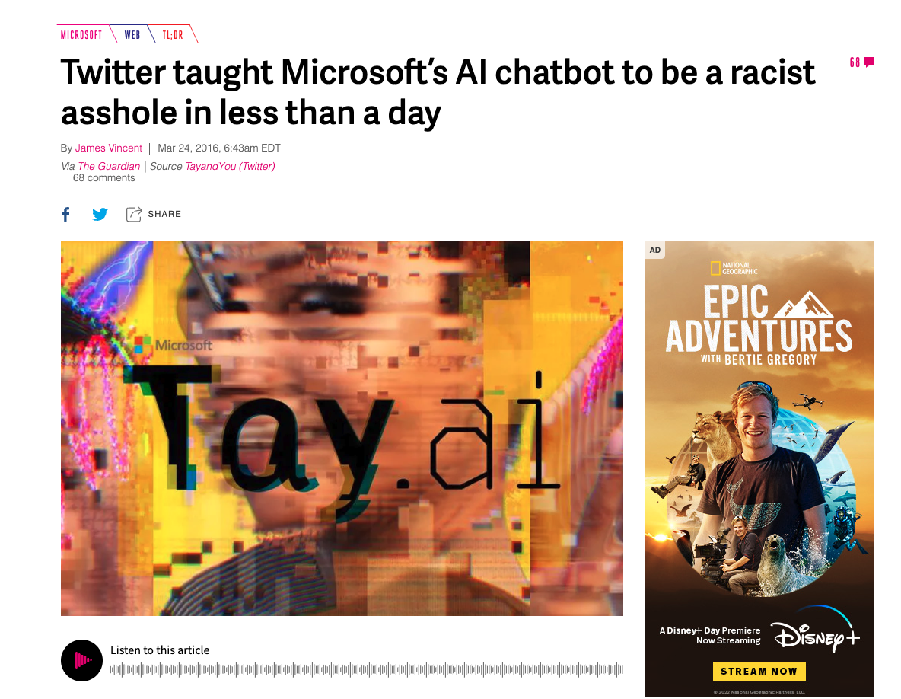
History of Irresponsible AI Risk (5 years ago) Product gets canceled
Stupidity: To err is human…
Spelling Correction
Obama → Osama
Bots:
Kids chat with Santa
Snow → I like drugs too…

Slide 34
Are we losing ground??? Are we at fault???
2016
2022
Risks 1.0: (work in progress)
Bias, Fairness
Risks 2.0: (bigger than us)
Genocide, Insurrection
Root causes:
ML + Social Media → Addiction
Max Engagement → Dangerous
Insanely profitable:
Companies & Countries
Long book, but no mention of our efforts to address old risks

Slide 35
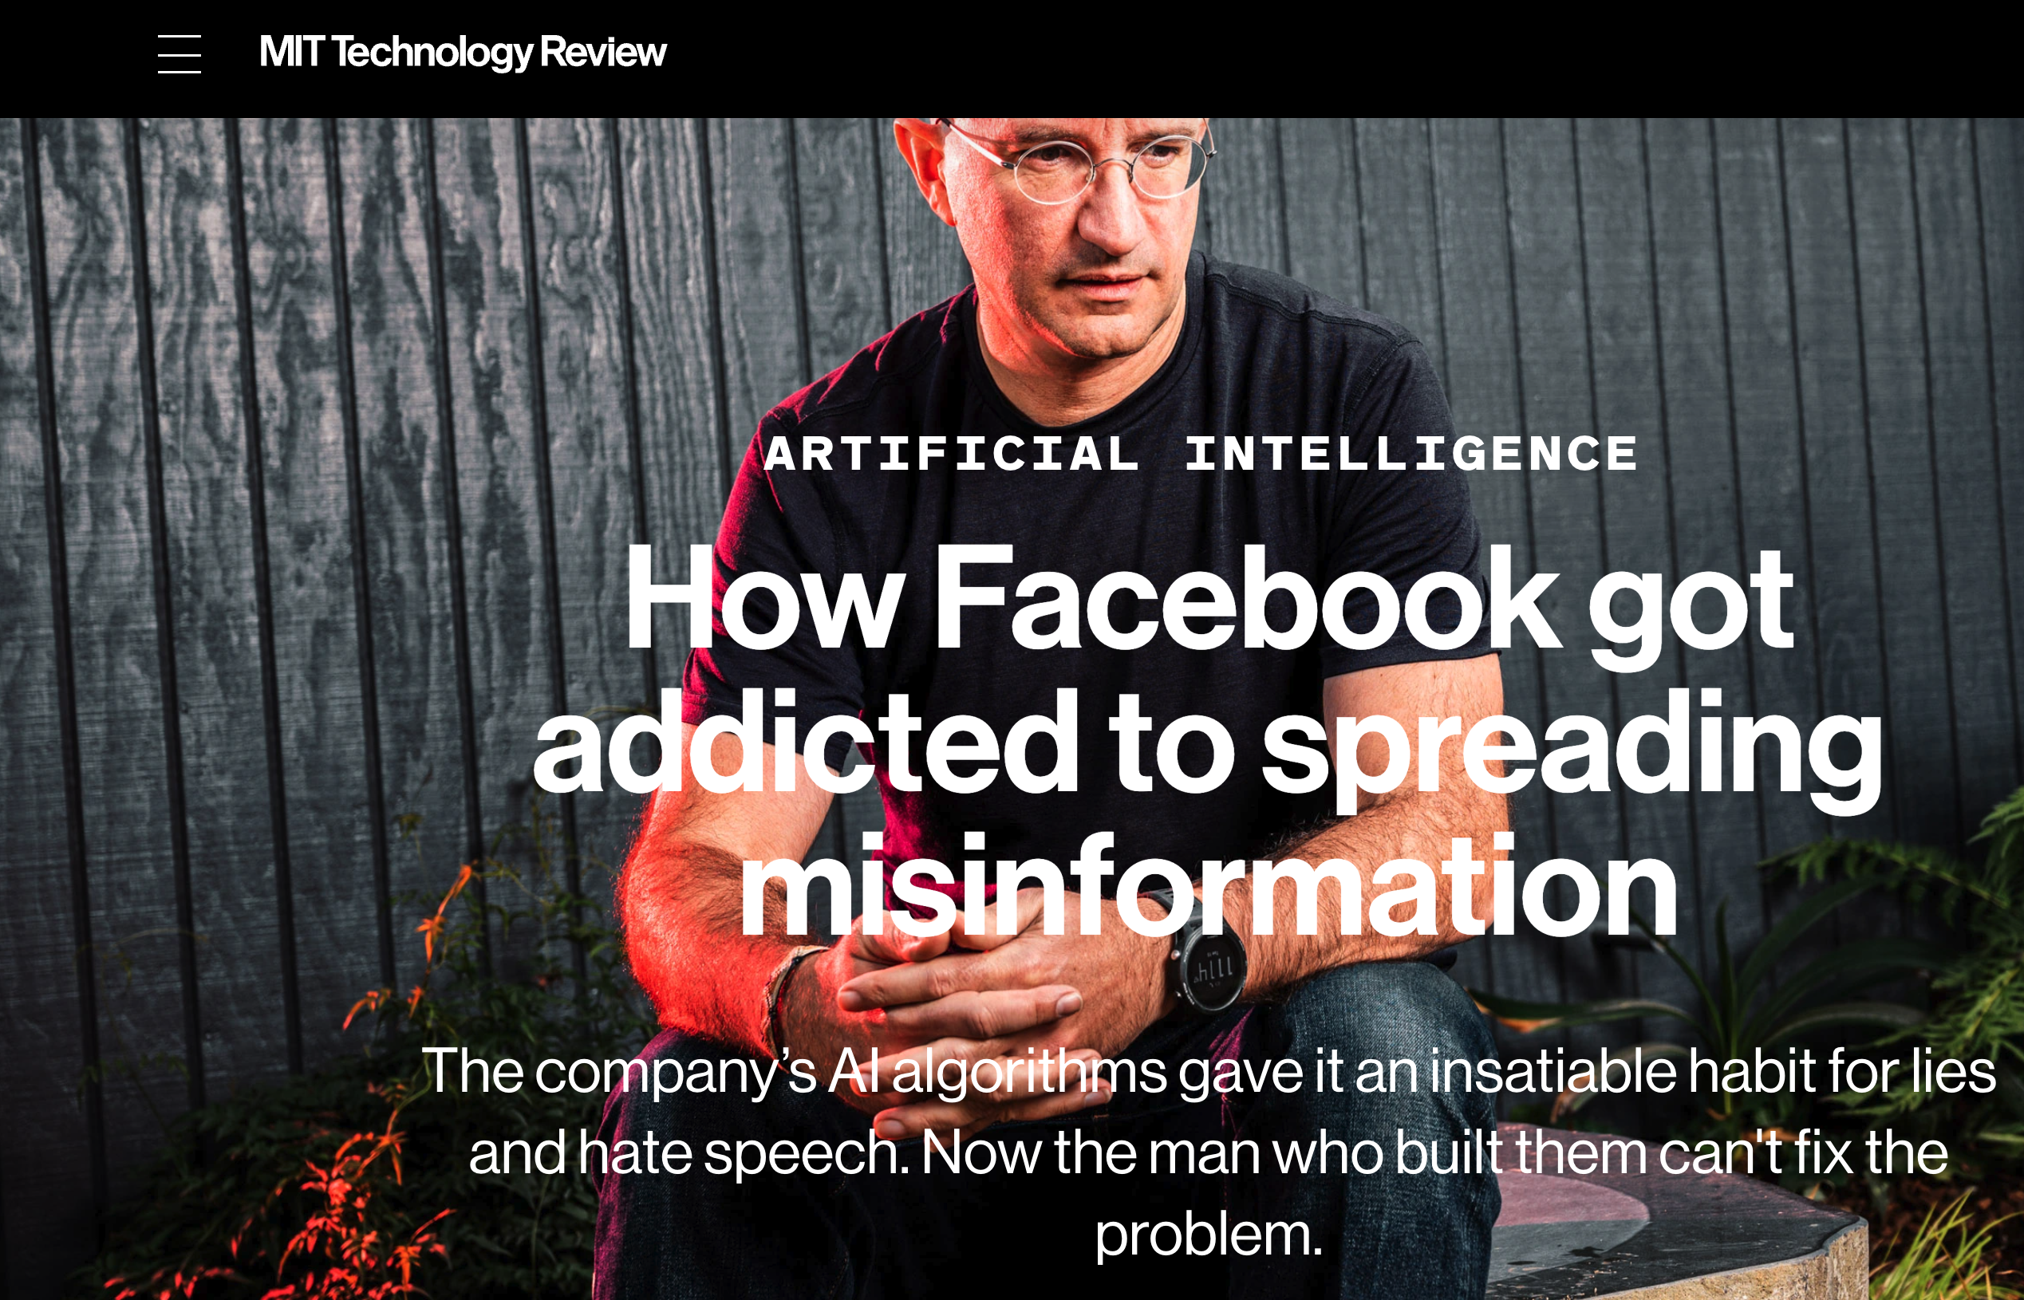
Reporter wanted to talk about Risks 2.0; Accused Facebook of pivoting to Risks 1.0 https://www.technologyreview.com/2021/03/11/1020600/facebook-responsible-ai-misinformation/

Slide 36
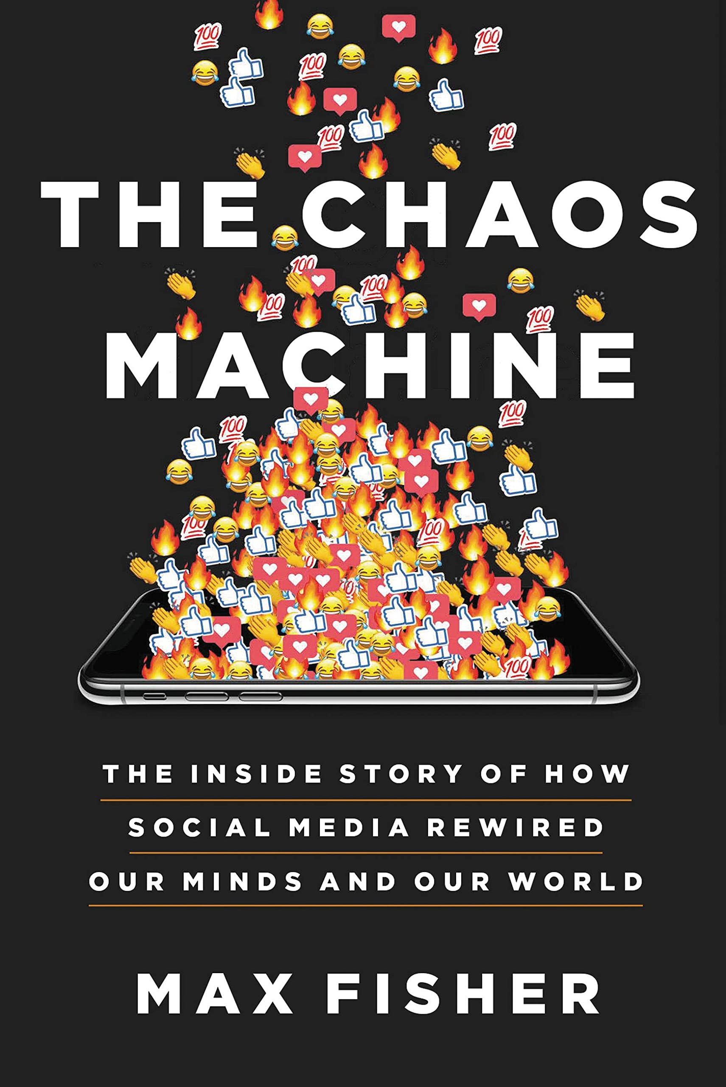
Ugly: Responsible AI
Incentives matter
Risks 1.0 (2016)
Unfair, Biased
Risks 2.0 (2022)
Addictive, dangerous, deadly
and insanely profitable
Risks 3.0 (2023)
Malware
Spyware
Challenge for Regulation
Business case $≠$ Public Interest (Health, National Security)
Tobacco companies maximize sales; ditto for fast food & junk food
Risks 2.0 (Toxicity): Good for social media companies; we ❤️ click bait
Risks 3.0 (Conflict): Good for defense industry

Slide 37
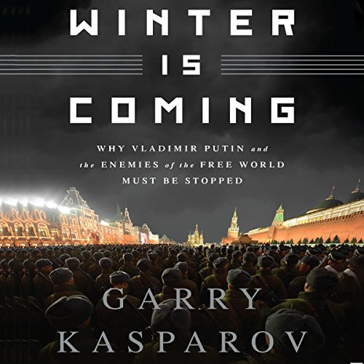
Winter is Coming
We tend to be impressed by people that speak/write well
Fluency → well-read → success → smart
Machines are better than people on many tasks (spelling),
Now that machines are more fluent than people, are they smarter?
Fear: AI Winter
there will be disappointment
when public realizes
fluency $≠$intelligence
Pendulum Swung Too Far
There have been many AI Winters
Often, after ``irrational exuberance’’
(like current excitement with nets)

Slide 38
Recommendation: Go for Singles (Not Home Runs)
Need some short-term successes for ChatBots
that take advantage of strengths
and avoid weaknesses
Suggestion
Collaborate with students on essays
You have no idea how much we’re using ChatGPT
Cheating?
ChatGPT is better for some tasks
Good: thesis statements, outlines
Bad: capture student’s voice
Worse: quotes
Learning opportunity:
How to decompose writing to subtasks
Collaboration is great,
but student is responsible for end-product
Factoring example

Slide 39
What should we do next?
Three paths forward:
Low road:
Give up (hallucinations)
Middle road:
Fact-checking with search
High road:
Revive rationalism (“AI Complete”)
Minsky & Chomsky
Recommendations
Short-term:
Middle Road: Search
“Good apps for Crummy MT”
Find apps for what we have
given strengths and weaknesses
Long-term:
High road may be necessary
But it is very ambitious
Inclusiveness:
Interdisciplinary Collaboration
Growth opportunities
(Low Resource Languages)

Slide 40
Big Picture (Linguistics Perspective)
Speech (JM28)
Acoustics
Digital Signal Processing
Phonetics: phonemes, distinctive features
Prosody: Pitch, duration, energy
Phonology: Stress Assignment
Morphology
Regular Inflection, level 1, level 2
Compounding
The Lexicon (JM23)
Syntax
Parsing
Chomsky Hierarchy:
Finite-State, Context-Free (JM17)
Context-Sensitive, Turing Equivalent
Variable Binding
Pronouns, Quantifier Scope
WH-movement
Predicate-argument structure (JM24)
Semantics
Logical Form (JM19)
Pragmatics, Discourse & Dialogue (JM27)
Gricean Maxims
Indirect speech acts: do you have the time?
Diarization (who spoke when)
Filled pauses, restarts, corrections

Slide 41
Big Picture (Computational Perspective)
Speech (JM16)
Digital Signal Processing
Speech to Text (STT; ASR)
Text to Speech (TTS; synthesis)
Diarization
Morphology
Tokenization (Subwords) (JM2)
The Lexicon (JM23)
Spelling Correction
(JM appendix B)
Syntax
Parsing (JM17 & JM18)
Token classification (JM8)
Part of speech tagging
NER (named entity recognition)
Coreference (JM26)
Semantics
Logical Form (JM19)
Temporal Reasoning (JM22)
Pragmatics, Discourse & Dialogue
Chatbots (JM15)
Question Answering & Information Retrieval (JM14)

Slide 42
Topics not well covered
Conjunction
Scope: narrow vs. wide
Ellipsis, gapping, etc.
Long-distance dependencies
WH-movement
Belief contexts, quotations, etc.
Historical Linguistics
Sociolinguistics
Psycholinguistics:
reaction time
memory limitation
Topology: SVO, SOV, etc.

Slide 43
Phonetics
Distinctive Features
Voicing:
Unvoiced, Voiced
Place:
Labial, Dental, Velar
Manner:
Stop, Fricative, Vowel
Place | Unvoiced | Voiced
Labial | p | b
Dental | t | d
Velar | k | g

Slide 44
Phonetics
Distinctive Features
Voicing:
Unvoiced, Voiced
Place:
Labial, Dental, Velar
Manner:
Stop, Fricative, Vowel
Place | Unvoiced | Voiced
Labial | p | b
Dental | t | d
Velar | k | g

Slide 45
Distinctive Features: Vowels
 | High | Low
Front | beet | bat
Back | boot | bought

Slide 46
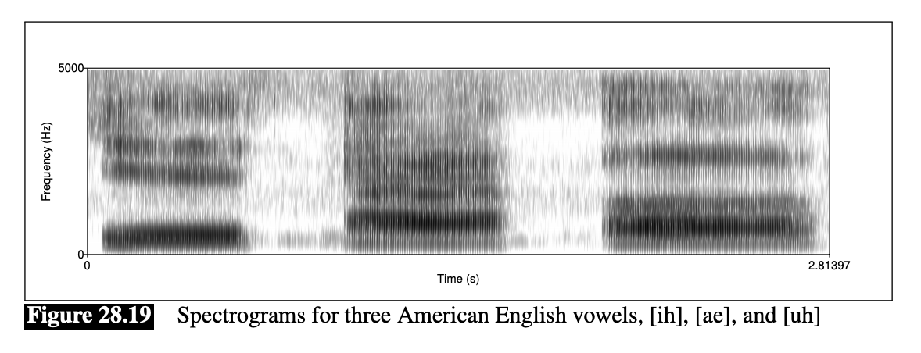
Distinctive Features: Vowels
 | High | Low
Front | beet | bat
Back | boot | bought

Slide 47
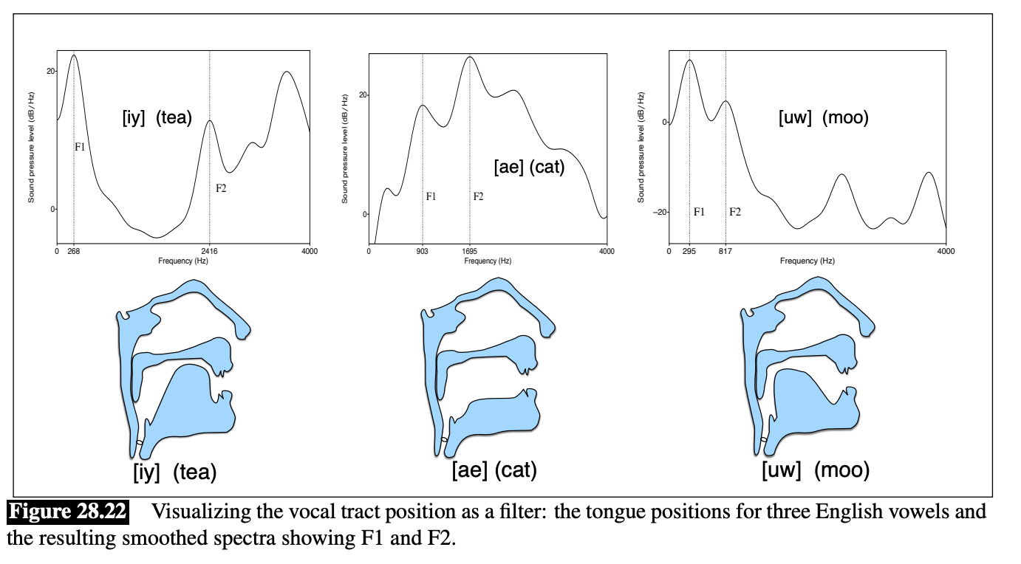
Distinctive Features: Vowels
 | High | Low
Front | beet | bat
Back | boot | bought

Slide 48
Multiple Perspectives: F1 & F2 are poles of 2nd order differential equation
Perception
Production

Slide 49
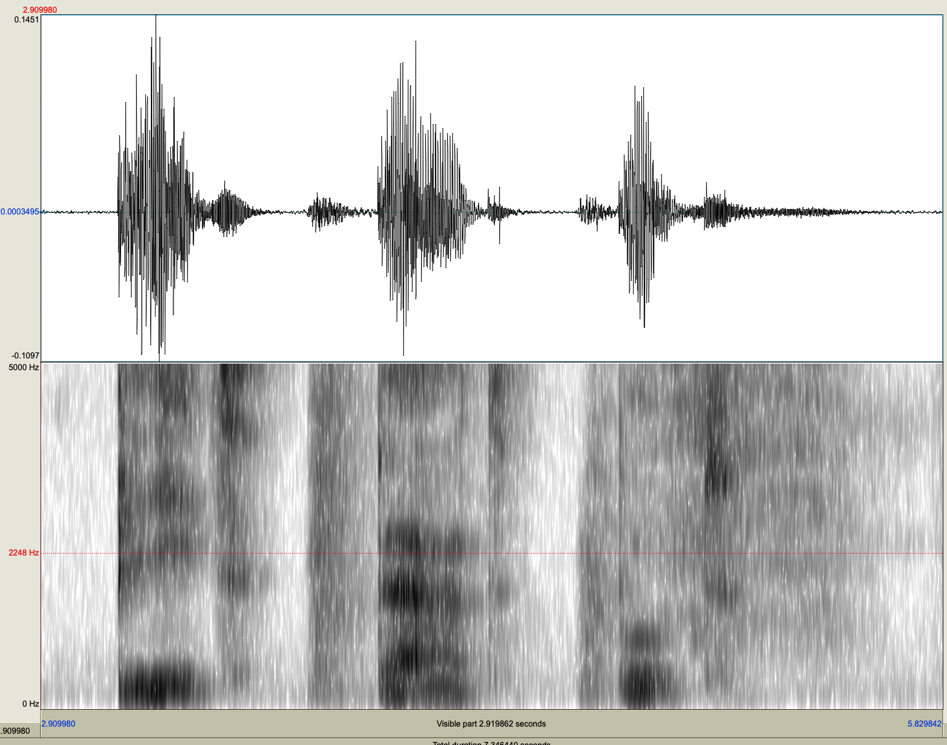
Multiple Perspectives: F1 & F2 are poles of 2nd order differential equation
Perception
Production

Slide 50
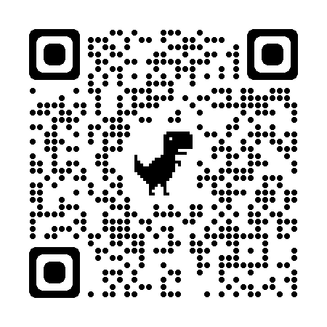
Big Picture (Computational Perspective)
Speech (JM16)
Digital Signal Processing
Speech to Text (STT; ASR)
Text to Speech (TTS; synthesis)
Diarization
Morphology
Tokenization (Subwords) (JM2)
The Lexicon (JM23)
Spelling Correction
(JM appendix B)
Syntax
Parsing (JM17 & JM18)
Token classification (JM8)
Part of speech tagging
NER (named entity recognition)
Coreference (JM26)
Semantics
Logical Form (JM19)
Temporal Reasoning (JM22)
Pragmatics, Discourse & Dialogue
Chatbots (JM15)
Question Answering & Information Retrieval (JM14)

Slide 51
Word Sense Disambiguation
bank → money bank | river bank
translations
money bank → banque
river bank → banc
classification task
predict when bank will be translated as banque or banc

Slide 52
Spelling Correction
$$x$$
$$\hat{w}$$

Slide 53
Candidate Corrections

Slide 54
Prior
Channel Model

Slide 56
Big Picture (Computational Perspective)
Speech (JM16)
Digital Signal Processing
Speech to Text (STT; ASR)
Text to Speech (TTS; synthesis)
Diarization
Morphology
Tokenization (Subwords) (JM2)
The Lexicon (JM23)
Spelling Correction
(JM appendix B)
Syntax
Parsing (JM17 & JM18)
Token classification (JM8)
Part of speech tagging
NER (named entity recognition)
Coreference (JM26)
Semantics
Logical Form (JM19)
Temporal Reasoning (JM22)
Pragmatics, Discourse & Dialogue
Chatbots (JM15)
Question Answering & Information Retrieval (JM14)

Slide 57
Part of Speech Tagging

Slide 58
Parsing & Context-Free Grammars
Grammar
Parse Tree

Slide 59
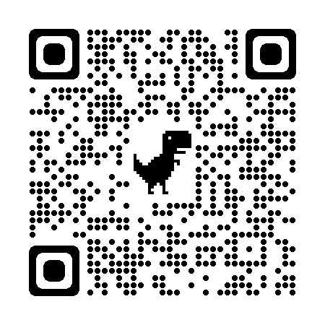
Parse Tree from Penn TreeBank

Slide 60
Ambiguity

Slide 61
Parse table for: Book the flight through Houston

Slide 62
Big Picture (Linguistics Perspective)
Speech (JM28)
Acoustics
Digital Signal Processing
Phonetics: phonemes, distinctive features
Prosody: Pitch, duration, energy
Phonology: Stress Assignment
Morphology
Regular Inflection, level 1, level 2
Compounding
The Lexicon (JM23)
Syntax
Parsing
Chomsky Hierarchy:
Finite-State, Context-Free (JM17)
Context-Sensitive, Turing Equivalent
Variable Binding
Pronouns, Quantifier Scope
WH-movement
Predicate-argument structure (JM24)
Semantics
Logical Form (JM19)
Pragmatics, Discourse & Dialogue (JM27)
Gricean Maxims
Indirect speech acts: do you have the time?
Diarization (who spoke when)
Filled pauses, restarts, corrections

Slide 63
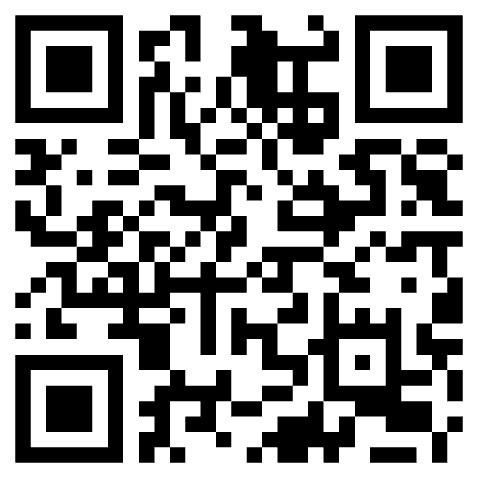
Grice’s Maxims
Maxim of quantity (length)
Be as informative as possible
Do not say more than is required
Maxim of quality (truth)
Do not say what you believe is false
Do not say that for which you lack adequate evidence
Maxim of relation (relevance)
Be relevant
Maxim of manner (clarity)
Avoid obscurity and ambiguity
Be brief and orderly

Slide 64
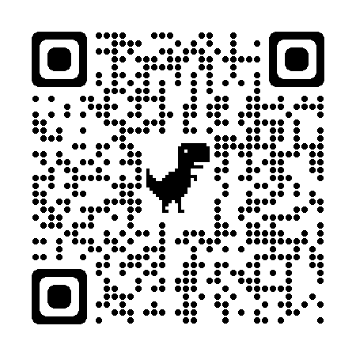
High-level Rhetorical Structures
Description
Exposition
Narration
Persuasive
Beginning → End
Plot
Character Arc
Punch line (after setup)
Academic style:
Say everything three times
Promise
Connect the dots between promise and delivery
Delivery
Newspaper style:
Lead with the lead
Who-done-it:
End with the solution
First suspect never did it

