Slide 1
CS6120: Lecture 5
Jiaji Huang
https://jiaji-huang.github.io

Slide 2
Recap of Previous Lectures
Feature extraction
0.5
-1.2
2.5
👍
1.8
2.2
-2.0
⋮
⋮
classifier
⋮
👎
documents
Representations

Slide 3
Recap of Previous Lectures
Features
Bag of words
TF-IDF
Word2vec, PMI
Classifiers
Naïve Bayesian
Logistic regression
Softmax classifier

Slide 4
Recap of Previous Lectures
Review skip gram: a 2-layer network
e.g., receive a training sample (x=the, y=quick)
the
the
P(y=the)
the
P(y=fox)
fox
fox
No order information!
$$⋮$$
$$⋮$$
quick
quick
P(y=quick)
Maximize it
$$W$$
$$C$$
$$\left(s_{1},..,s_{n}\right)=\left(\frac{e^{s_{1}}}{\sum_{i=1}^{n}{s_{i}}}, …, \frac{e^{s_{n}}}{\sum_{i=1}^{n}{s_{i}}}\right)$$
Look-up embedding layer
Linear layer
softmax

Slide 5
Modern architecture: Order Information
e.g., BERT (masked language modeling)
the
the
P(y=the)
The [mask] brown fox
[mask]
P(y=fox)
fox
fox
$$⋮$$
$$⋮$$
quick
Nonlinear layers
quick
P(y=quick)
brown
[mask]
Maximize it
Look-up embedding layer
Linear layer
softmax

Slide 6
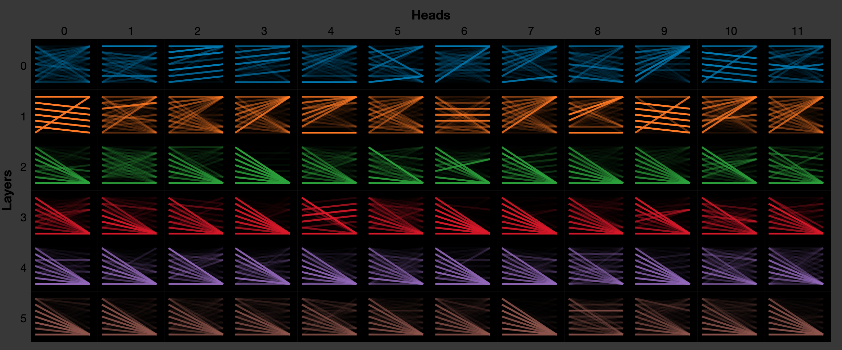
Recap of Previous Lectures
Attention
Visualization
fine-tuning
benchmarks

Slide 7
Agenda for Today
Deep dive of “Nonlinear layers”
Recurrent Neural Network (RNN)
Architectures
Transformer
Transformer Language Models
Representations in Transformer

Slide 8
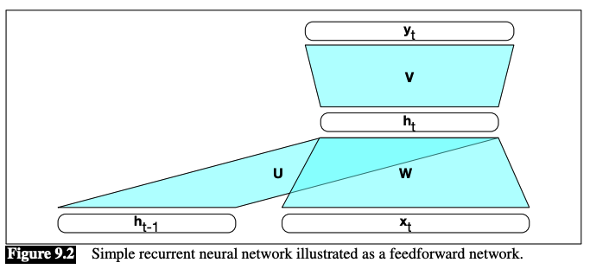
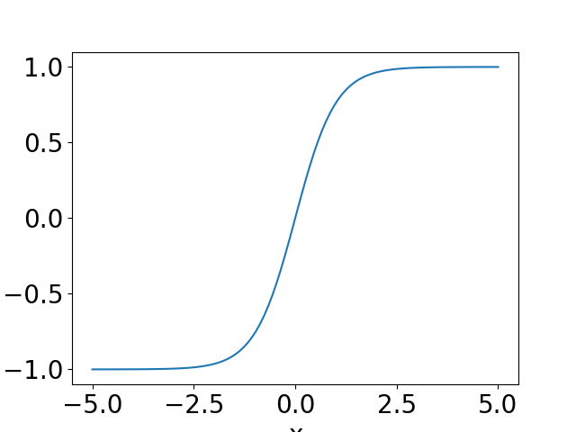
RNN
Hidden state $h_{t}$
Input $x_{t}$
$h_{t}=g(Uh_{t−1}+Wx_{t})$
$y_{t}=f(Vh_{t})$
e.g., $g(∙)$ as tanh, $f\left(∙\right)$ as softmax
Illustration from https://web.stanford.edu/~jurafsky/slp3/9.pdf

Slide 9
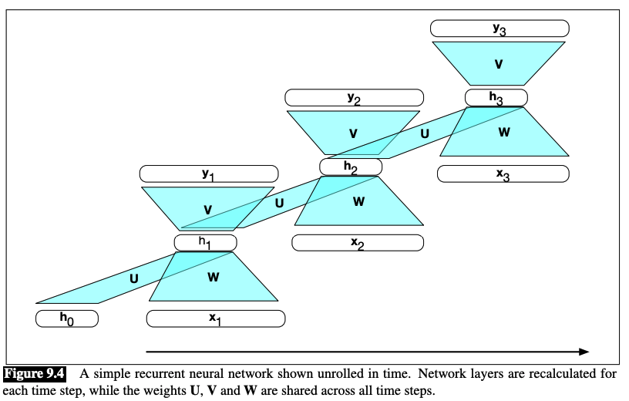
RNN
“Unroll” along time axis
Illustration from https://web.stanford.edu/~jurafsky/slp3/9.pdf

Slide 10
Stacked RNN layers
$$h_{t}^{1}=g(U^{1}h_{t−1}^{1}+W^{1}x_{t})$$
$$h_{t}^{2}=g(U^{2}h_{t−1}^{2}+W^{2}h_{t}^{1})$$
$$h_{t}^{3}=g(U^{3}h_{t−1}^{3}+W^{3}h_{t}^{2})$$
$$⋮$$

Slide 11
Stacked RNN layers
Illustration from https://web.stanford.edu/~jurafsky/slp3/9.pdf

Slide 12
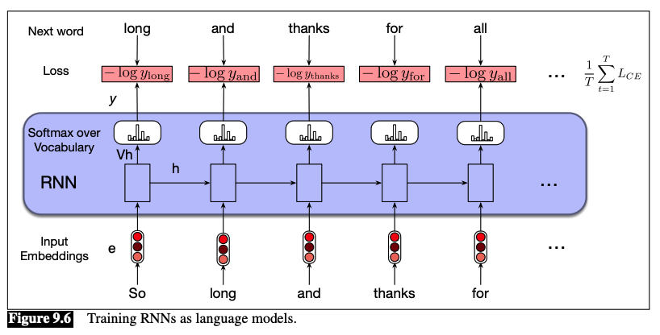
RNN for (Causal) language Modeling
Predict next word given previous ones
Illustration from https://web.stanford.edu/~jurafsky/slp3/9.pdf

Slide 13
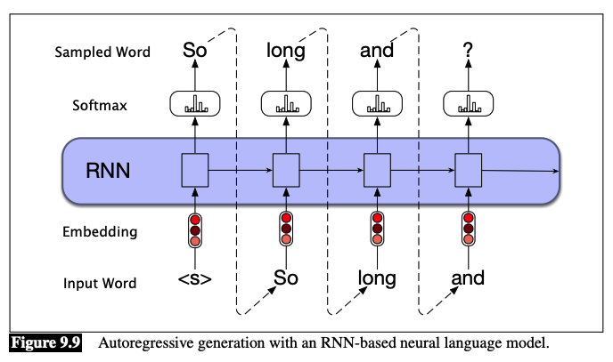
RNN for Text Generation
Generate the next word given previous ones
Illustration from https://web.stanford.edu/~jurafsky/slp3/9.pdf

Slide 14
Bi-directional RNN
Input $x_{1},x_{2},…,x_{T}$
$h_{t}^{f}={RNN}_{f}(x_{1},x_{2},…,x_{t})$
$h_{t}^{b}={RNN}_{b}(x_{T},x_{T−1},…x_{t})$
$h_{t}=[h_{t}^{f},h_{t}^{b}]$

Slide 15
Bi-directional RNN
Illustration from https://web.stanford.edu/~jurafsky/slp3/9.pdf

Slide 16
Why bi-directional
Some applications allow us to see the entire sequence, e.g.,
Text Classification
Speech Recognition
Bi-directional often beats uni-directional:
e.g., a speech recognition example (lower WER is better)
ASR results from https://www.jonathanleroux.org/pdf/Moritz2019Interspeech09.pdf

Slide 17
LSTM, but why?
RNNs can be hard to train
Gradient explosion and vanishing problem
In modern words, attention span is very short!

Slide 18
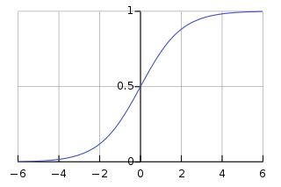
LSTM
Forget gate $f_{t}=σ(U_{f}h_{t−1}+W_{f}x_{t})$
$$k_{t}=c_{t−1}⊙f_{t}$$
Add gate ${ i}_{t} =σ\left(U_{i}h_{t−1}+W_{i}x_{t}\right)$ $g_{t}=\tanh{(U_{g}h_{t−1}+W_{g}x_{t})}$ $j_{t}= g_{t}⊙i_{t}$
Combined $c_{t}=j_{t}+k_{t}$
Output gate
$$o_{t}=σ(U_{o}h_{t−1}+W_{o}x_{t})$$
$$h_{t}=o_{t}⊙\tanh{{(c}_{t})}$$
sigmoid

Slide 19
LSTM
Illustration from https://web.stanford.edu/~jurafsky/slp3/9.pdf

Slide 20
GRU
A Variant of LSTM
Fewer gates, less parameters

Slide 21
Agenda for Today
Deep dive of “Nonlinear layers”
Recurrent Neural Network (RNN)
Architectures
Transformer
Transformer Language Models
Representations in Transformer

Slide 22
Typical Architectures
Note: all RNNs can be replaced by LSTMs!
Illustration from https://web.stanford.edu/~jurafsky/slp3/9.pdf

Slide 23
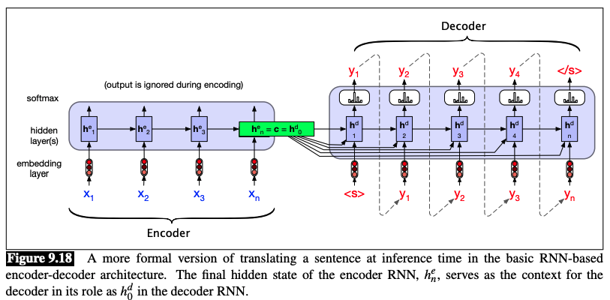
Enc-Dec with RNNs
Applications: translation, summarization, dialog, …
Illustration from https://web.stanford.edu/~jurafsky/slp3/9.pdf

Slide 24
Attention in Enc-Dec Architecture
Drawback of using a single context vector
Illustration from https://web.stanford.edu/~jurafsky/slp3/9.pdf

Slide 25
Attention in Enc-Dec Architecture
$$α_{ij}=h_{i}^{d}∙h_{j}^{e}$$
Illustration from https://web.stanford.edu/~jurafsky/slp3/9.pdf

Slide 26
Agenda for Today
Deep dive of “Nonlinear layers”
Recurrent Neural Network (RNN)
Architectures
Transformer
Transformer Language Models
Representations in Transformer

Slide 27
More Parallelizable than RNN
Illustration from https://web.stanford.edu/~jurafsky/slp3/10.pdf

Slide 28
A Transformer Block
Illustration from https://web.stanford.edu/~jurafsky/slp3/10.pdf

Slide 29
Math of Self-attention
Map hidden states to keys, queries and values
$$q_{i}=W^{q}x_{i}, k_{i}=W^{k}x_{i}, v_{i}=W^{v}x_{i}$$
Raw score
$$s_{i,j}=q_{i}∙k_{j}/\sqrt{d}$$
Attention weights
$$α_{i,j}=\frac{e^{s_{i,j}}}{\sum_{l}{e^{s_{i,l}}}}$$
Output Hidden states
$$y_{i}=\sum_{j}{α_{i,j}v_{j}}$$

Slide 30
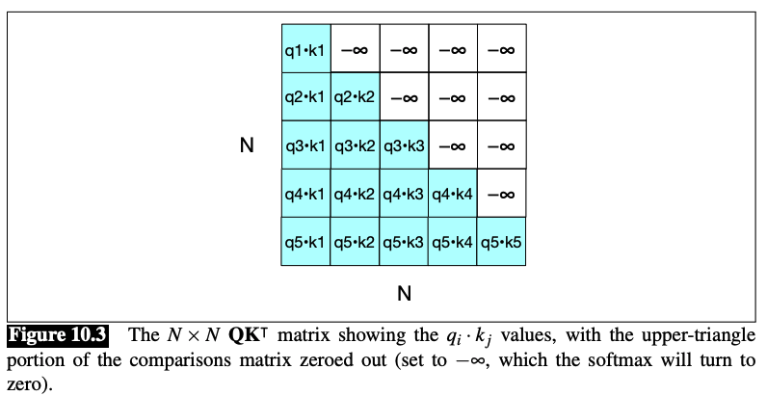
Attention Mask
$α_{i,j}=\frac{e^{s_{i,j}}}{\sum_{l}{e^{s_{i,l}}}}$, $y_{i}=\sum_{j}{α_{i,j}v_{j}}$
The range of $j$ (or $l$) for causal language model: $j≤i$
Illustration from https://web.stanford.edu/~jurafsky/slp3/10.pdf

Slide 31
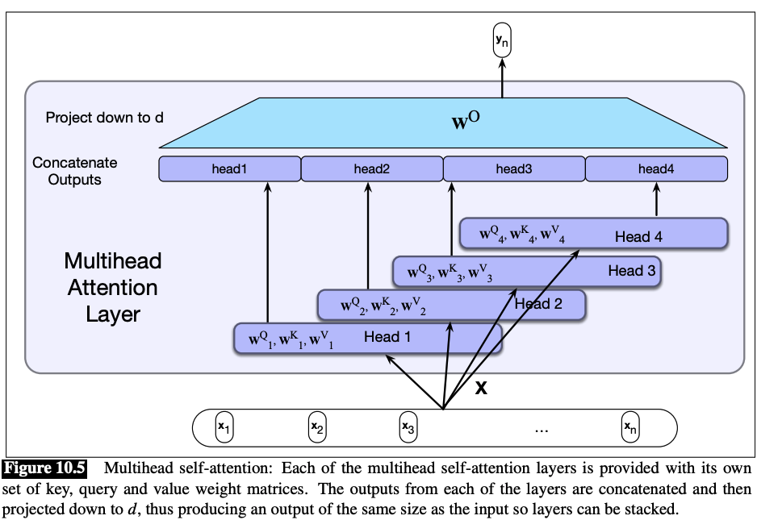
Multi-head Attention
Multiple sets of $W^{q}$, $W^{k}$and $W^{v}$
concatenate output from each head
Project with $W^{o}$
Illustration from https://web.stanford.edu/~jurafsky/slp3/10.pdf

Slide 32
Residual Connection
$$x+FF\left(x\right)$$
$$x+selfAttn\left(x\right)$$
Illustration from https://web.stanford.edu/~jurafsky/slp3/10.pdf

Slide 33
Why Residual Connection
Consider a system with residual connection
$$y=Ax\left(θ\right)+x(θ)$$
We use gradient descent to train $θ$
$$\frac{∂y}{∂θ}=(A+I)\frac{∂x}{∂θ}$$
$A+I$ is better “conditioned” than $A$
Called diagonal loading sometimes

Slide 34
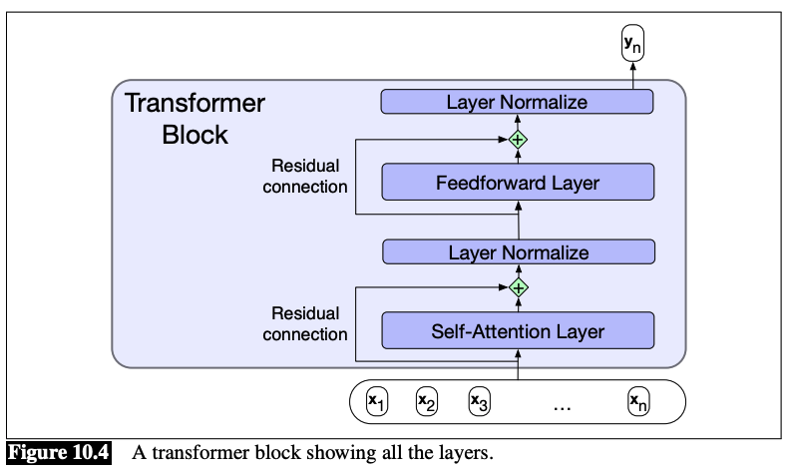
Layer Normalization
Illustration from https://web.stanford.edu/~jurafsky/slp3/10.pdf

Slide 35
Feedforward Layer
$$y=W_{2}σ(W_{1}x)$$
Illustration from https://web.stanford.edu/~jurafsky/slp3/10.pdf

Slide 36
Brief Summary
What are the parameters to be trained?
Which part has most parameters?
Illustration from https://web.stanford.edu/~jurafsky/slp3/10.pdf

Slide 37
Word Order Information
Encode following two sentences
“It is good, isn’t it ?” v.s. “it isn’t good, is it ?”
Take the hidden state at last time step as sentence embedding
The embeddings are the same!
How to break the symmetry?

Slide 38
Positional Encoding
Illustration from https://web.stanford.edu/~jurafsky/slp3/10.pdf

Slide 39
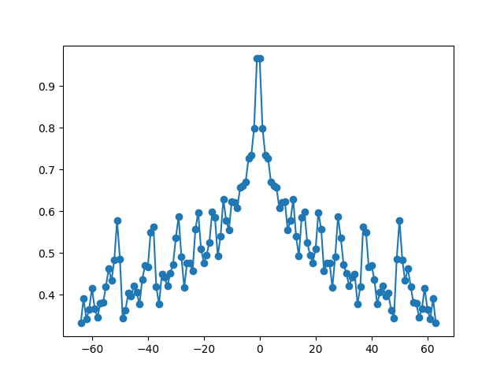
Absolute Position Encoding
Each position with a encoding vector
E.g, sinusoidal
$${\overset{⃑}{p}}_{i}=\left[\sin{ω_{1}i},\cos{ω_{1}}i,…,\sin{ω_{d/2}i,}\cos{ω_{d/2}}i\right]$$
Why it helps
$${\overset{⃑}{p}}_{i}∙{\overset{⃑}{p}}_{j}=\sum_{s=1}^{d/2}{\cos{ω_{s}(i−j)}}$$

Slide 40
Relative Position Encoding
Some function of $i−j$
E.g., ALiBi’s raw score
$$s_{i,j}=\frac{q_{i}∙k_{j}}{\sqrt{d}}−c\left|i−j\right|, c>0$$
Encourage to pay more attention to nearby tokens

Slide 41
RoPE: Another Relative Position Encoding
Rotate $q_{i}$ by $i×θ$, $k_{j}$ by $j×θ$
So if $\left|i−j\right|$ big, their inner product is small

Slide 42
Agenda for Today
Deep dive of “Nonlinear layers”
Recurrent Neural Network (RNN)
Architectures
Transformer
Transformer Language Models
Representations in Transformer

Slide 43
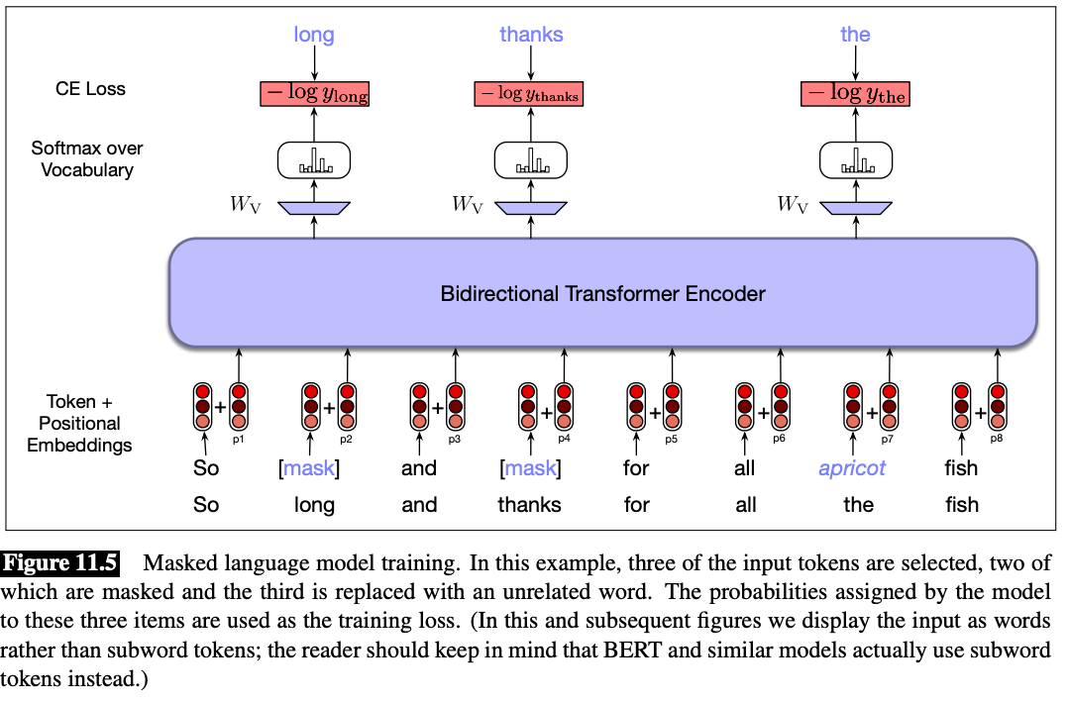
Masked Language Model
Sees left and right contexts
no attention mask
Illustration from https://web.stanford.edu/~jurafsky/slp3/11.pdf

Slide 44
Masked Language Model
Aka encoder model
E.g. BERT
Application: language understanding tasks

Slide 45
Causal Language Model
Illustration from https://web.stanford.edu/~jurafsky/slp3/10.pdf

Slide 46
Causal Language Model
Aka decoder model
E.g., GPT-x, Llama
Applications: language generation tasks

Slide 47
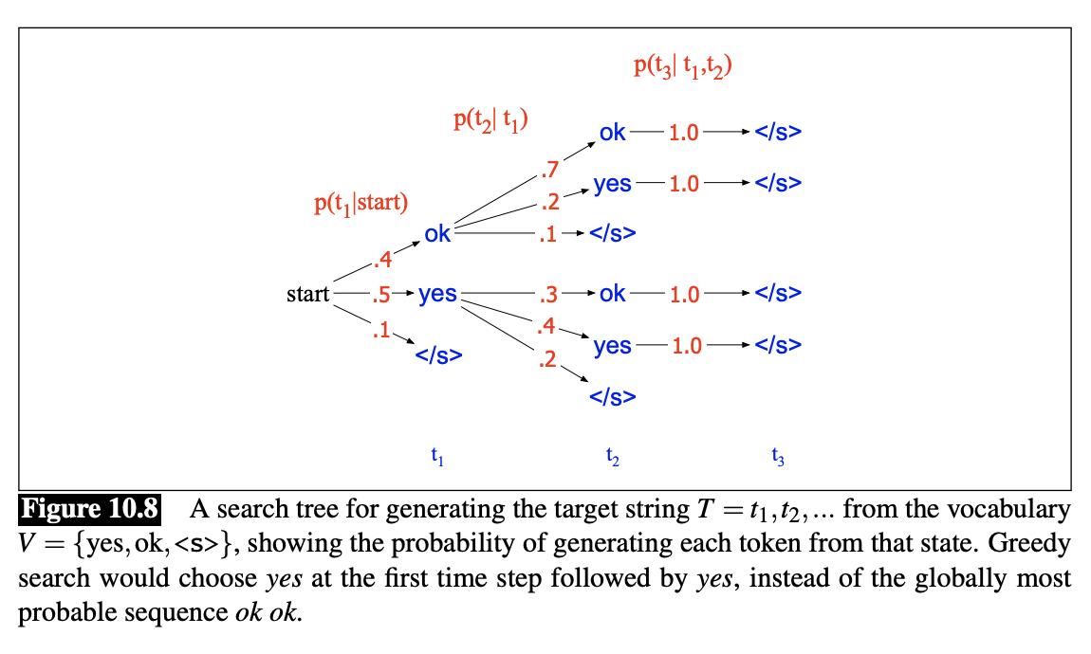
Language Generation
How to sample the most probable path from softmax probabilities?
Greedy
Beam search
Illustration from https://web.stanford.edu/~jurafsky/slp3/10.pdf

Slide 48
Language Generation
Most probable path is too deterministic
Top-K sampling
Nucleus sampling

Slide 49
Agenda for Today
Deep dive of “Nonlinear layers”
Recurrent Neural Network (RNN)
Architectures
Transformer
Transformer Language Models
Representations in Transformer

Slide 50
The representations occupy a small cone

Slide 51
Similarity between Attention Heads
Consecutive layers are similar
Some heads are similar
Motivates pruning of attention heads
Image from https://aclanthology.org/2021.naacl-main.72.pdf

Slide 52
Similarities between Published Models
Image from https://proceedings.neurips.cc/paper_files/paper/2021/file/a1c3ae6c49a89d92aef2d423dadb477f-Paper.pdf

Slide 53
Bilingual Lexicon Induction Revisited
Source embedding $X∈ℝ^{n×d}$, target embedding $Y∈ℝ^{n×d}$
Learn a rotation matrix $R∈ℝ^{d×d},RR^{T}=I$
Procrustes problem
$$\min_{R:RR^{T}=I}{{\left\|XR−Y\right\|}^{2}}$$
We can show it’s equivalent to solving
$$\max_{R:RR^{T}=I}\left\langle R,Y^{T}X\right\rangle$$
Let the SVD of $Y^{T}X=UΛV^{T}$, then optimum $R^{∗}=UV^{T}$

