Slide 1
CS6120
Jiaji Huang
https://jiaji-huang.github.io

Slide 2
About myself
PhD in electrical engineering from Duke University
Thesis: statistical signal processing and machine learning
Worked at Baidu Research on NLP and Speech
Now at AWS, on Large Language Models

Slide 3
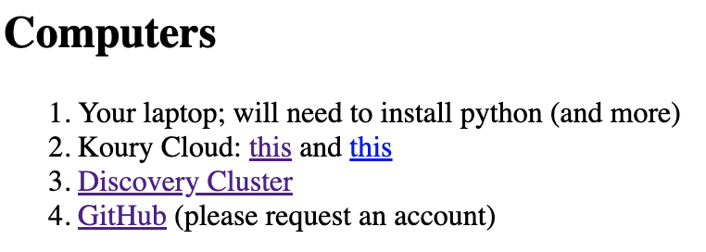
Announcement
Discovery Cluster ready
Check the 3rd link on syllabus

Slide 4
Motivating Task: Positive or Negative Reivew?
Example from slides of last term

Slide 5
A Machine Learning Approach
Feature extraction
0.5
-1.2
2.5
👍
1.8
2.2
-2.0
⋮
⋮
classifier
⋮
👎
documents
Representations

Slide 6
How to build the pipeline
this lecture
Classical:
Hand crafted features,
e.g., bag of words (NLP), sift (computer vision), MEL filter banks (speech)
Learn the classifier on training features
Modern:
End-to-end Learn a (deep) network that extracts feature together with a classifier
Cutting-edge
Pretrain + (supervised) finetune + RLHF + task specific adaptation
Amount of Resources

Slide 7
Roadmap
Document representation (classical)
Bag of words
tf-idf
Word representation (modern)
Word2vec and PMI
Applications
Classifier
Naïve Bayesian classifier
Softmax classifier

Slide 8
Roadmap
Document representation (classical)
Bag of words
tf-idf
Word representation (modern)
Word2vec and PMI
Applications
Classifier
Naïve Bayesian classifier
Softmax classifier

Slide 9
https://web.stanford.edu/~jurafsky/slp3/slides/7_NB.pdf

Slide 10
tf-idf
Words have different importances, overlooked by simple count
tf: term frequency (multiple ways to define)
$${tf}_{t,d}=\frac{count(t,d)}{\sum_{t}{count(t,d)}}$$
$${tf}_{t,d}=\log{[1+count(t,d)]}$$
idf: inverse document frequency
$${idf}_{t}=\log\left(\frac{\# total docs}{\#docs that have term t}\right)$$
tf-idf for word $t$ in document $d$: ${tf}_{t,d}×{idf}_{t}$

Slide 11
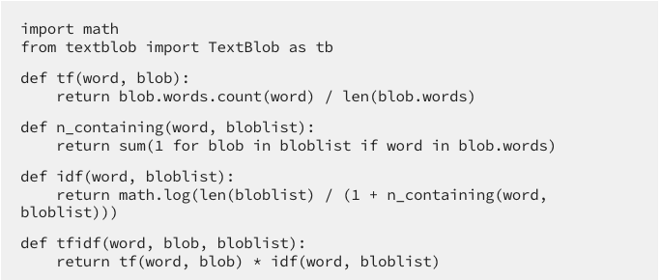
Implementation*
Showing a python demo …
* Example is taken from here

Slide 12
Brain storming
Ways to improve bag of words representation?
Word order information: counts of tuple of n words (n-gram)
tf is unigram probability in document
For “new” word: sub-word counts
More efficient: dimension reduction, PCA etc…
…

Slide 13
Dimension Reduction
For i=1, …, reduced_dimension:
Find next orthogonal direction with biggest variance
Project feature to this direction
Easily solved by singular value decomposition (SVD)
samples
directions
SVD
features
projections

Slide 14
Roadmap
Document representation (classical)
Bag of words
tf-idf
Word representation (modern)
Word2vec and PMI
Applications
Classifier
Naïve Bayesian classifier
Softmax classifier

Slide 15
Word representation
Endow each word a vector
Most naïve way: one-hot vector, length equal to vocab size
A better way, ensure
Similar words are “nearby in semantic space”

Slide 16
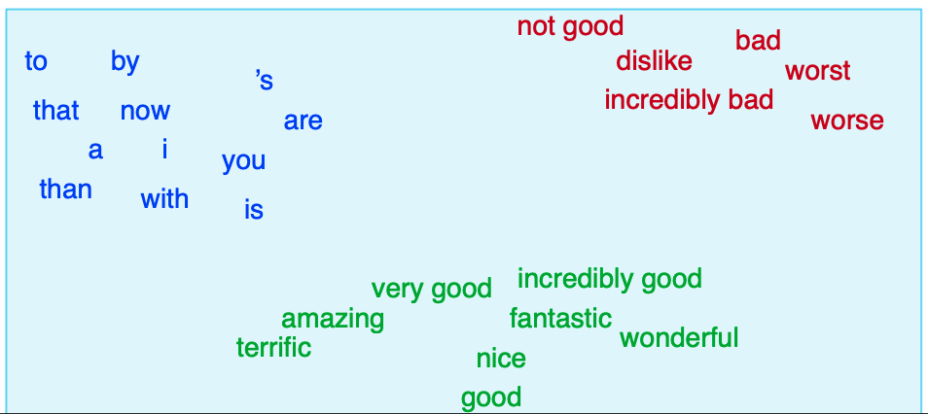
Word representation
Aka “word embedding”, as it’s embedded into a space
Why represent them as vectors?

Slide 17
One use case: Word Analogy
Allows us to use linear algebra
Man to woman is like king to ?
woman
?
man
king
man – woman = king - ?
? = king – man + woman
Take ? as the nearest neighbor of RHS

Slide 18
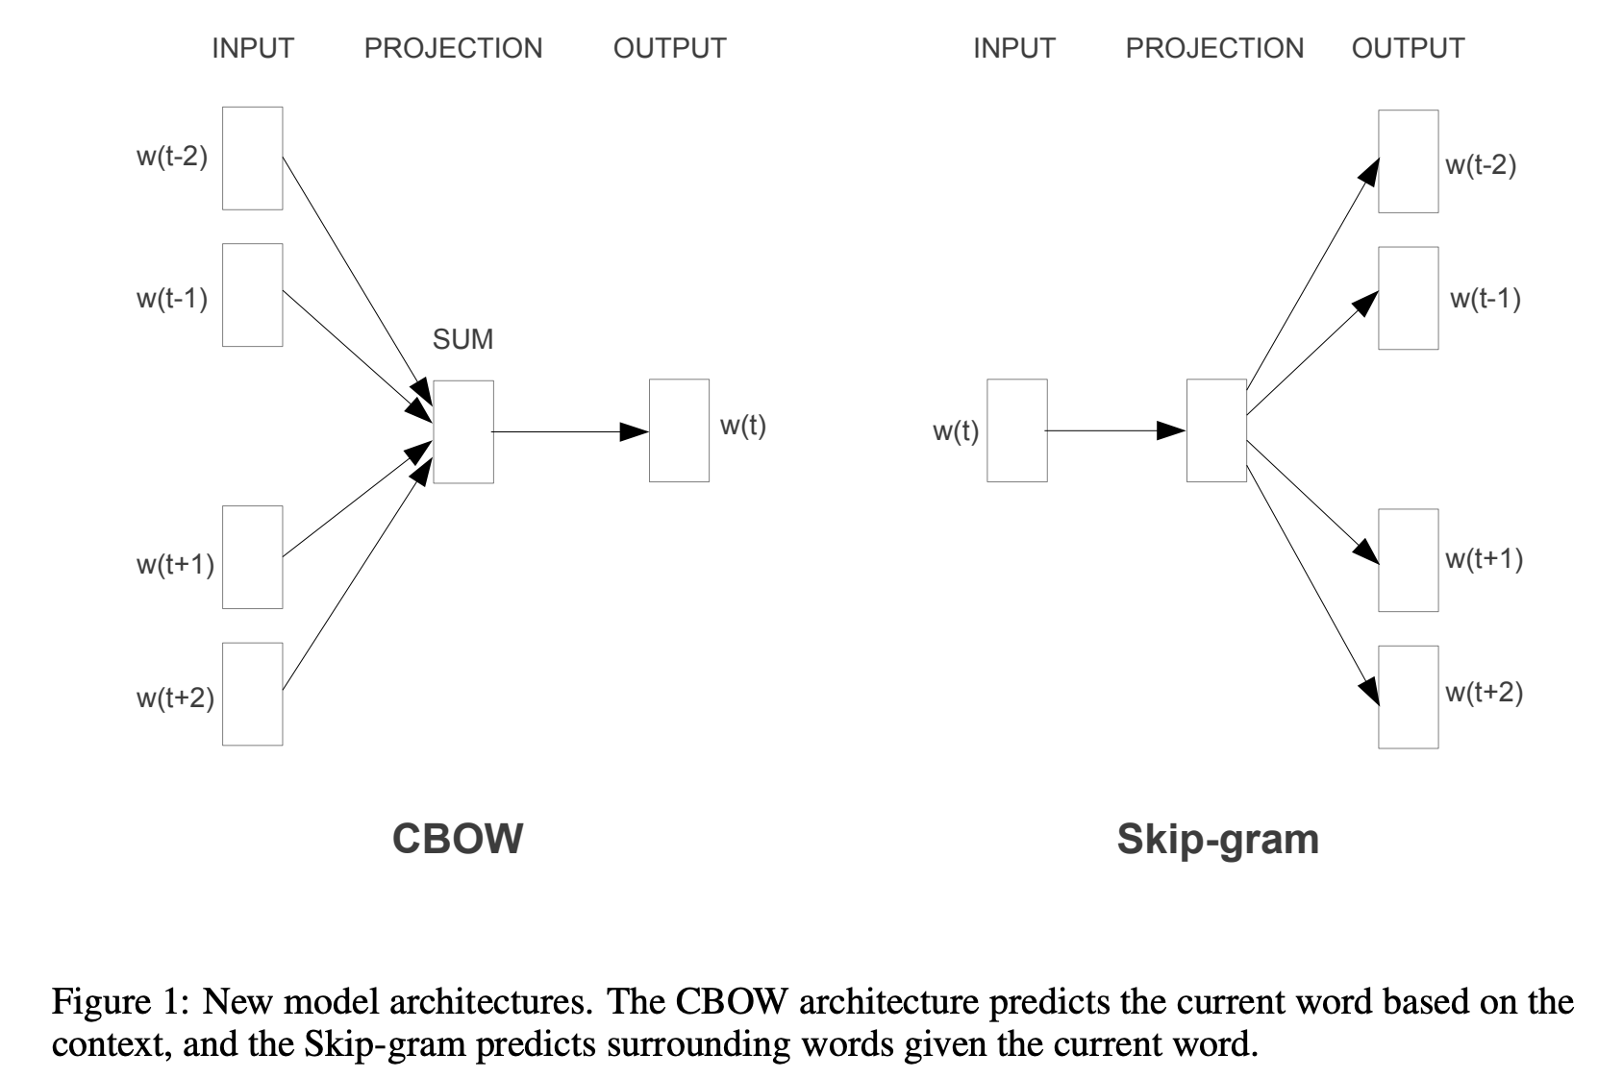
word2vec

Slide 19
Deep dive into skip-gram
How do we train it? Suppose a window size of 2
Figure taken from blogpost

Slide 20
Deep dive into skip-gram
Viewed as 2-layer network
e.g., receive a training sample (x=the, y=quick)
the
the
P(y=the)
the
P(y=fox)
fox
fox
$$⋮$$
$$⋮$$
quick
quick
P(y=quick)
Maximize it
$$W$$
$$C$$
$$\left(s_{1},..,s_{n}\right)=\left(\frac{e^{s_{1}}}{\sum_{i=1}^{n}{s_{i}}}, …, \frac{e^{s_{n}}}{\sum_{i=1}^{n}{s_{i}}}\right)$$
Look-up embedding layer
Linear layer
softmax

Slide 21
Why softmax here
The outputs after linear layer are not probabilities
i.e., they don’t add to 1
Softmax converts them to probabilities
e.g., consider
$$[s_{1},…, s_{6}]=[\text{0.6,} \text{1.1,}\text{ −}\text{1.5,} \text{1.2,} \text{3.2,}\text{ −}\text{1.1}]$$
$$softmax\left(s_{1},…, s_{6}\right)=\left[\frac{e^{s_{1}}}{\sum_{i=1}^{6}{s_{i}}}, …, \frac{e^{s_{6}}}{\sum_{i=1}^{6}{s_{i}}}\right]=\text{[0.055,0.090,0.0067,0.10,0.74,0.010]}$$
We will revisit this later

Slide 22
Deep dive into skip-gram
The overall training objective is
$$\min_{Θ}{\sum_{x,y}{−\log{p_{Θ}(y|x)}}}$$
where $Θ$ are parameters in the network
Typically, we use $W$ as word representation
Trained by stochastic gradient descent (SGD)
Details in last part of this lecture!

Slide 23
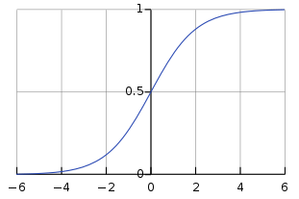
skip-gram with negative sampling
Vocab can be huge
huge summation on softmax denominator!
An efficient variant: contrast with negative samples
P(x and y co-occur) = $σ\left(W_{x}^{T}C_{y}\right)$,
where $σ\left(s\right)=\frac{1}{1+e^{−s}}$ , sigmoid function
Will revisit this later

Slide 24
skip-gram with negative sampling
Denote negative samples as $y_{i}, i=1,…,k$ from $q(y)$
Maximize:
$$\log{σ\left(W_{x}^{T}C_{y}\right)+\sum_{i=1}^{k}{\left[\log{σ\left(−W_{x}^{T}C_{y_{i}}\right)}\right]}}$$
In practice, $q(y)$ is uni-gram probability
Is this a good approximation for softmax?

Slide 25
Packages
native c implementation
handy python package: genism, fastText, …

Slide 26
Why so successful
See Prof. Church’s opinion piece
A few initial successes
Plenty of room to improve
Publish code and data

Slide 27
PMI
The PMI (point wise mutual information) between two words $w_{1}$, $w_{2}$
$$PMI(w_{1};w_{2})≜\log_{2}{\frac{p(w_{1},w_{2})}{p\left(w_{1}\right)p(w_{2})}=\log_{2}{\frac{p(w_{1}|w_{2})}{p(w_{1})}}}$$
Consider $w_{2}$ as context word
2D count table
$$w_{2}$$
$$w_{1}$$

Slide 28
PMI
$$w_{2}$$
$$w_{1}$$
$p\left(w_{1}\right)=\frac{count(w_{1})}{\sum_{w_{1}}{counts(w_{1})}}$
$p\left(w_{1},w_{2}\right)=\frac{count({w_{1},w}_{2})}{\sum_{w_{1},w_{2}}{count(w_{1},w_{2})}}$
Practically: How associated are two words?

Slide 29
Positive PMI
PMI ranges from $−∞$ to $+∞$
Negative values are problematic as
Unreliable without enormous corpora
Suppose w1 and w2 each occur with probability ${10}^{−6}$
Hard to be sure $p(w1, w2)$ is significantly different than ${10}^{−12}$
So we just replace negative PMI with 0
$$PPMI(w_{1};w_{2})=\max{(PMI\left(w_{1};w_{2}\right), 0)}$$

Slide 30
Example
$$w_{2}$$
$$w_{1}$$
$$p\left(w_{1}=information,w_{2}=data\right)=\frac{3982}{111716}=0.3399$$
$$p\left(w_{1}=information\right)=\frac{7703}{11716}=0.6575$$
$$p\left(w_{2}=data\right)=\frac{5673}{11716}=0.4842$$
$$PMI\left(information, data\right)=\log_{2}{\frac{0.3399}{0.6575×0.4842}=0.0944}$$

Slide 31
Example

Slide 32
Connections
Do some math on whiteboard …

Slide 33
Generalize: *2vec
Create pairwise associations between entities, call it matrix $M$
Then factorize $M$!

Slide 34
Measure word similarity with embeddings
Dot product
$$v^{T}w=\sum_{i=1}^{d}{v_{i}w_{i}}$$
Big if their angle is small
But also favors long vectors, i.e., $\left\|v\right\|=\sum_{i=1}^{d}{v_{i}^{2}}$ big
Frequent words have long vectors (why so?)

Slide 35
Measure word similarity with embeddings
Normalize by length
$$\cos\left(v, w\right)=\frac{v^{T}w}{\left\|v\right\|\left\|w\right\|}$$

Slide 36
Application: Bilingual Lexicon Induction (BLI)
Translate words without aligned bilingual text
Introduce some “anchors”
dos (two)
boat
Barco (boat)
three
car
coche (car)
tres (three)
plane
avión (plane)
bike
uno (one)
two
bicicleta (bike)
one
when
cuando (when)
how
what
qué (what)
cómo (how)

Slide 37
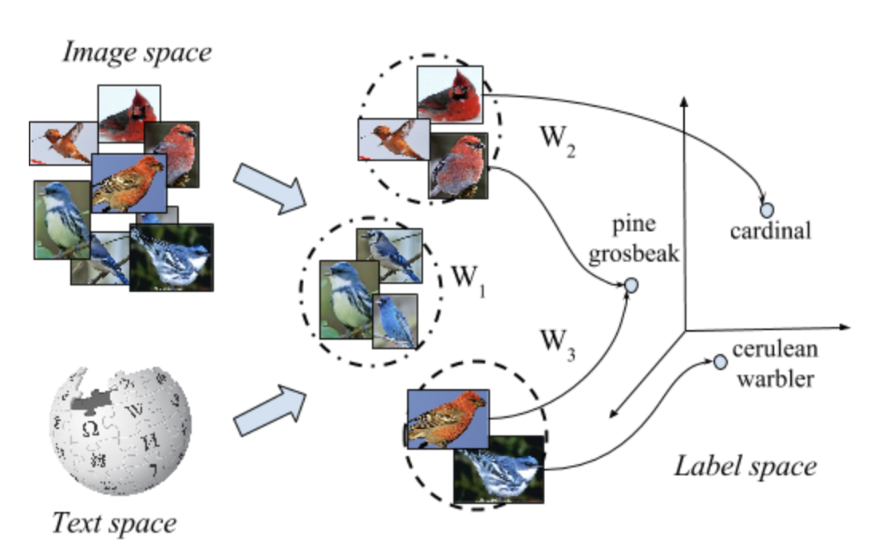
Application: Bilingual Lexicon Induction (BLI)
English anchors: $X=[x_{1},…x_{n}]$, Spanish anchors: $Y=[y_{1},…y_{n}]$
Learn a rotation matrix $R$ that aligns them
$$\min_{R}{{\left\|RX−Y\right\|}^{2}}$$
Nearest neighbor search for $Rx$ in the space of $y$’s
Extension: zero-shot learning
Image taken from here

Slide 38
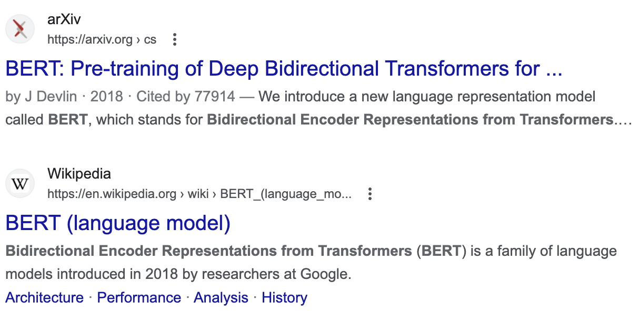
Connection with BERT
Masked Language modeling
Randomly mask some word
Ask to predict based on context words, e.g.
The [mask] brown fox [mask] over [mask] lazy dog

Slide 39
Connection with BERT
The BERT architecture
the
the
P(y=the)
The [mask] brown fox
[mask]
P(y=fox)
fox
fox
$$⋮$$
$$⋮$$
quick
Transformer
quick
P(y=quick)
brown
[mask]
Maximize it
Look-up embedding layer
Linear layer
softmax

Slide 40
Roadmap
Document representation (classical)
Bag of words
tf-idf
Word representation (modern)
Word2vec and PMI
Applications
Classifier
Naïve Bayesian classifier
Softmax classifier

Slide 41
Naïve Bayesian Classifier
Feature $f∈ℝ^{d}$, label $y∈\{1,..,c\}$. Invoke Bayesian rule:
$p\left(y | f\right)=\frac{p\left(y\right)p(f|y)}{p(f)}$
Only interested in denominator
Assume conditional independence among feature dimensions
$$p(y|f)∝p(y)\prod_{i}{p(f_{i}|y)}$$
likelihood
prior
Parameterized, e.g., Gaussian, multinomial

Slide 42
Start Slides from Last term
Caveat: notation inconsistency, but we will explain

Slide 43
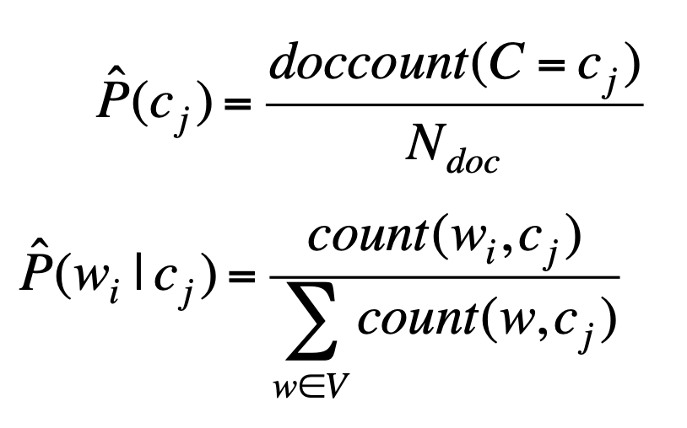
Training NBC for document classification
Maximum Likelihood Estimates: just use the frequencies in the training set
To calculate count(w_{i}, c_{j}): concatenate all documents in class c into a mega-document and use the frequencies in that mega-document

Slide 44
https://web.stanford.edu/~jurafsky/slp3/slides/7_NB.pdf

Slide 45
https://web.stanford.edu/~jurafsky/slp3/slides/7_NB.pdf

Slide 46
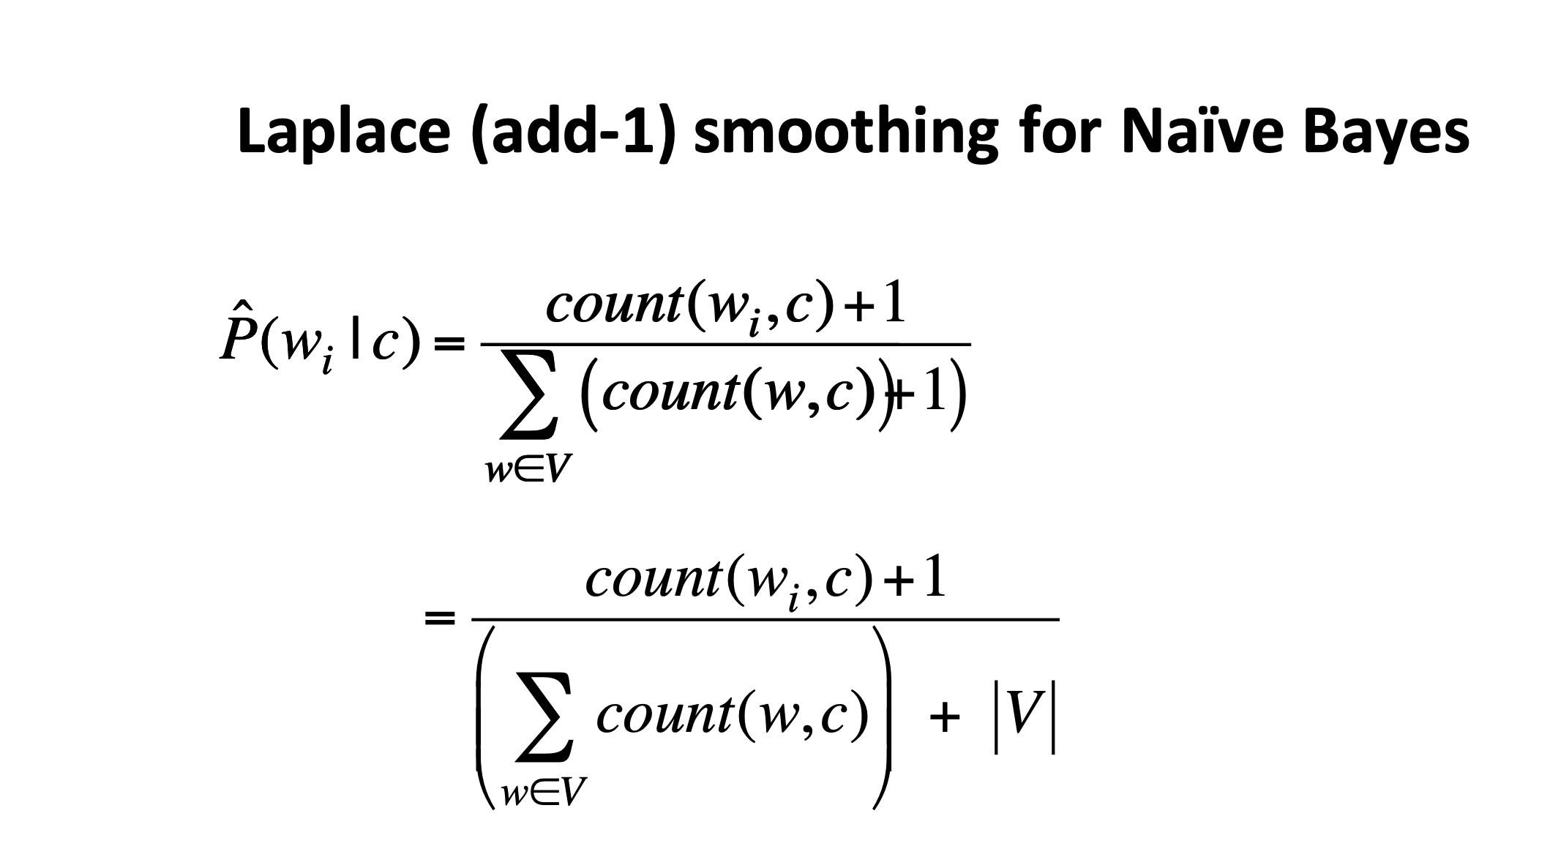
https://web.stanford.edu/~jurafsky/slp3/slides/7_NB.pdf

Slide 47
https://web.stanford.edu/~jurafsky/slp3/slides/7_NB.pdf

Slide 48
https://web.stanford.edu/~jurafsky/slp3/slides/7_NB.pdf

Slide 49
https://web.stanford.edu/~jurafsky/slp3/slides/7_NB.pdf

Slide 50
End Slides from Last term

Slide 51
Questions
How did we parameterize the likelihood?
Multinomial
How about tf-idf?
Sure, just replace word count with it
Packages? Sklearn
…

Slide 52
Binary Classification
Positive v.s. negative reviews
Feature $f∈ℝ^{d}$, label $y∈\left\{0, 1\right\}$
Come up with $P(Y=1|f)$ or $P\left(Y=0 | f\right)=1−P(Y=1|f)$

Slide 53
Logistic Regression
Logit (raw score) $s=α^{T}f+β$, where $α∈ℝ^{d}$, $β∈ℝ$
$p\left(Y=1|f\right)=σ\left(s\right)=\frac{1}{1+e^{−s}}$ (sigmoid function)
$p\left(Y=0|f\right)=1−σ\left(s\right)=σ(−s)$
Training loss
$$\min_{α, β}{\sum_{(f,y)}{−\log{p(Y=y|f)}}}$$
Note: more compact way is to define
$\tilde{f}=[f;1]$, and $\tilde{α}=[α;β]$
Then $s=α^{T}f+β={\tilde{α}}^{T}\tilde{f}$

Slide 54
Generalize to Multi-class
Sentiment classification: Excellent / Good / fair / poor / terrible
POS tagging: noun / verb/ adjective / …
Multinomial logistic regression
Aka softmax classifer

Slide 55
Softmax classifier
Feature $f∈ℝ^{d}$, label $y∈\{1,..,c\}$
Linear layer $A=[a_{1},…,a_{c}]$to be learned
Logits (raw scores) $s_{i}=a_{i}^{T}f$
Probabilities $p_{i}(f)=\frac{e^{s_{i}}}{\sum_{j=1}^{c}{e^{s_{j}}}}$
Loss function:
$$\min_{A}{\frac{1}{\#training samples}\sum_{(f,y)}{\left\{ℓ(f,y)≜−\log{p_{y}(f)}\right\}}}$$

Slide 56
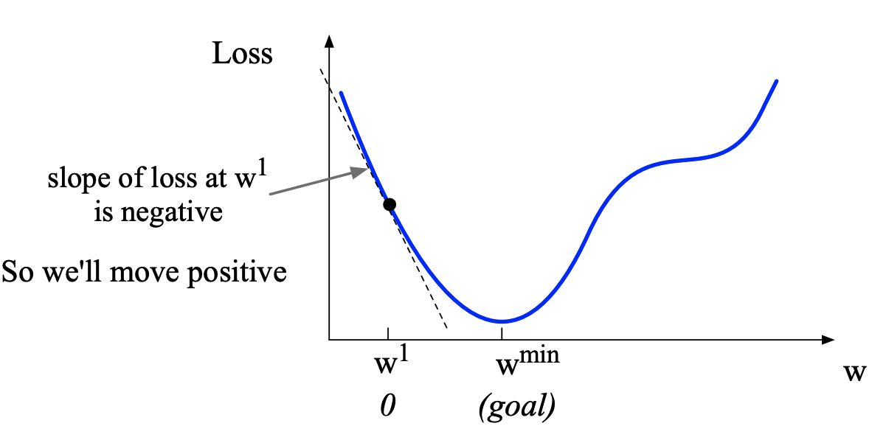
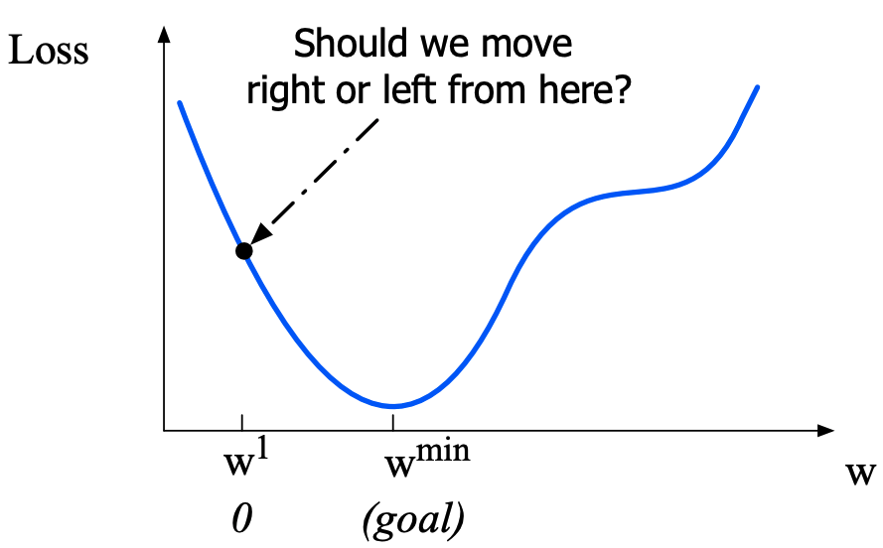
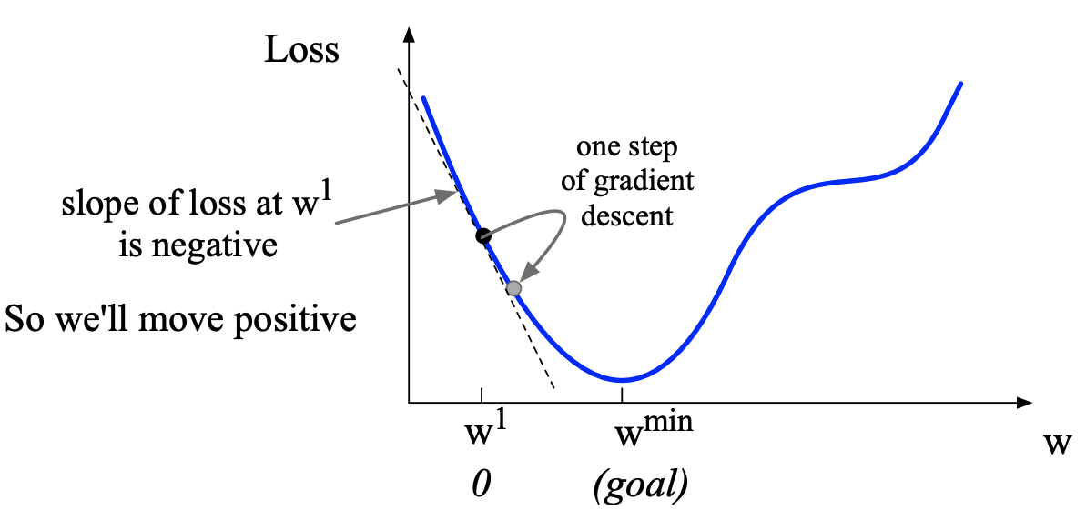
Gradient Solver
Gradient Descent, Consider 1D case
Image from Stanford NLP class slides

Slide 57
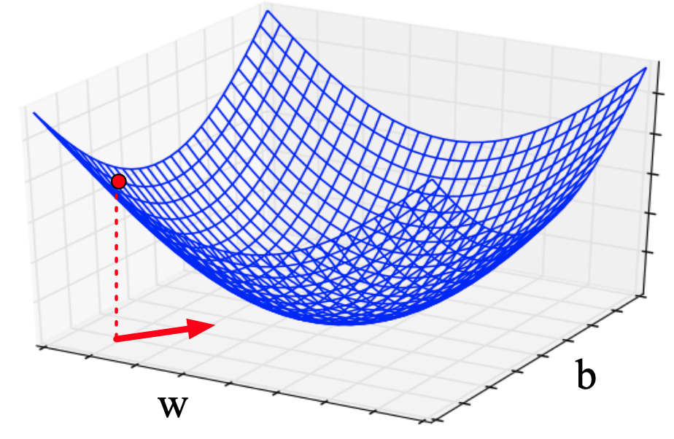
Gradient Solver
A loss function defined on $ℝ^{d}$
Gradient is a vector of $ℝ^{d}$, greatest increase of the function value
So move along the opposite direction by some stepsize
E.g., 2D

Slide 58
Stochastic Gradient Solver
Many loss function are of the form
$$\min_{θ}{\frac{1}{n}\sum_{i=1}^{n}{ℓ(x_{i},θ)}}$$
Stochastic gradient descent (SGD):
Sample an $x_{i}$ each time, move along $−\frac{∂ℓ(x_{i}, θ)}{∂θ}$
Minibatch SGD:
Sample a batch of $x_{i}$’s each time, move along $−\frac{1}{\left|ℬ\right|}\sum_{x_{i}∈ℬ}{\frac{∂ℓ(x_{i}, θ)}{∂θ}}$

Slide 59
Softmax classifier
Search optimal $A$ by Stochastic Gradient Descent (SGD)
Derive gradient due to a sample $(f, y)$
$$\frac{∂ℓ(f,y)}{∂a_{i}}=\frac{∂}{∂a_{i}}\left\{\log{\sum_{j=1}^{c}{e^{s_{j}}}}−s_{y}\right\}=\left\{\begin{aligned}{(p}_{y}−1)f&, i=y \\ p_{i}f, i≠y\end{aligned}\right.$$
Initialize $A$ randomly
While stopping criteria not met:
sample a batch of $(f,y)$’s, call the batch $ℬ$
$a_{i}−=γ∙\sum_{(f,y)∈ℬ}{\frac{∂ℓ(f,y)}{∂a_{i}}}$ for $i=1,…,c$

Slide 60
Questions
Does initialization matter?
No (because of convexity)
How do we choose batch size?
Trade-off between memory cost and time to convergence
What if $f$ also needs to be learned?
chain rule (pytorch excels)
What if $c$ huge?
...

Slide 61
Generalize
Generally, we can write
$$ℓ\left(f,y;θ\right)=−s_{y}(θ)+\log{\sum_{j=1}^{c}{e^{s_{j}(θ)}}}$$
$$\frac{∂ℓ}{∂θ}=−∇s_{y}(θ)+\sum_{j=1}^{c}{p_{j}}∇s_{j}(θ)$$
$$p_{j}=\frac{e^{s_{j}}}{\sum_{j=1}^{c}{e^{s_{j}}}}$$
Costly if $c$ big

Slide 62
Sampled softmax
Approximate $\sum_{j=1}^{c}{p_{j}}∇s_{j}(θ)$ with
$$\sum_{j=1}^{c^{′}}{q_{j}∇s_{j}(θ)}, c^{′}<c$$
E.g., $q_{j}$: unigram probability
Speed up training, but not testing

Slide 63
Discussion
Strength and weakness of Naïve Bayesian v.s. softmax
Small data: Naïve Bayesian
Big data: softmax, integrates well with joint learning of features

Slide 64
Overfitting
Softmax classifier in small data regime
Typical learning curve trends:
train
train
loss
validation
loss
validation
Training iterations
Training iterations

Slide 65
Regularization
A solution for overfitting
Add a regularizer
$$\min_{A}{\sum_{(f,y)}{ℓ(f,y)}}+αR(A)$$
Usually, $R(A)$ encourages weights in $A$ to be small

Slide 66
Two typical $R(A)$’s
L2 regularization, aka ridge regression
$$R\left(A\right)={\left\|A\right\|}^{2}=\sum_{i,j}{A_{i,j}^{2}}$$
L1 regularization, aka lasso
$$R\left(A\right)={\left\|A\right\|}_{1}=\sum_{i,j}{\left|A_{i,j}\right|}$$

Slide 67
SGD with regularizers
Additional term to $\frac{∂ℓ}{∂a_{i}}$
L2 regularization: $R\left(A\right)={\left\|A\right\|}^{2}$
$$\frac{∂R(A)}{∂A_{i,j}}=2A_{i,j}$$
L1 regularization: $R\left(A\right)={\left\|A\right\|}_{1}$
$$\frac{∂R(A)}{∂A_{i,j}}=sign(A_{i,j})$$

Slide 68
Early stopping
train
Stop training around here
loss
validation
Training iterations

