Slide 1
CS6120
Kenneth Church
https://kwchurch.github.io

Slide 2
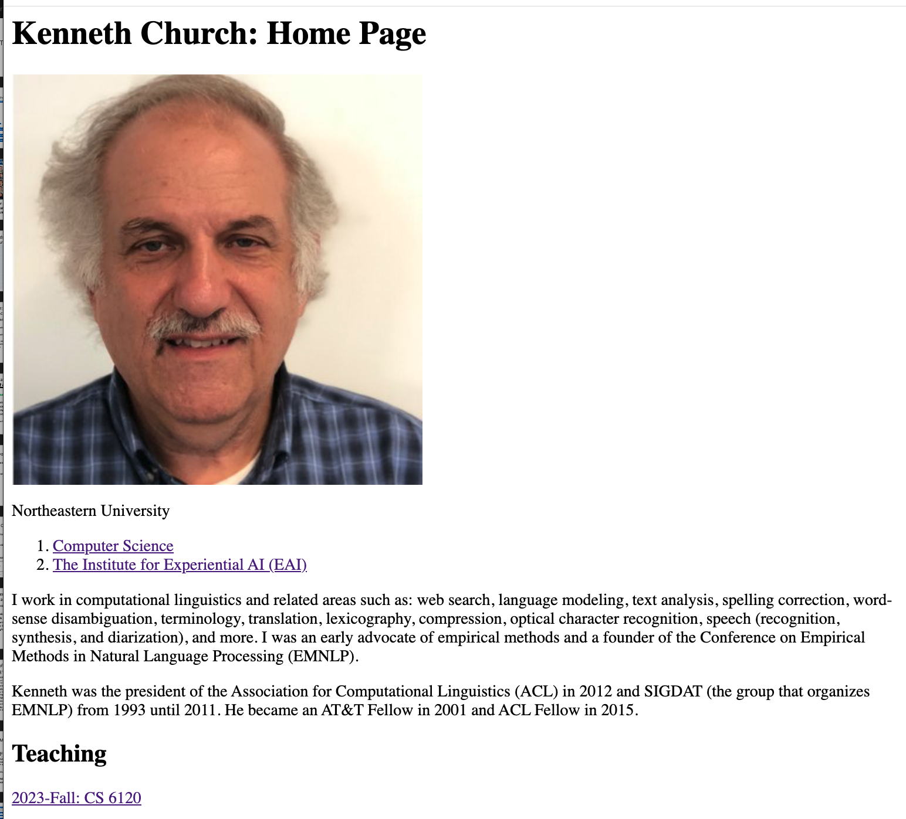
https://kwchurch.github.io

Slide 3
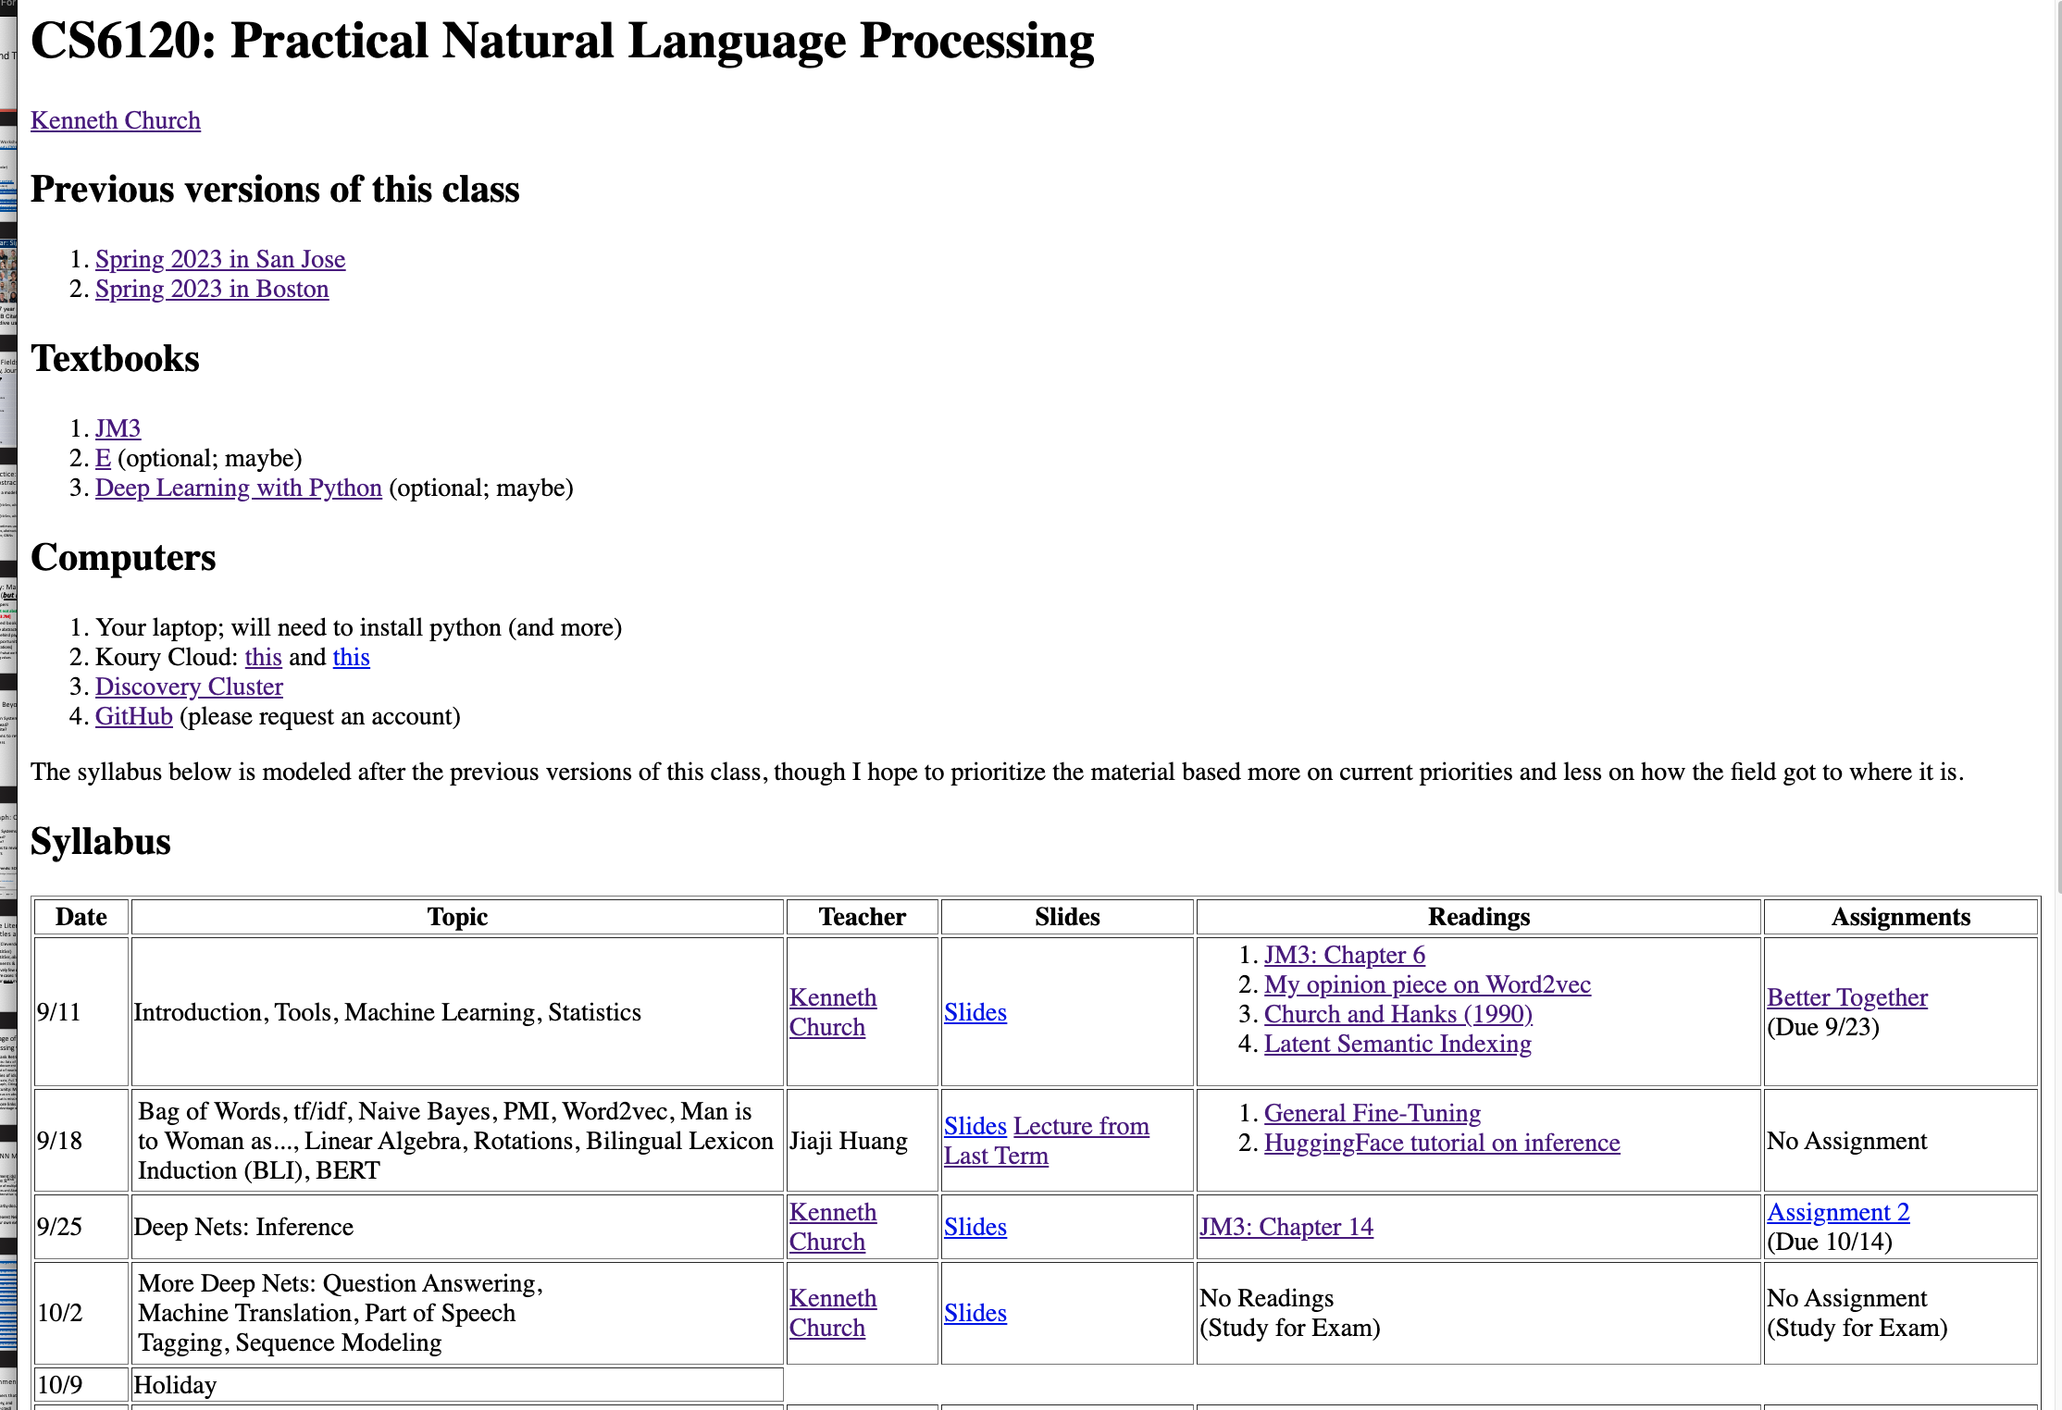

Slide 4
Goals for this class
Prioritize material based
  more on current priorities and
  less on how
    the field got to where it is
Start with what’s hot now
  Deep nets and Bots
End with
  Topics that may become great (again)
Success:
  Students have confidence that
    they can learn
      what you need to know
    just in time
      (when you need to know it)
  Learn to swim by
    jumping into deep end
      Won’t let you drown
      (but no spoon feeding)

Slide 5
Grading, Accessibility, Tardiness, Effort, etc.
Final Project:
  Encourage Team Efforts
  Proposal & Final Presentation
    Coding
    Written Presentation
    Oral Presentation
Mid-Term Exam
  Open book, computer, network
  If you can find a way to use ChatGPT to do the exam for you
    Shame on me!
Flipped Classroom
  Lectures → Recitations
  Homework → Readings/Lectures
  Assignments → Exercises
First Assignment → Calibration
  Expect wide range of backgrounds
  Don’t be discouraged if others find it too easy (and you don’t)
    I want to see effort/progress
    If they already know it
      They can’t learn it
Readings
  Intended to prepare for next class

Slide 6
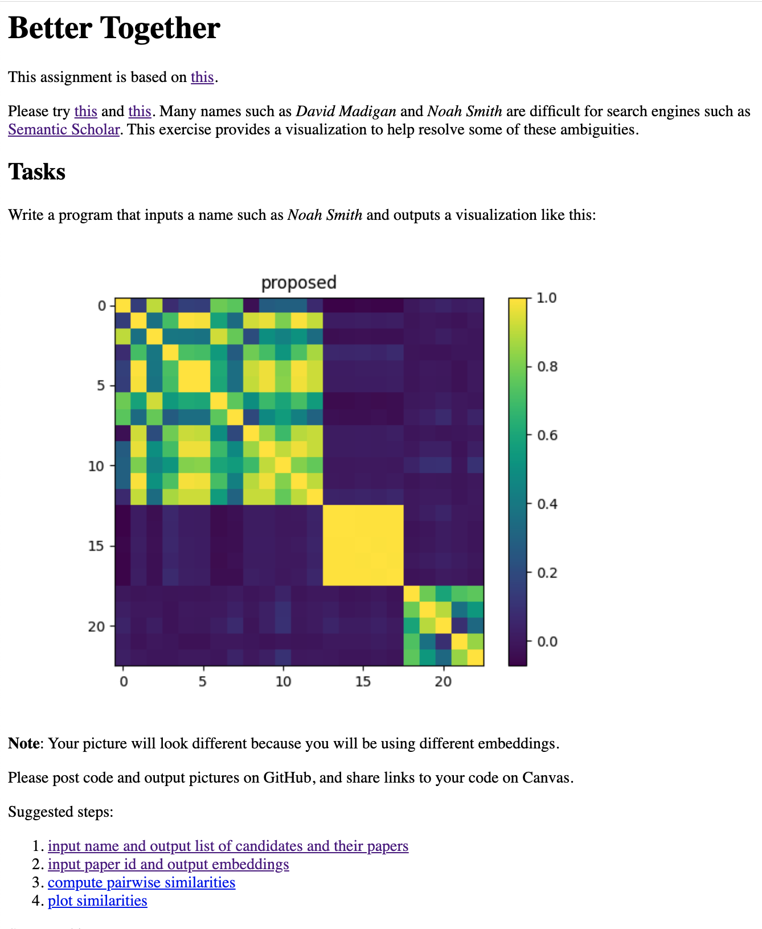
Better Together Homework
Purpose(s)
  Motivate
    What’s hot: deep nets, embeddings
    and what’s not: python, pip, etc.
  Calibration
    I’m clueless about…
  Avoid getting into details
    What is an embedding?
    What is a deep net?
  Little Languages
    Suggest that deep nets are like regression

Slide 7
Little Languages

Slide 8
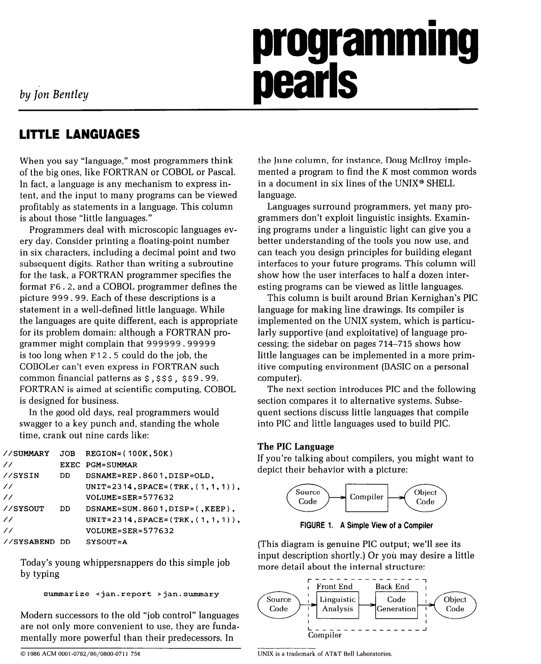
Little Languages (from Unix)
Bentley (CACM-1986)

Slide 9
We propose gft, a Little Language
In the good old days,
  real programmers would copy a few hundred lines of
    PyTorch from HuggingFace
  and modify as necessary to change
    models,
    datasets,
    task,
    etc.
With gft, 100s of lines → 1-line
  More accessible to masses
  (including non-programmers)

Slide 10
Standard 3-Step Recipe
Step | Description | Time | Hardware
1
2
3 | Inference (predict) | Seconds/Minutes | 0+ GPUs
Easy

Slide 11
Standard 3-Step Recipe
Most users should not do this themselves
Step | Description | Time | Hardware
1 | Pre-Training | Days/Weeks | Large GPU cluster
2
3 | Inference (predict) | Seconds/Minutes | 0+ GPUs

Slide 12
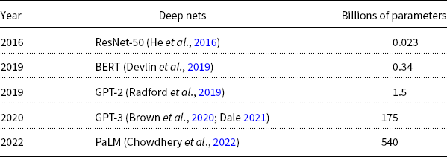
Hard:
Pre-Training Large Language Models (LLMs)
GPT-3
PaLM
GPT-2
BERT
ResNet
Most users should not invest in pretraining
because growth (& costs) are out of control

Slide 13
Standard 3-Step Recipe
Step | Description | Time | Hardware
1 | Pre-Training | Days/Weeks | Large GPU cluster
2 | Fine-Tuning (fit) | Hours/Days | 1+ GPUs
3 | Inference (predict) | Seconds/Minutes | 0+ GPUs
Not Hard

Slide 14

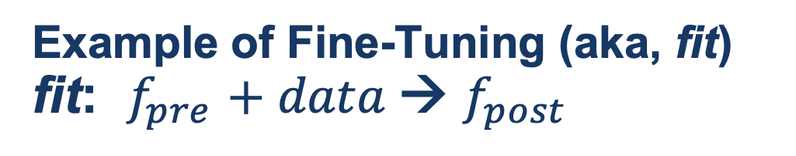
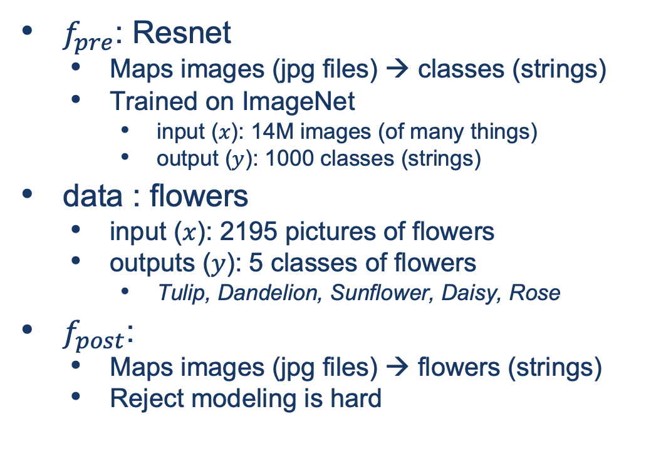
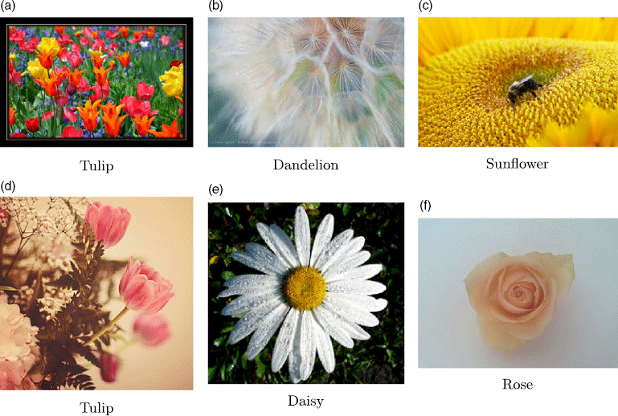
Guide Book App

Slide 15
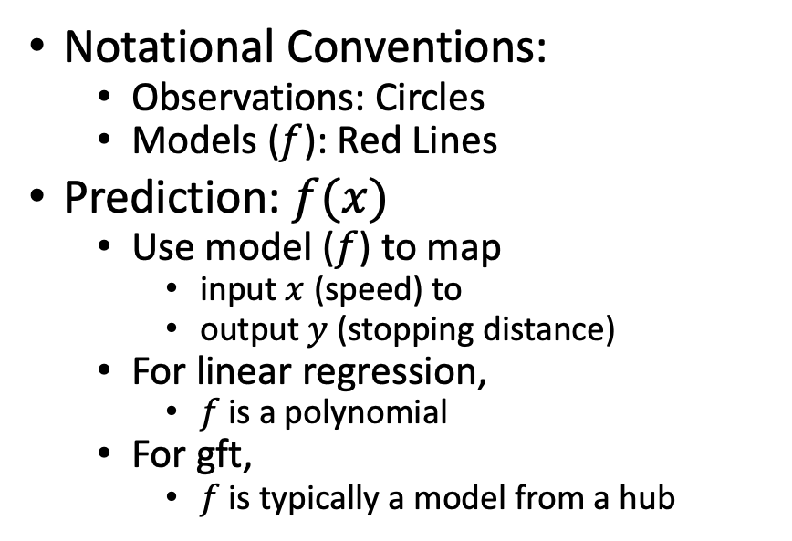
Fine-Tuning (Fit) in R (Statistics Package)
Make deep nets look like regression
(Not much programming)
Black Points:
cars dataset
Notational Conventions:
  Observations: Circles
  Models ($f$): Red Lines
Prediction: $f(x)$
  Use model ($f$) to map
    input $x$ (speed) to
    output $y$ (stopping distance)
  For linear regression,
    $f$is a polynomial
  For gft,
    $f$is typically a model from a hub
Red Line:
Model (f)

Slide 16
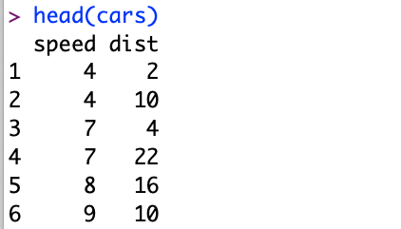
Datasets
Example: Cars
Two Columns:
cars$speed
cars$dist

Slide 17
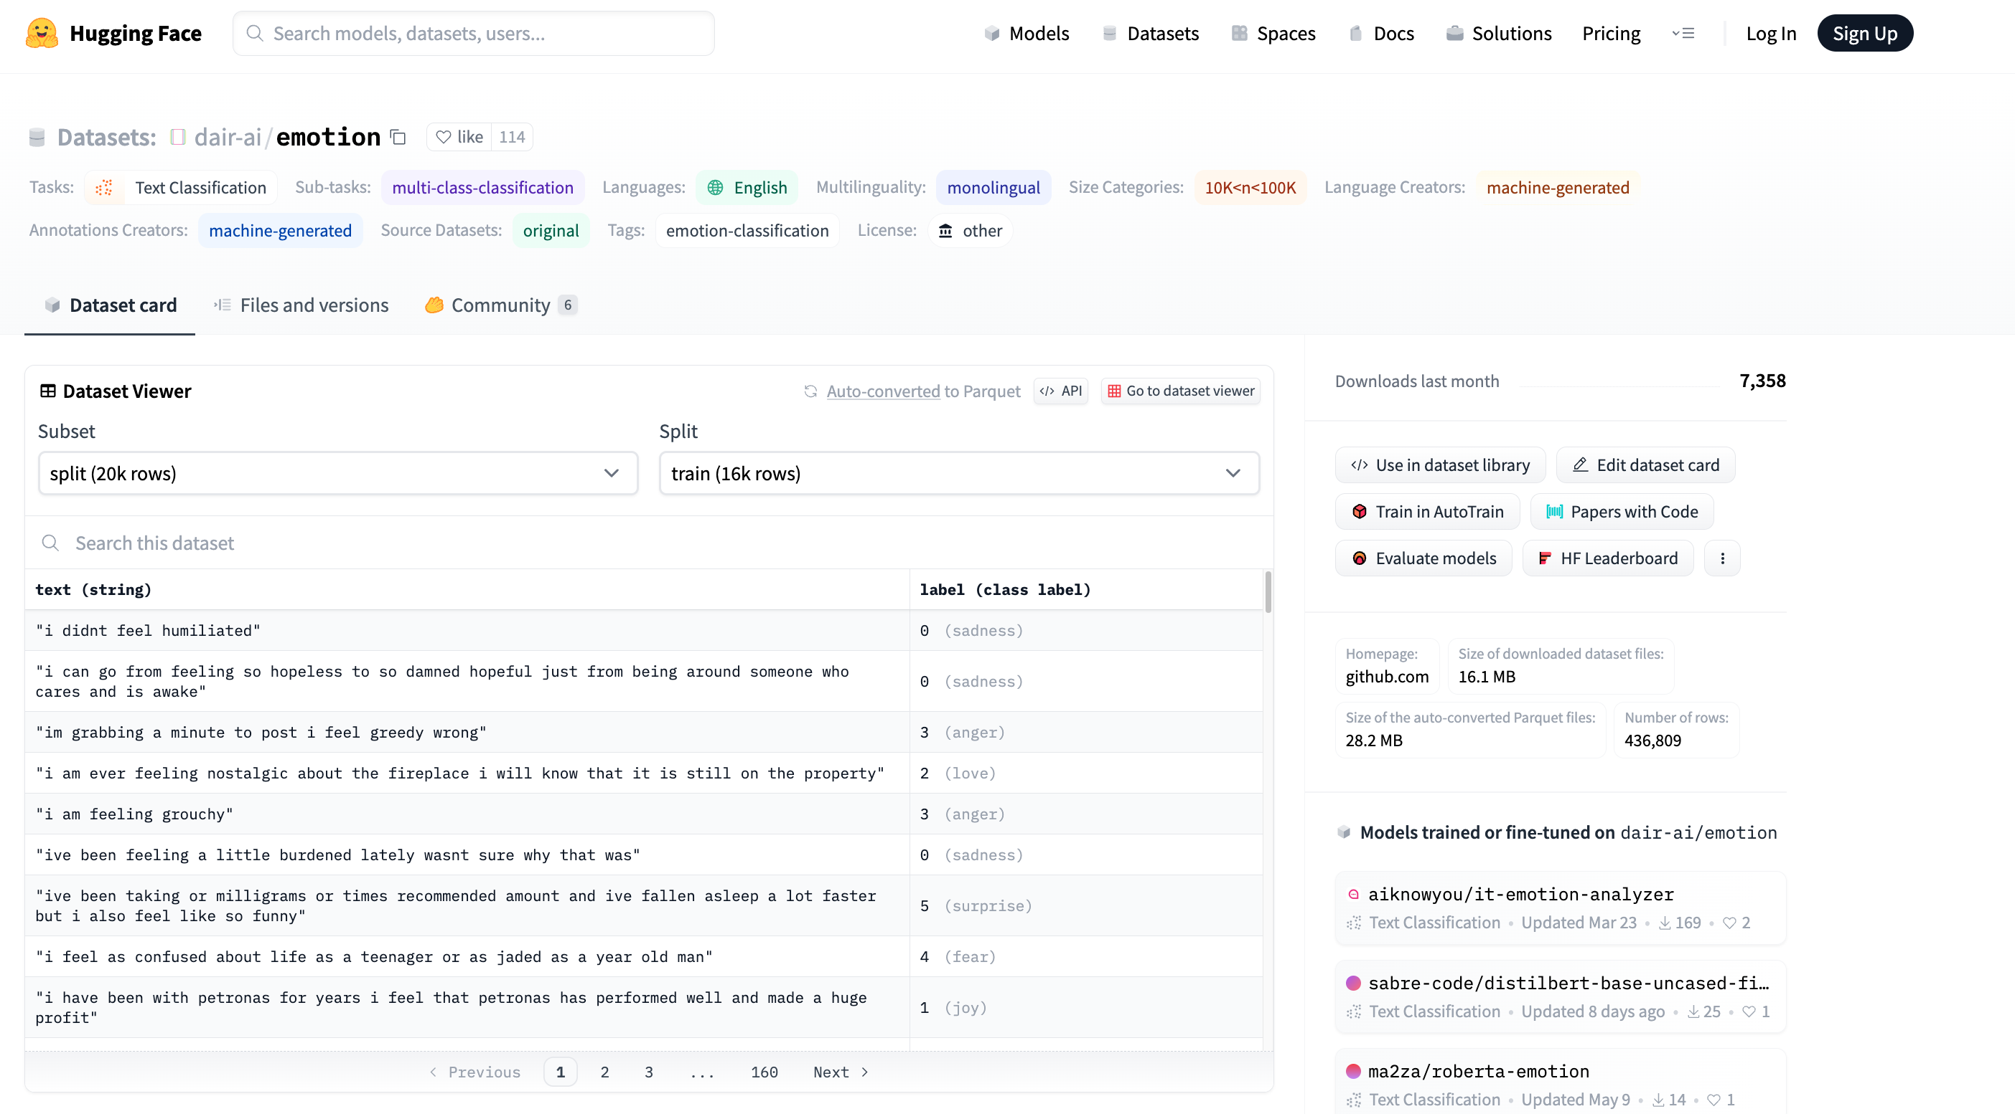


Example of Datasets in HuggingFace https://huggingface.co/datasets/dair-ai/emotion
$$x$$
$$y$$

Slide 18
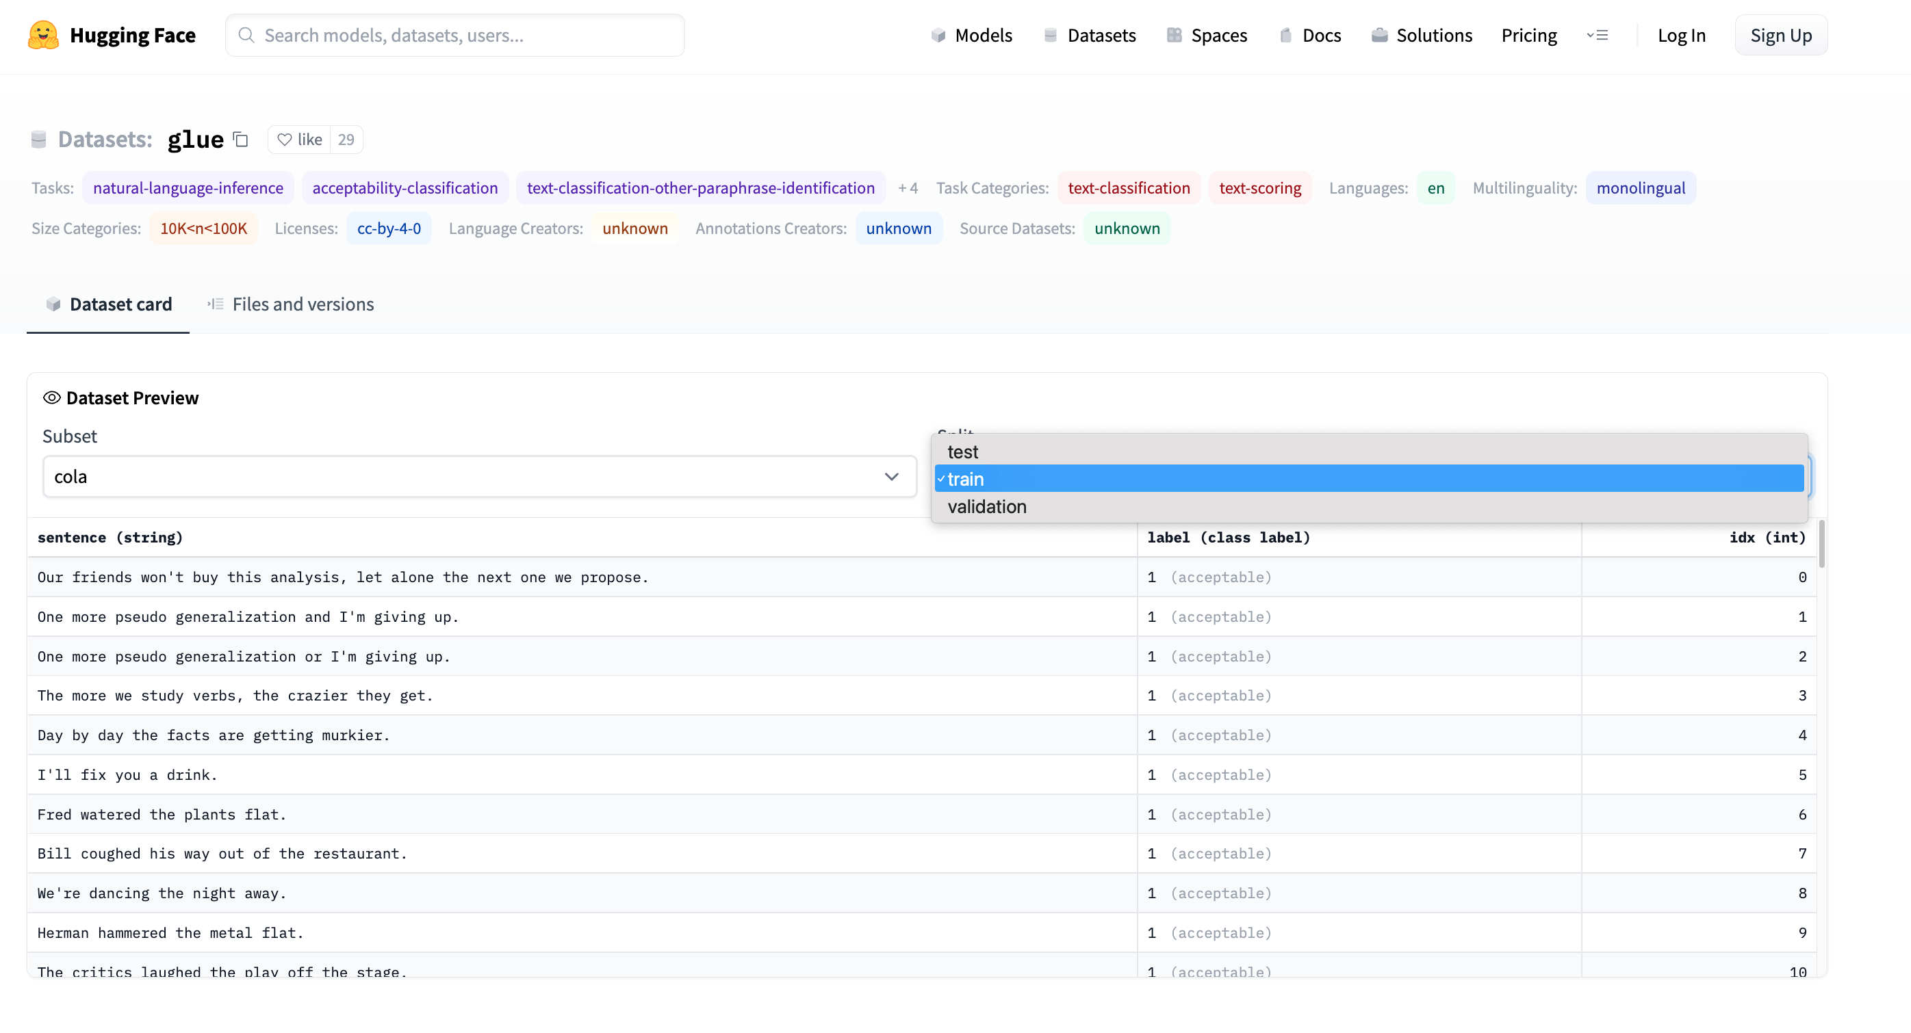
Emotion → GLUE (Cola) https://huggingface.co/datasets/glue/viewer/cola/train
Terminology: Splits
Terminology: Subset

Slide 19
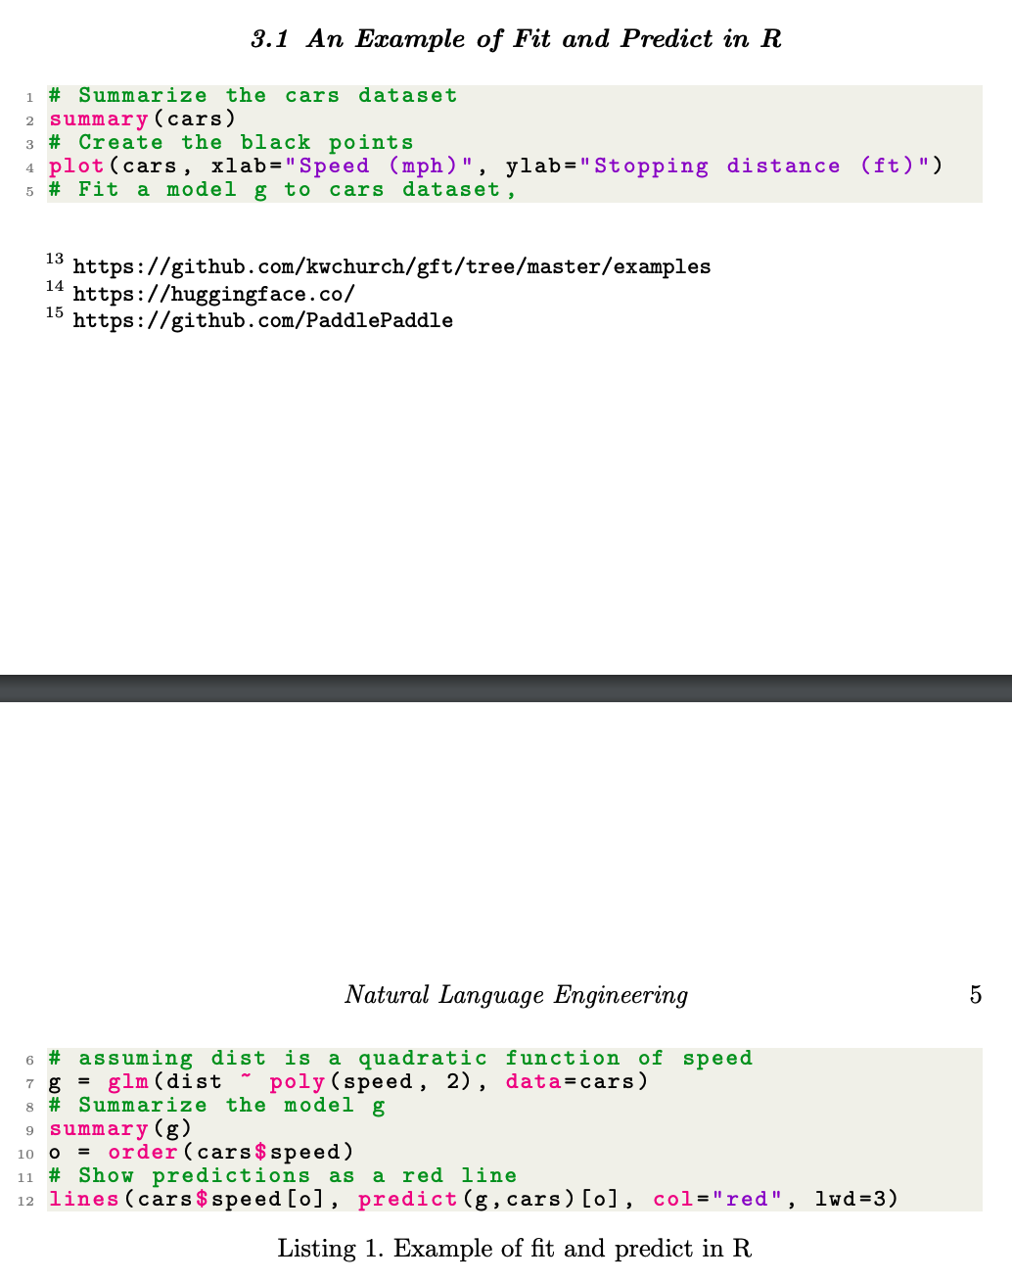
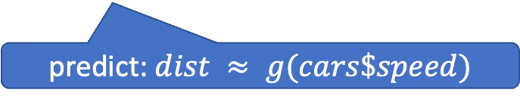
glm (General Linear Models) in R (and Sklearn)
glm: fit poly model with data
predict: $dist ≈ g(cars\$speed)$

Slide 20
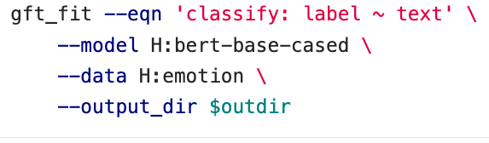

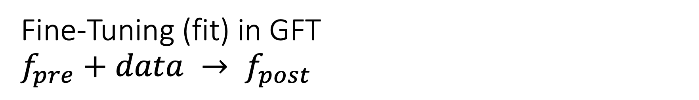
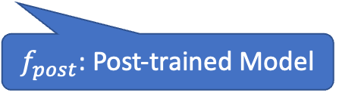
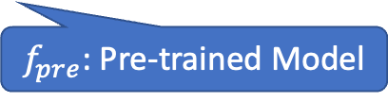
Fine-Tuning (fit) in GFT
$f_{pre}+data → f_{post}$
Flowers
  $f_{pre}$: Resnet
  $data:$flowers
$f_{pre}$: Pre-trained Model
$f_{post}$: Post-trained Model
Fine-Tuning (fit) in R

Slide 21
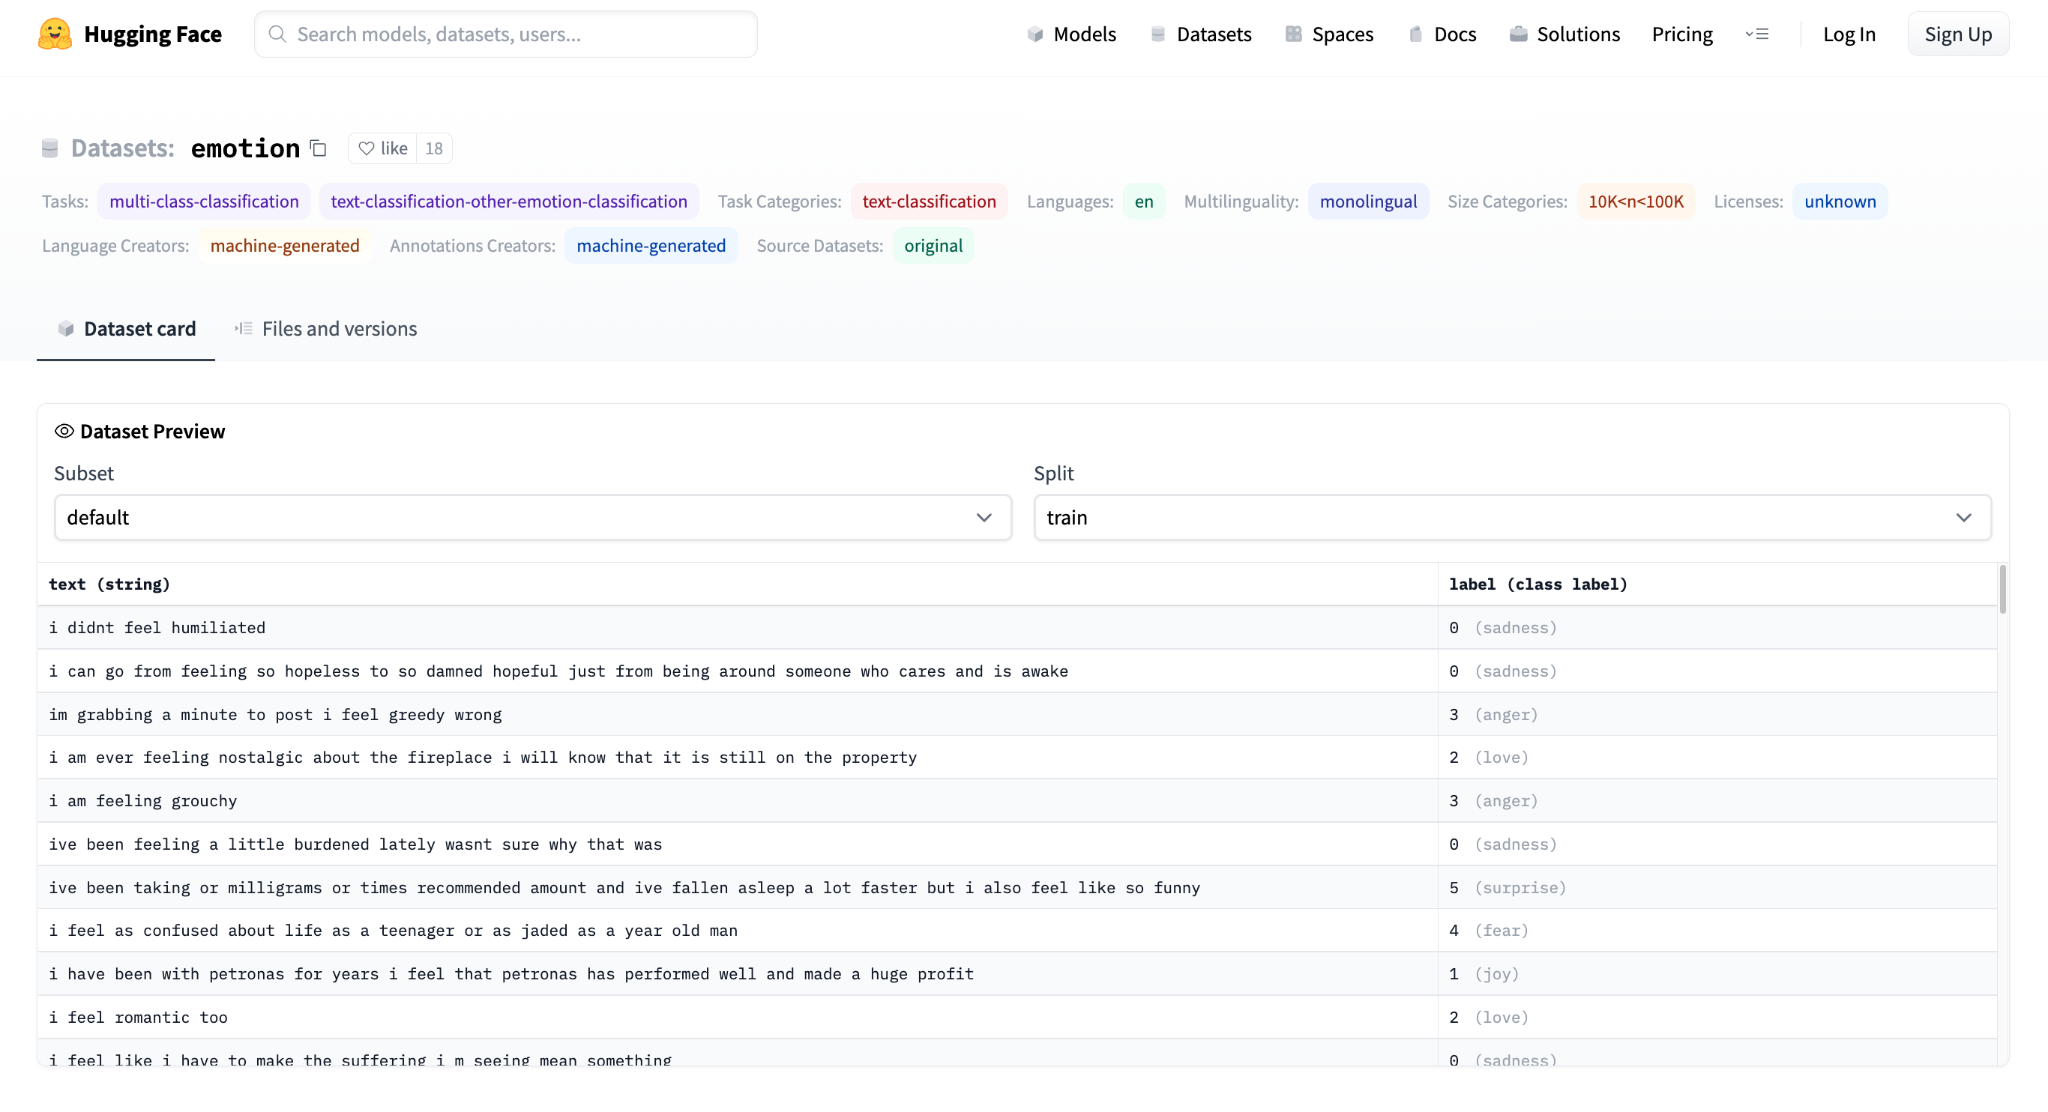

Emotion Dataset
$$classify:label\sim text$$
Task/Loss
Columns
Columns
Row

Slide 22
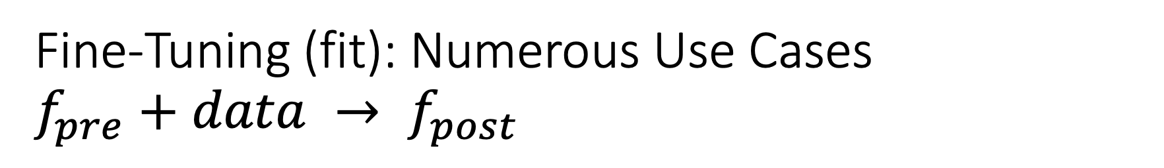
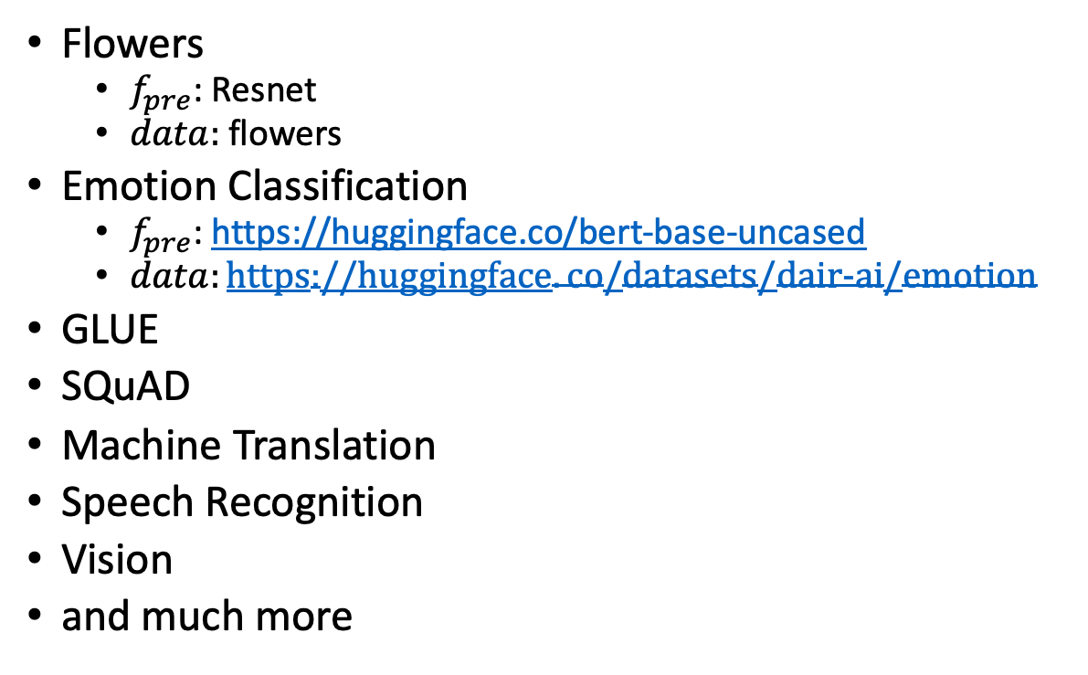
Fine-Tuning (fit): Numerous Use Cases
$f_{pre}+data → f_{post}$
Flowers
  $f_{pre}$: Resnet
  $data:$flowers
Emotion Classification
  $f_{pre}$: https://huggingface.co/bert-base-uncased
  $data:https://huggingface.co/datasets/dair−ai/emotion$
GLUE
SQuAD
Machine Translation
Speech Recognition
Vision
and much more
$f_{pre}$: Pre-trained Model
$f_{post}$: Post-trained Model
Fine-Tuning (fit) in R

Slide 23
GLUE Subsets
GLUE COLA SUBSET
Sentence | Label
Bill sang himself to sleep. | 1 (acceptable)
Bill squeezed the puppet through the hole. | 1 (acceptable)
Bill sang Sue to sleep. | 1 (acceptable)
The elevator rumbled itself to the ground. | 0 (unacceptable)
If the telephone rang, it could ring itself silly. | 1 (acceptable)
She yelled hoarse. | 0 (unacceptable)
Ted cried to sleep. | 0 (unacceptable)
The tiger bled to death. | 1 (acceptable)
Subset | Dataset
COLA | H:glue,cola
SST2 | H:glue,sst2
WNLI | H:glue,wnli
MRPC | H:glue,mrpc
QNLI | H:glue,qnli
QQP | H:glue,qqp
SSTB | H:glue,sstb
MNLI | H:glue,mnli

Slide 24
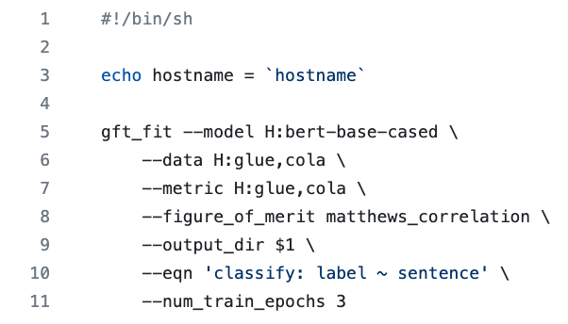
GFT Program for COLA
GLUE COLA SUBSET
Sentence | Label
Bill sang himself to sleep. | 1 (acceptable)
Bill squeezed the puppet through the hole. | 1 (acceptable)
Bill sang Sue to sleep. | 1 (acceptable)
The elevator rumbled itself to the ground. | 0 (unacceptable)
If the telephone rang, it could ring itself silly. | 1 (acceptable)
She yelled hoarse. | 0 (unacceptable)
Ted cried to sleep. | 0 (unacceptable)
The tiger bled to death. | 1 (acceptable)
https://github.com/kwchurch/gft/blob/master/examples/fit_examples/model.HuggingFace/language/data.HuggingFace/glue/cola.sh

Slide 25
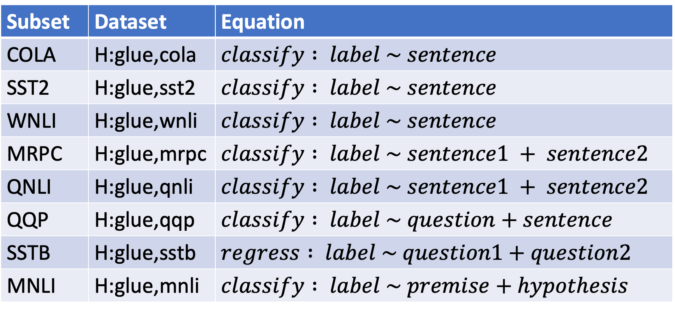
Simple Equations Cover Many Cases of Interest
GLUE: A Popular Benchmark
Subset | Dataset | Equation
COLA | H:glue,cola | $$classify : label \sim sentence$$
SST2 | H:glue,sst2 | $$classify : label \sim sentence$$
WNLI | H:glue,wnli | $$classify : label \sim sentence$$
MRPC | H:glue,mrpc | $$classify : label \sim sentence1 + sentence2$$
QNLI | H:glue,qnli | $$classify : label \sim sentence1 + sentence2$$
QQP | H:glue,qqp | $$classify : label \sim question+sentence$$
SSTB | H:glue,sstb | $$regress : label \sim question1+question2$$
MNLI | H:glue,mnli | $$classify : label \sim premise+hypothesis$$

Slide 26
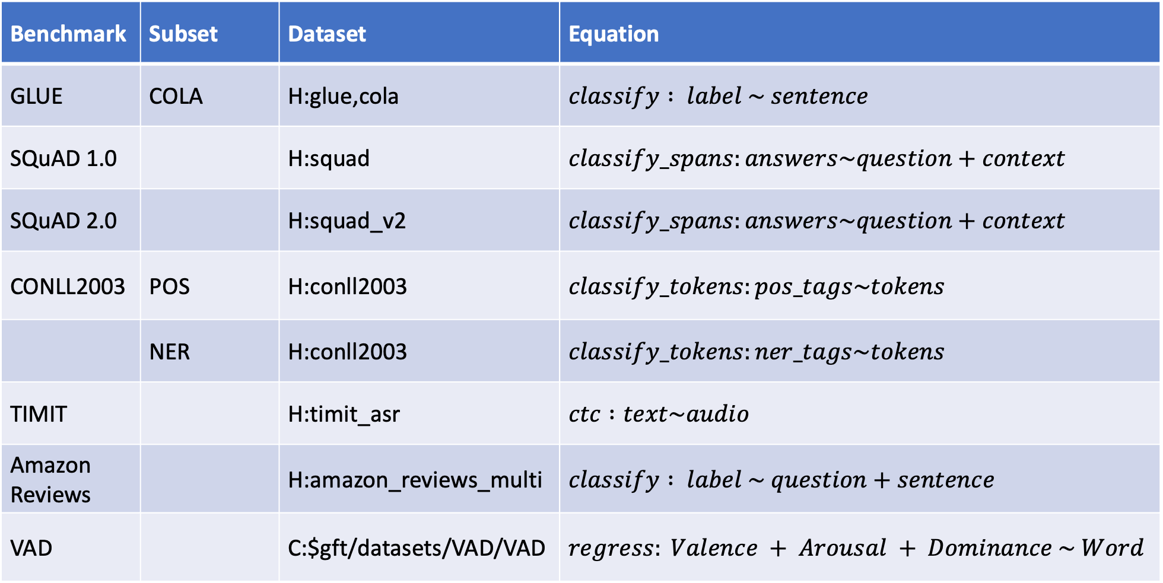

Equation Keywords $≈$ Pipeline Tasks
Benchmark | Subset | Dataset | Equation
GLUE | COLA | H:glue,cola | $$classify : label \sim sentence$$
SQuAD 1.0 |  | H:squad | $$classify_spans:answers\sim question+context$$
SQuAD 2.0 |  | H:squad_v2 | $$classify_spans:answers\sim question+context$$
CONLL2003 | POS | H:conll2003 | $$classify_tokens:pos_tags\sim tokens$$
 | NER | H:conll2003 | $$classify_tokens:ner_tags\sim tokens$$
TIMIT |  | H:timit_asr | $$ctc :text\sim audio$$
Amazon Reviews |  | H:amazon_reviews_multi | $$classify : label \sim question+sentence$$
VAD |  | C:$gft/datasets/VAD/VAD | $$regress: Valence + Arousal + Dominance \sim Word$$

Slide 27
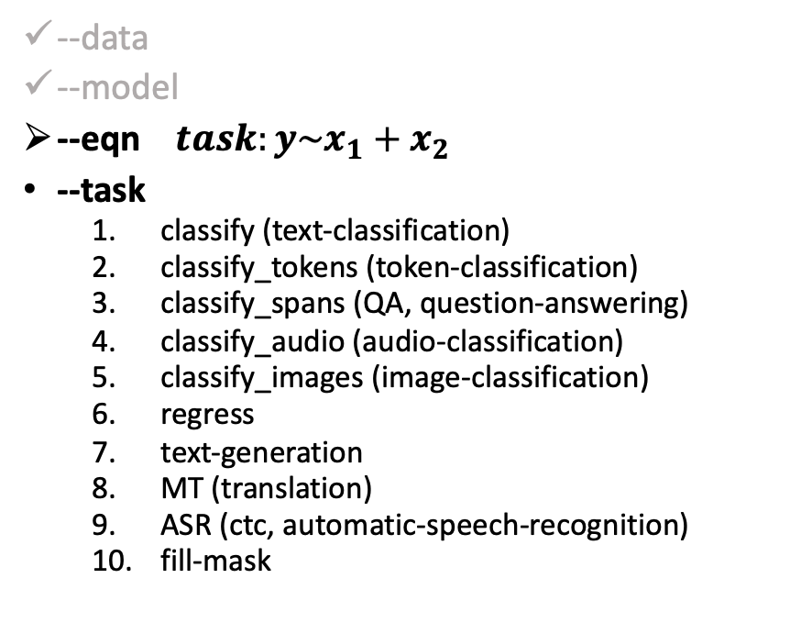
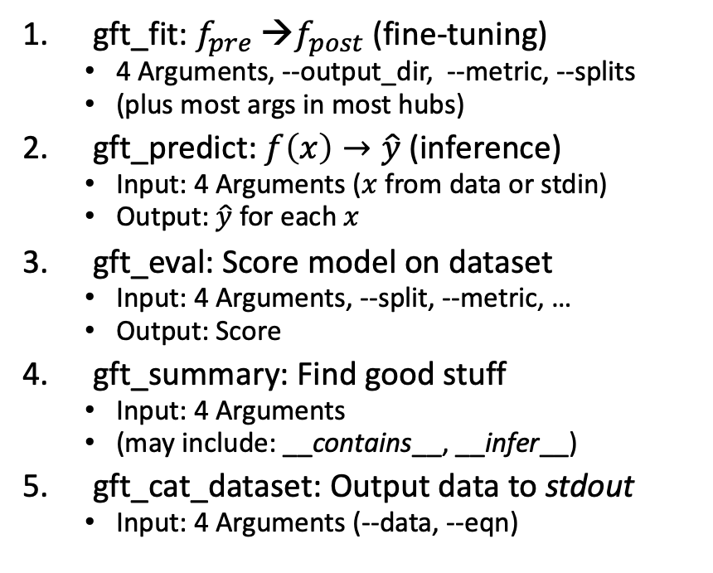
gft Cheat Sheet
(General Fine-Tuning)
4+1 Functions
4 Arguments
gft_fit: $f_{pre}$ →$f_{post}$(fine-tuning)
  4 Arguments, --output_dir, --metric, --splits
  (plus most args in most hubs)
gft_predict: $f\left(x\right)→\hat{y}$ (inference)
  Input: 4 Arguments ($x$ from data or stdin)
  Output: $\hat{y}$ for each $x$
gft_eval: Score model on dataset
  Input: 4 Arguments, --split, --metric, …
  Output: Score
gft_summary: Find good stuff
  Input: 4 Arguments
  (may include: __contains__, __infer__)
gft_cat_dataset: Output data to stdout
  Input: 4 Arguments (--data, --eqn)
--data
--model
--eqn $task:y\sim x_{1}+x_{2}$
--task
  classify (text-classification)
  classify_tokens (token-classification)
  classify_spans (QA, question-answering)
  classify_audio (audio-classification)
  classify_images (image-classification)
  regress
  text-generation
  MT (translation)
  ASR (ctc, automatic-speech-recognition)
  fill-mask

Slide 28
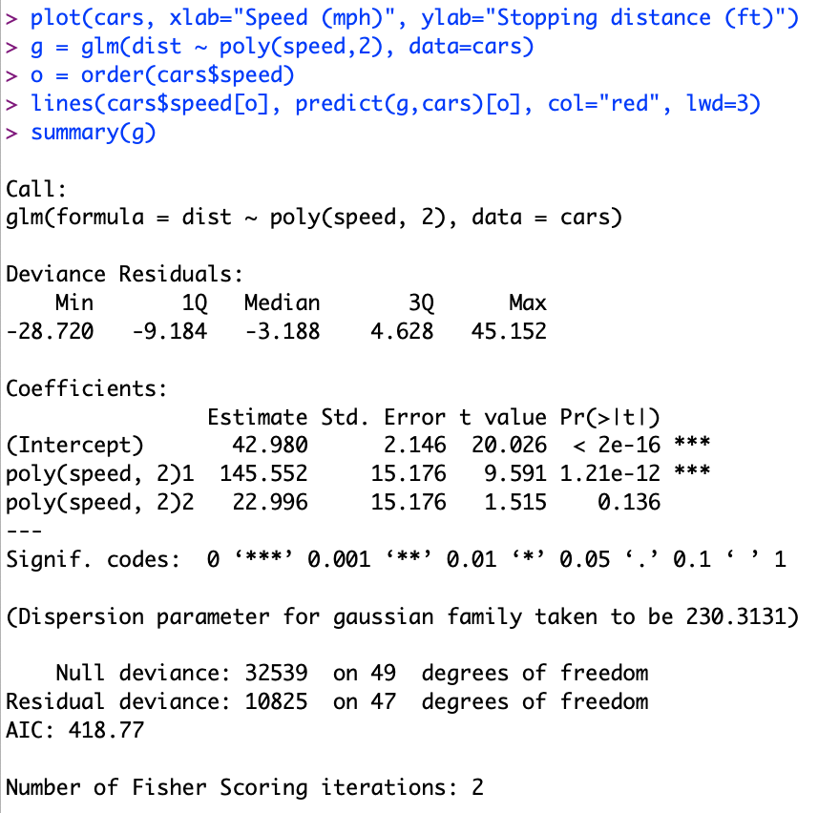
Regression in R:
Summarize (almost) anything
Fit a model (g) to data (cars)

Slide 29
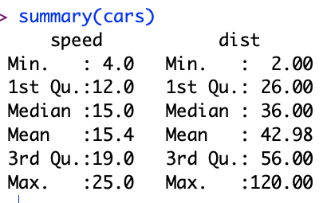
Regression in R:
Summarize (almost) anything

Slide 30
Regression in R:
Summarize (almost) anything
Fit a model (g) to data (cars)
Predict
Summarize a model (g)
Opportunity to Improve g

Slide 31
gft_summary
Summarize almost anything
  Models
  Datasets

Slide 32





Tasks
$$y∈\left\{0,1,2,…\right\}$$
classify, text-classification
regress
QA, Question Answering, classify spans
token classification
  NER (Named Entity Recognition)
  POS (Part of Speech Tagging)
translation, MT
ASR, Automatic Speech Recognition, ctc
$y∈ℝ$ or $y∈ℝ^{N}$
$y$ for each start/end of span
$y$ for each token
$y$ for each phoneme

Slide 33
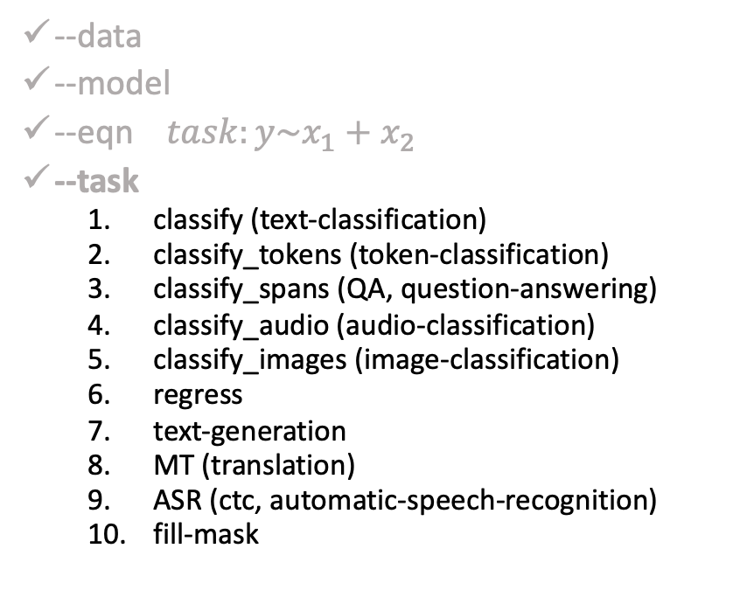
gft Cheat Sheet
(General Fine-Tuning)
4+1 Functions
4 Arguments
gft_fit: $f_{pre}$ →$f_{post}$(fine-tuning)
  4 Arguments, --output_dir, --metric, --splits
  (plus most args in most hubs)
gft_predict: $f\left(x\right)→\hat{y}$ (inference)
  Input: 4 Arguments ($x$ from data or stdin)
  Output: $\hat{y}$ for each $x$
gft_eval: Score model on dataset
  Input: 4 Arguments, --split, --metric, …
  Output: Score
gft_summary: Find good stuff
  Input: 4 Arguments
  (may include: __contains__, __infer__)
gft_cat_dataset: Output data to stdout
  Input: 4 Arguments (--data, --eqn)
--data
--model
--eqn $task:y\sim x_{1}+x_{2}$
--task
  classify (text-classification)
  classify_tokens (token-classification)
  classify_spans (QA, question-answering)
  classify_audio (audio-classification)
  classify_images (image-classification)
  regress
  text-generation
  MT (translation)
  ASR (ctc, automatic-speech-recognition)
  fill-mask

Slide 34
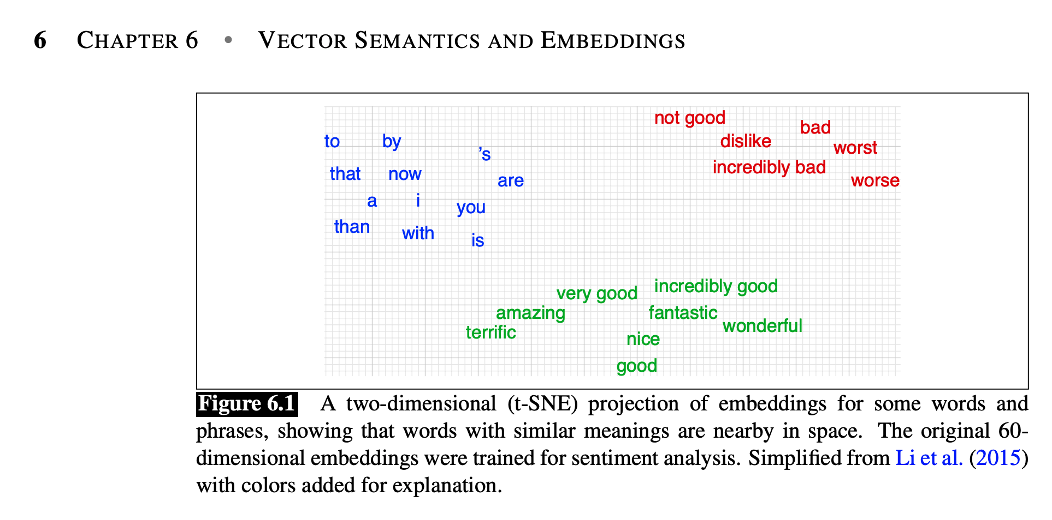
Machine Learning Before Deep Nets
Collocation
  PMI (Church & Hanks, 1990)
Word2vec (Factored PMI)
Anything to vec
  Homework: Better Together
    Doc2vec (in many ways)
    Cosine similarity
    Similar text vs. similar context
Regression: linear, logistic
Sklearn and Scipy
JM3 Chapter 6 (Spoiler Alert: Reading for next time)

Slide 35
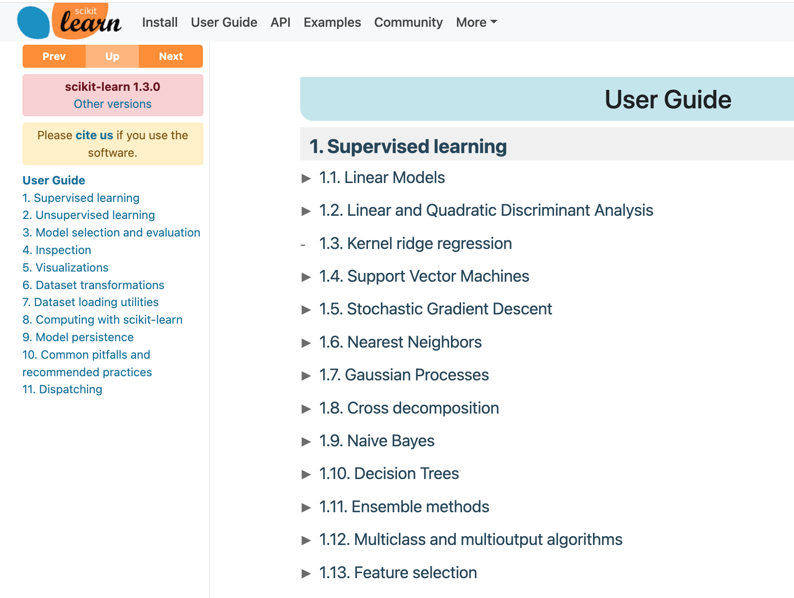
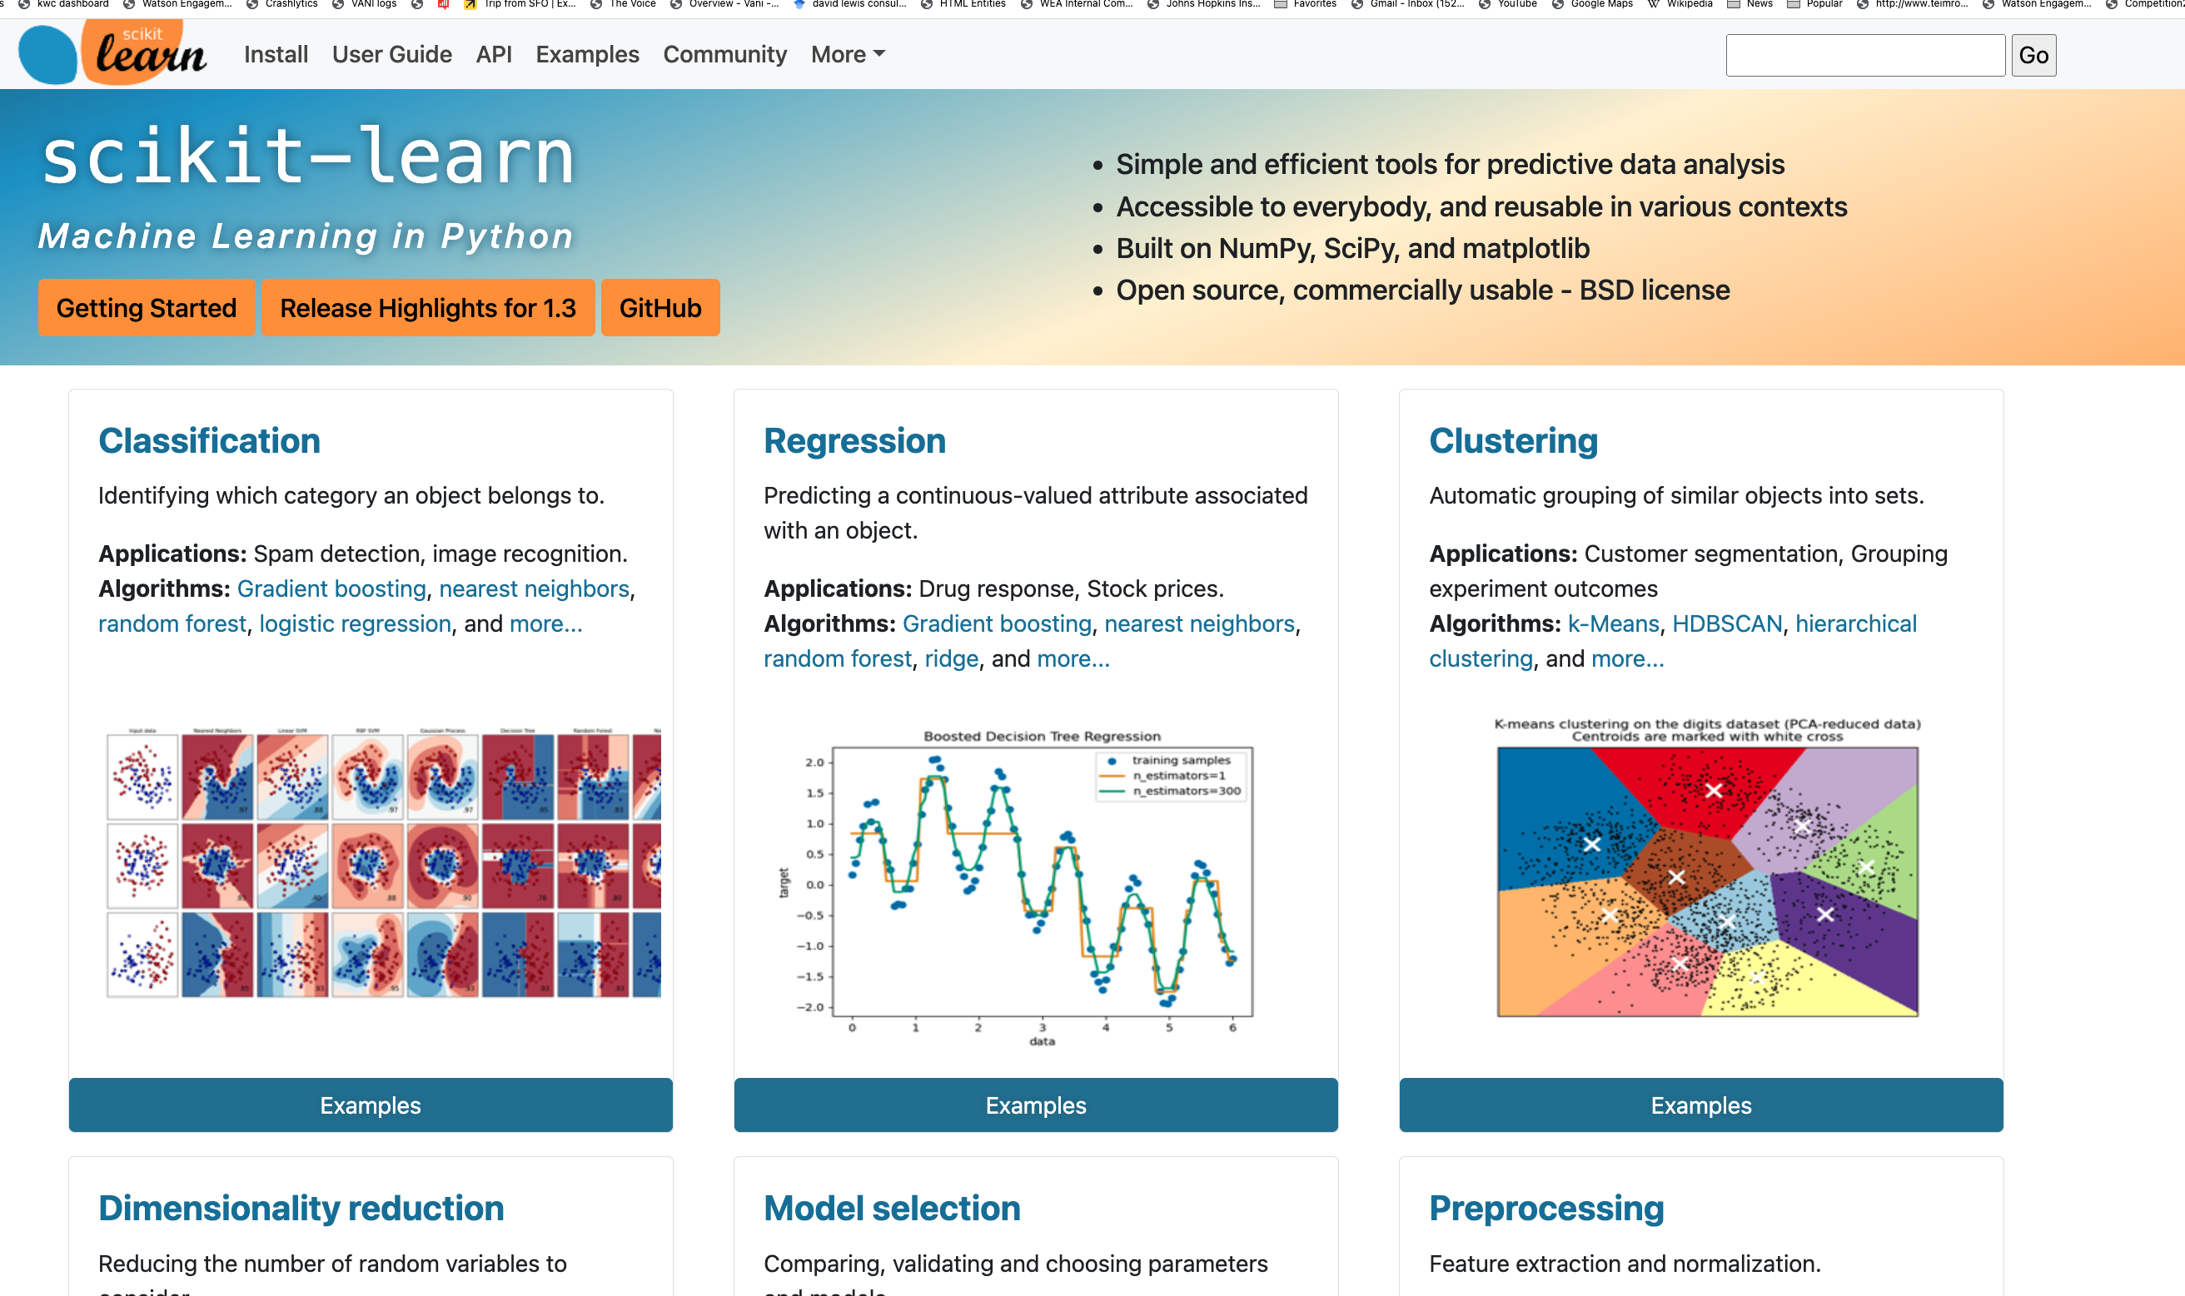
Sklearn

Slide 36
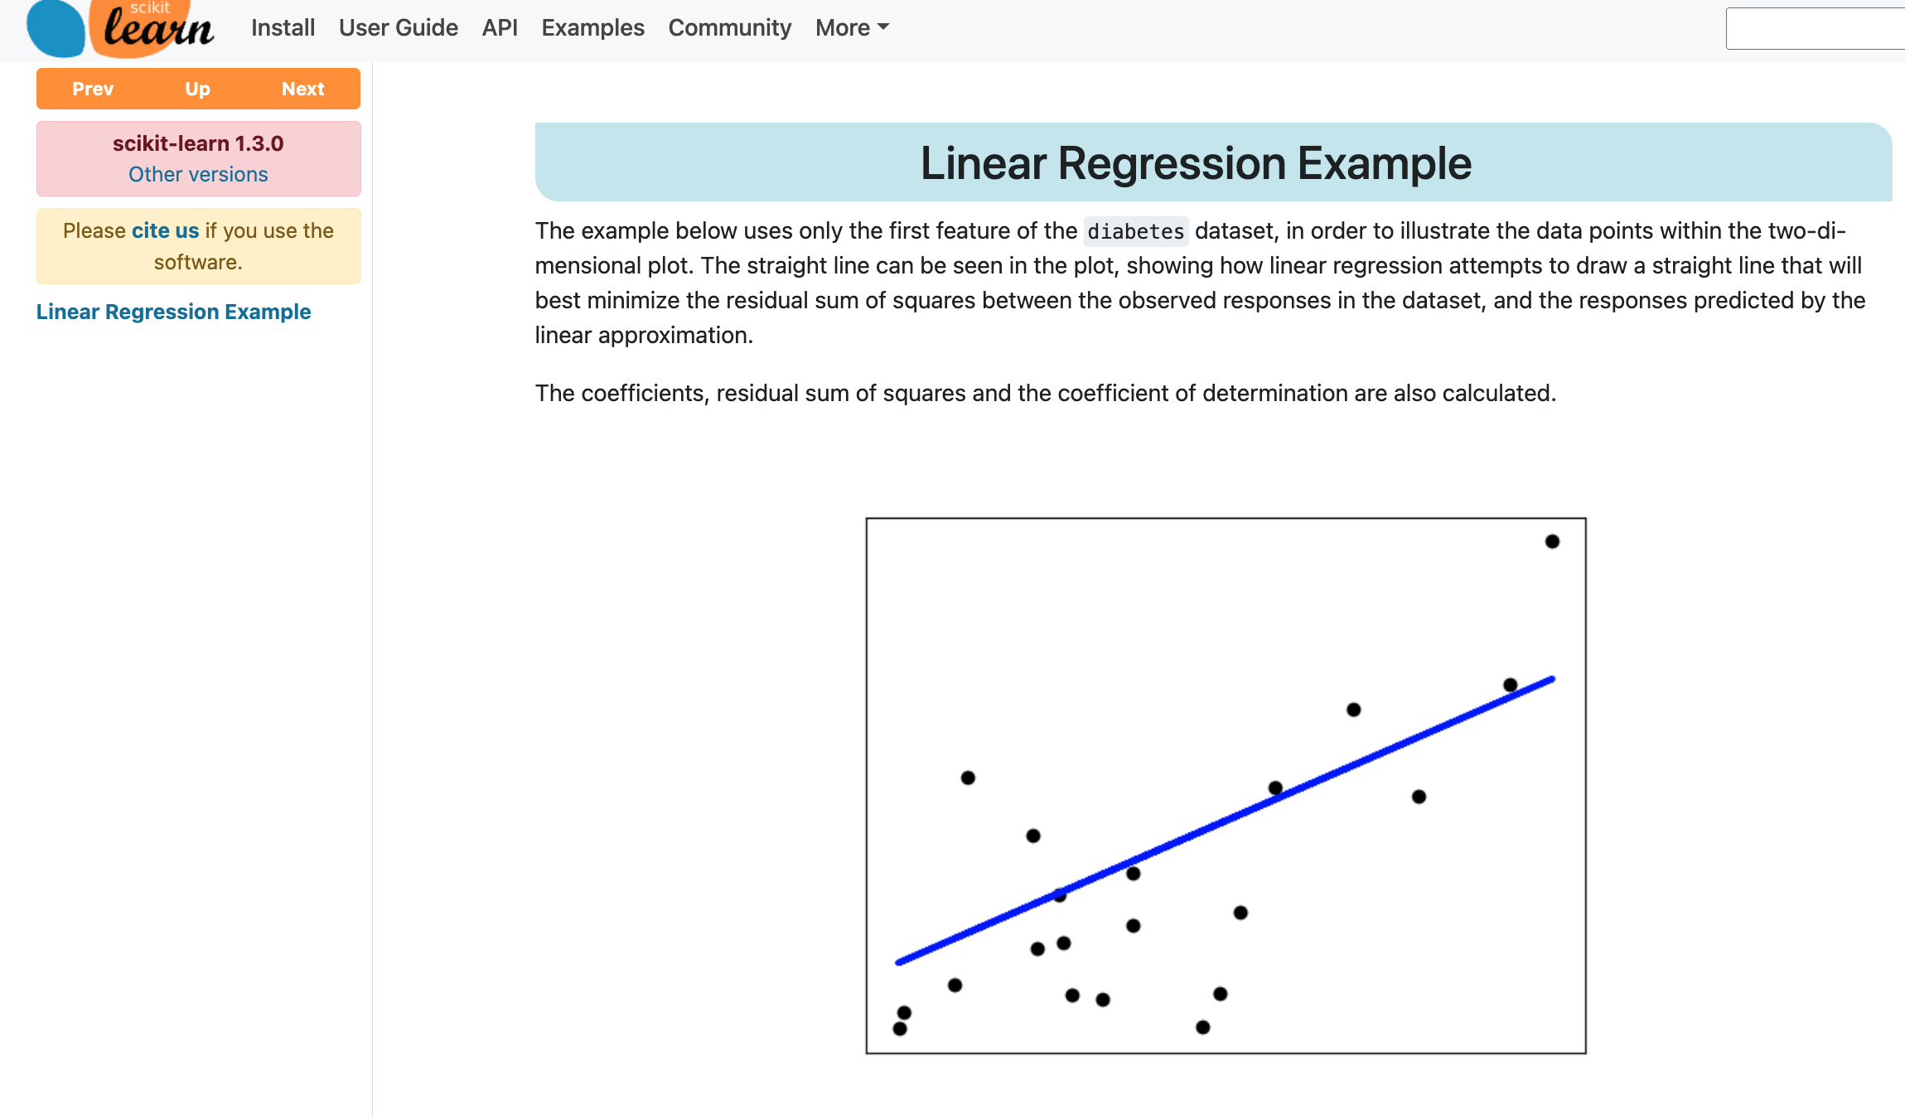

Slide 37
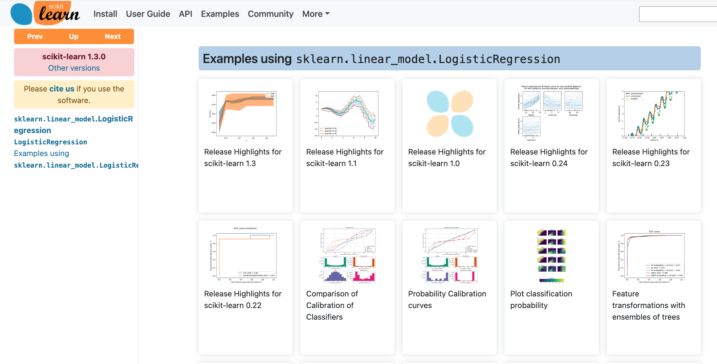

Slide 38
Linear Regression and Logistic Regression
Linear
  g1 = glm(dist ~ poly(speed,2), data=cars)
Logistic
  g2 = glm(dist > 50 ~ poly(speed,2), data=cars, family=binomial)
Models
  > g1$coef
  (Intercept) poly(speed, 2)1 poly(speed, 2)2
  42.98000 145.55226 22.99576
  > g2$coef
  (Intercept) poly(speed, 2)1 poly(speed, 2)2
  -1.137922 16.172581 2.031136

Slide 39
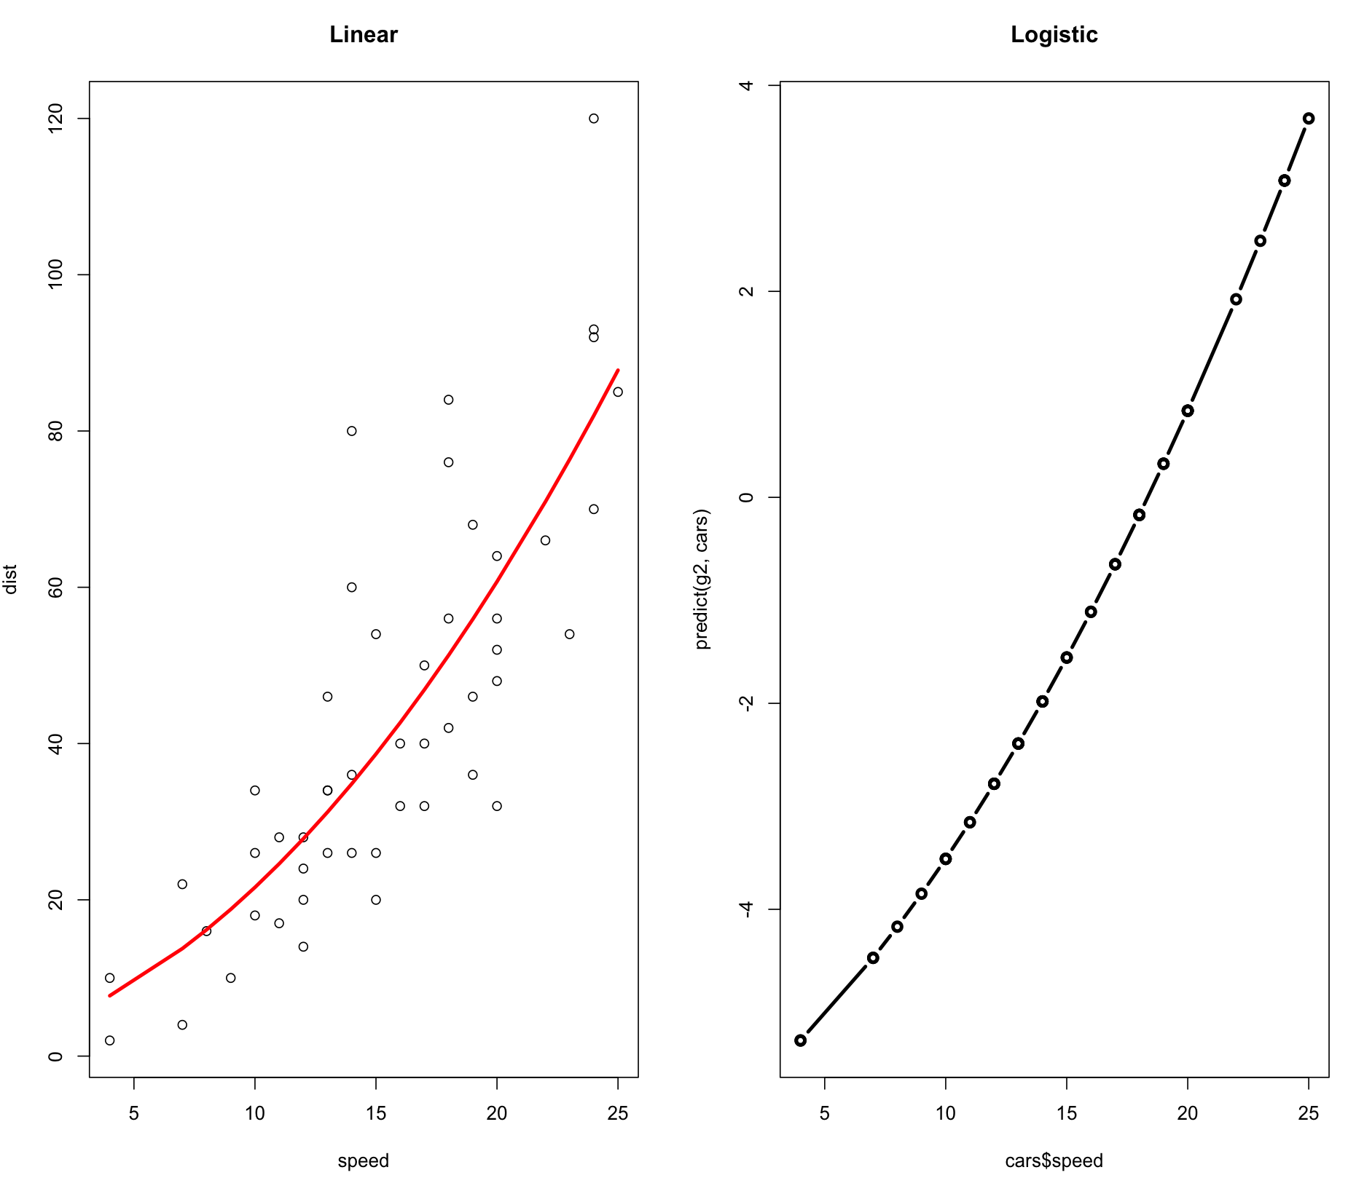
Linear and Logistic Regression
> g1 = glm(dist ~ poly(speed,2), data=cars)
> g2 = glm(dist > 50 ~ poly(speed,2), data=cars, family=binomial)
> plot(cars, main="Linear")
> lines(cars$speed, predict(g1, cars), col="red", lwd=3)
> plot(cars$speed, predict(g2, cars), type='b', lwd=3, main="Logistic")

Slide 40

Inverses
sigmoid = function(z) 1/(1+exp(-z))
logit = function(p) log(p/(1-p))
$$σ\left(z\right)=\frac{1}{1+e^{−z}}$$
$$logit\left(p\right)=log\frac{p}{1−p}$$
Note: sigmoid & logit are inverses of one another:
$$logit(σ(z))= z$$
$$σ(logit(p)) = p$$

Slide 41
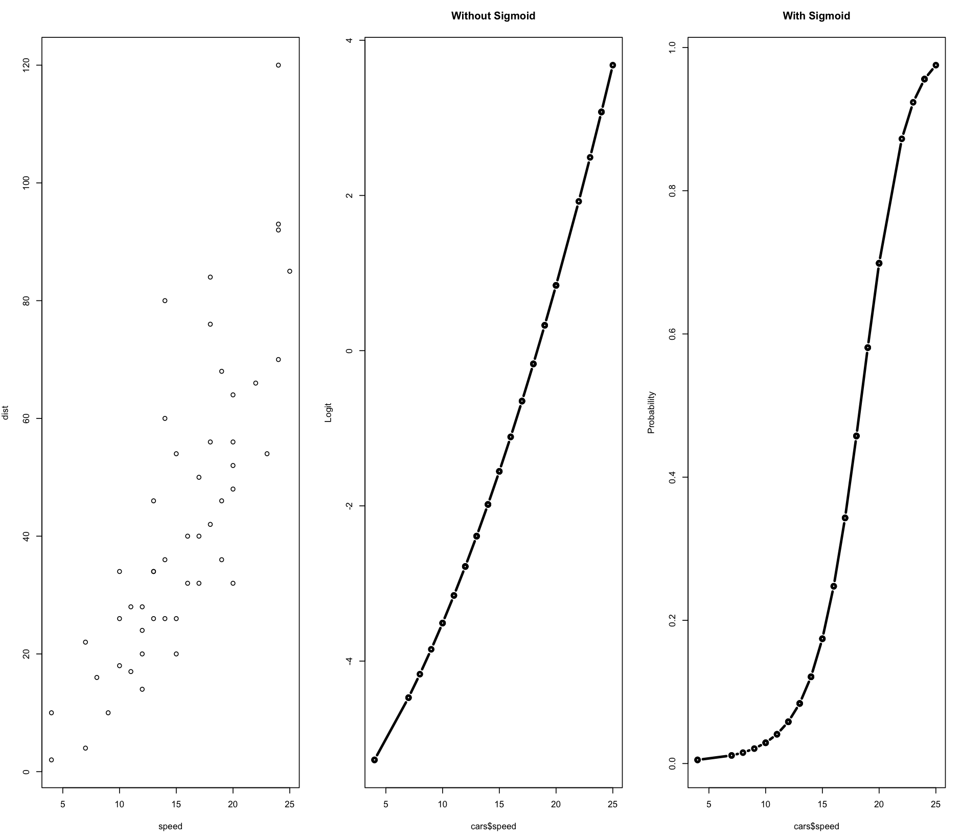
Linear and Logistic Regression
> g1 = glm(dist ~ poly(speed,2), data=cars)
> g2 = glm(dist > 50 ~ poly(speed,2), data=cars, family=binomial)
> plot(cars$speed, predict(g2, cars), type='b', lwd=3, main="Without Sigmoid", ylab="Logit")
> plot(cars$speed, sigmoid(predict(g2, cars)), type='b', lwd=3, main="With Sigmoid", ylab="Probability")

Slide 42
Recap
What’s where:
  https://kwchurch.github.io/
Formalities:
  Northeastern Rules, Culture, etc.
  Instructors, TA, Office Hours
Goals, Expectations, etc.
  Encouraging learning:
    Teamwork, Online Resources, Bots
    As long as these tools → learning
  Grading:
    Assignments:
      Effort/Learning >> Solving Problems
    Mid-Term Exam:
      Open book, network
      But no teams
    Final Project: Proposal, Oral, Written
Better Together Homework
Little Languages: Unix, AWK, R
Deep Nets
  Inference (predict)
  Fine-Tuning (fit)
  Pre-training
    aka base/fundamental models
    (don’t do it)
Deep nets are like regression
  Linear regression:
    Cars example: fit/predict in R
  Datasets:
    cars dataset in R is like
    emotion dataset on huggingface
  Classification vs. Regression
    Logistic Regression: example of binary classification
  Similarities of linear and logistic regression

Slide 43
Recap
What’s where:
  https://kwchurch.github.io/
Formalities:
  Northeastern Rules, Culture, etc.
  Instructors, TA, Office Hours
Goals, Expectations, etc.
  Encouraging learning:
    Teamwork, Online Resources, Bots
    As long as these tools → learning
  Grading:
    Assignments:
      Effort/Learning >> Solving Problems
    Mid-Term Exam:
      Open book, network
      But no teams
    Final Project: Proposal, Oral, Written

Slide 44
Recap
What’s where:
  https://kwchurch.github.io/
Formalities:
  Northeastern Rules, Culture, etc.
  Instructors, TA, Office Hours
Goals, Expectations, etc.
  Encouraging learning:
    Teamwork, Online Resources, Bots
    As long as these tools → learning
  Grading:
    Assignments:
      Effort/Learning >> Solving Problems
    Mid-Term Exam:
      Open book, network
      But no teams
    Final Project: Proposal, Oral, Written

Slide 45
SciPy

Slide 46
gft Design Goals
Inclusiveness:
  Accessible to Masses
    (including non-programmers)
  Portability
  Ease-of-Use/Transparency >> SOTA
Hide Complexity/Magic (Alchemy)
  No one would suggest
    Regression-like methods are ``intelligent’’

Slide 47
Portability:
Inclusiveness + Hedge
gft Programs
H → HuggingFace
gft_fit --model H:bert-base-cased \
--data H:emotion \
--output_dir $1 \
--eqn 'classify: label ~ text'
Hedge
(Supply Chains)
Hedge
(Supply Chains)
P → PaddleNLP
gft_fit --model P:ernie-tiny \
--data P:chnsenticorp \
--output_dir $1 \
--eqn 'classify: label ~ text'
Emphasis on Chinese

Slide 48
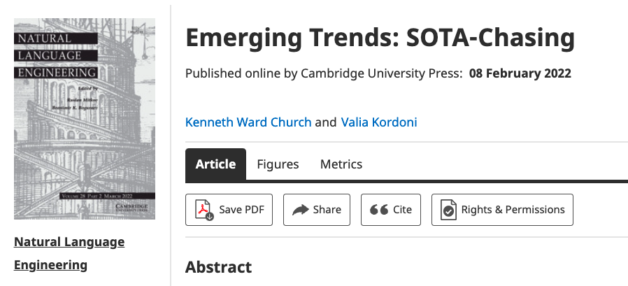
Strategy: Inclusiveness
Get your priorities right: Inclusiveness >> Exclusiveness
  SOTA-Chasing 👎 (Exclusive: mine is bigger than yours)
  Crossing the Chasm 👍 (Inclusive: Appeal to mainstream users)
  Hubs: Get big quick 👍 (Inclusive: Usage >> SOTA)

Slide 49
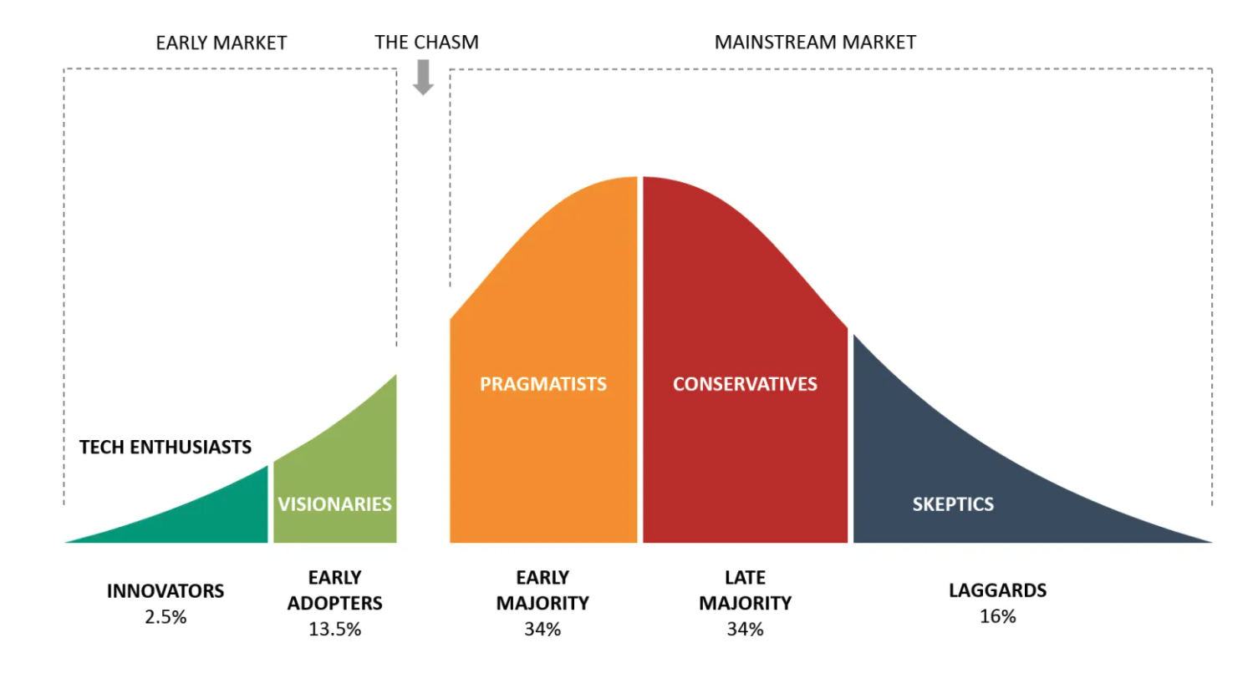
Bigger Opportunities:
(l)users (aka poets)
Engineers

Slide 50
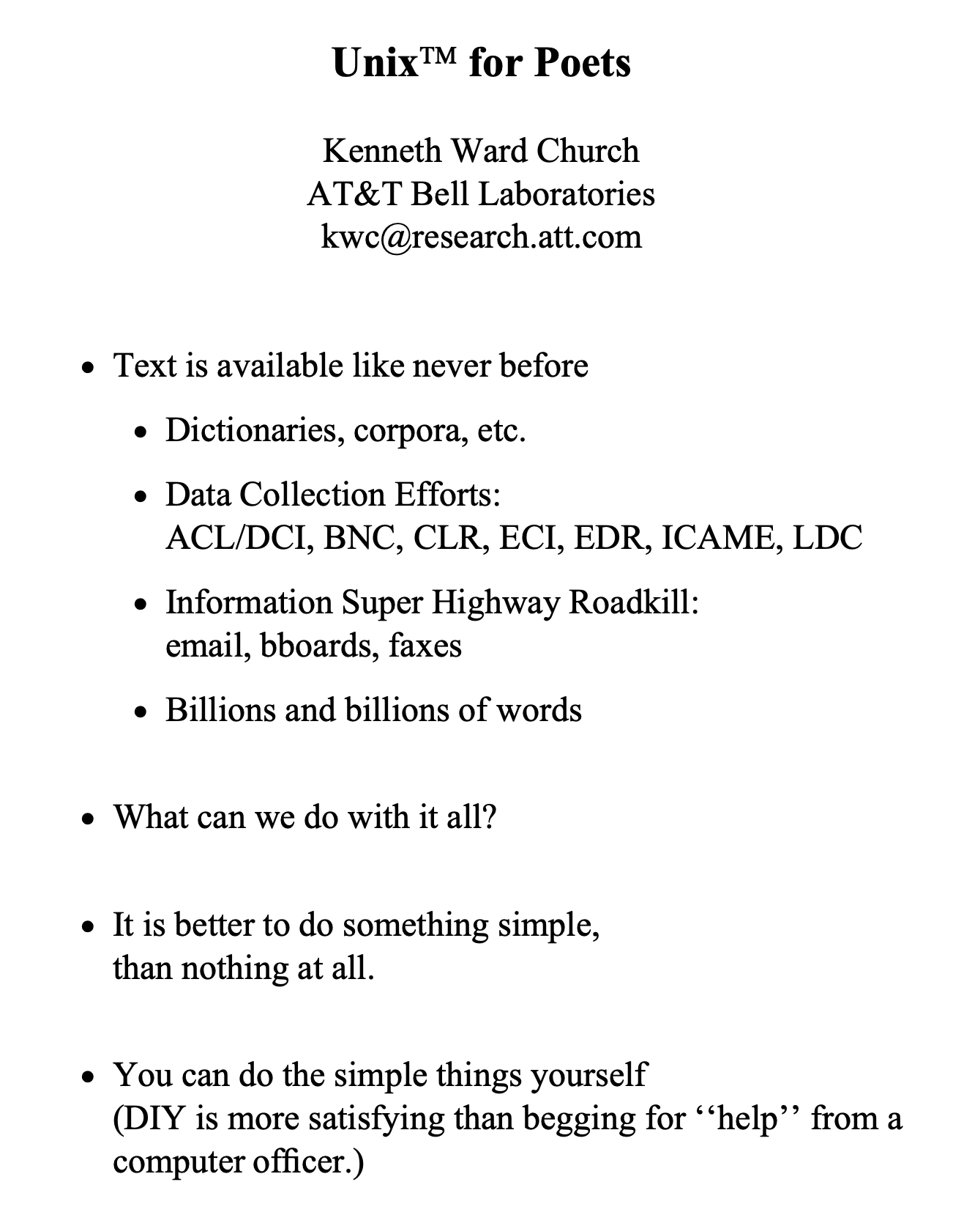
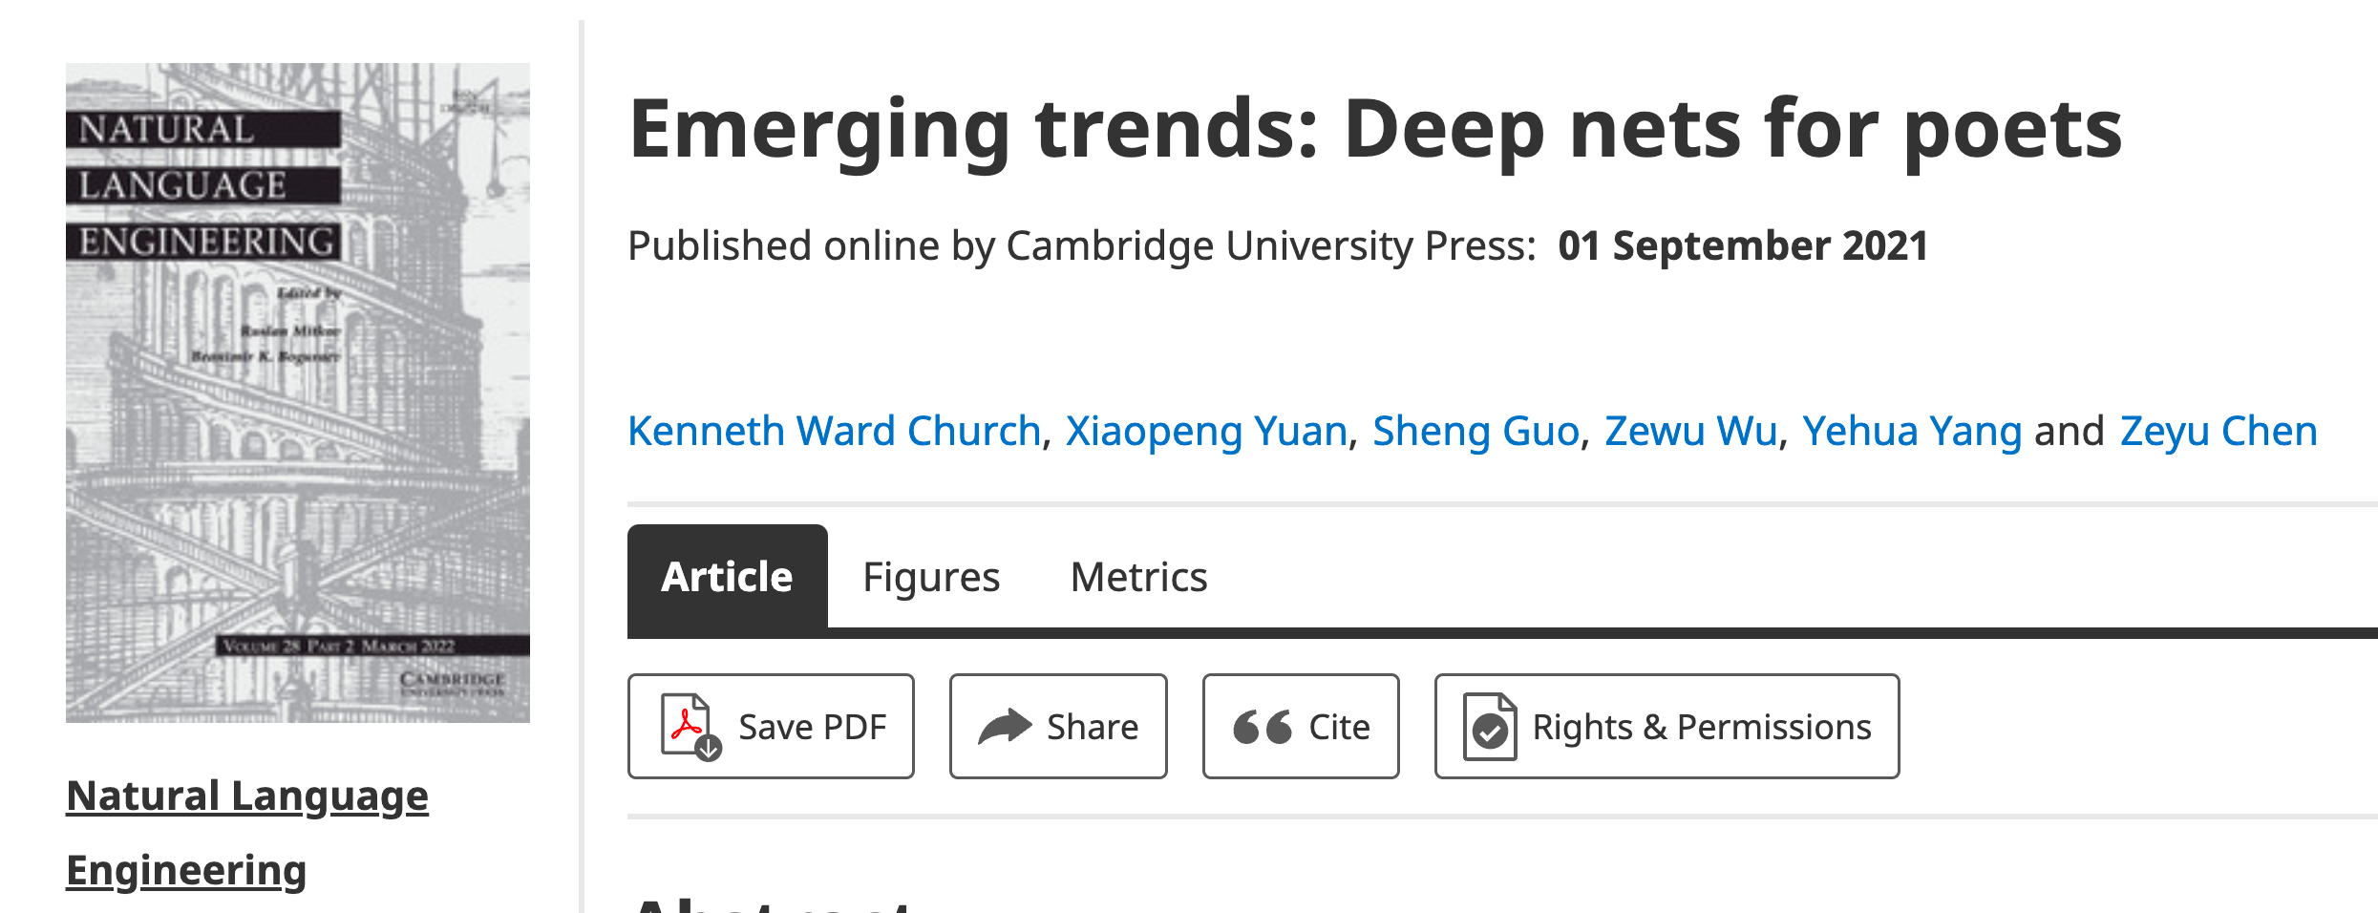
Poets
Poets is an imperfect metaphor,
  intended as a gesture toward inclusion.
The future for deep nets
  will benefit by reaching out to
    a broad audience of potential users,
  including people with
    little or no programming skills,
    and little interest in training models.
Lessons from success of Unix
  Less is more
  Inclusion: Appeal to power users as well as masses
  Portability: Inclusiveness++

Slide 51
Hub Strategy: Usage >> SOTA
(Sensible) Priority for Startups
(Mistaken) Priority Research
Startup Strategy:
  Get big quick
SOTA is like sprinting (hard work)
  Avoid temptation to sprint to front
    (except when it is worth the effort)
  Hubs spend most of the race
    in the peloton drafting researchers
  Make it easy for 3rd parties
    to post their best models on your hub
Use of 3rd parties → Wide range in quality
  Best are amazing: best in class, industrial strength…
  But some don’t work well, and may not even load…
  Help users find good stuff & embrace community

Slide 52

Two Perspectives on Datasets
Machine Learning
Psychology (Presupposes $∃$Hypothesis)
Splits: train/val/test
Treat rows as iid
  Identical and independently distributed
Idealistic, but maybe unrealistic
  Changes over time, Context, etc.
More papers on models
  than Datasets
Relatively little interest in
  Is the Dataset Realistic?
  Motivation? (Does anyone care? If so, who?)
  What is the dataset testing?
  Sampling/balance? From which population?
  Can it be gamed? Leakage?
Validity
  Content validity
  Construct validity
  Criterion validity
  Face validity
  Discriminant validity
Reliability
  Inter-rater reliability
  Test-retest reliability
  Internal reliability/Inter-item consistency
  Split half reliability
Lexicography

Slide 53
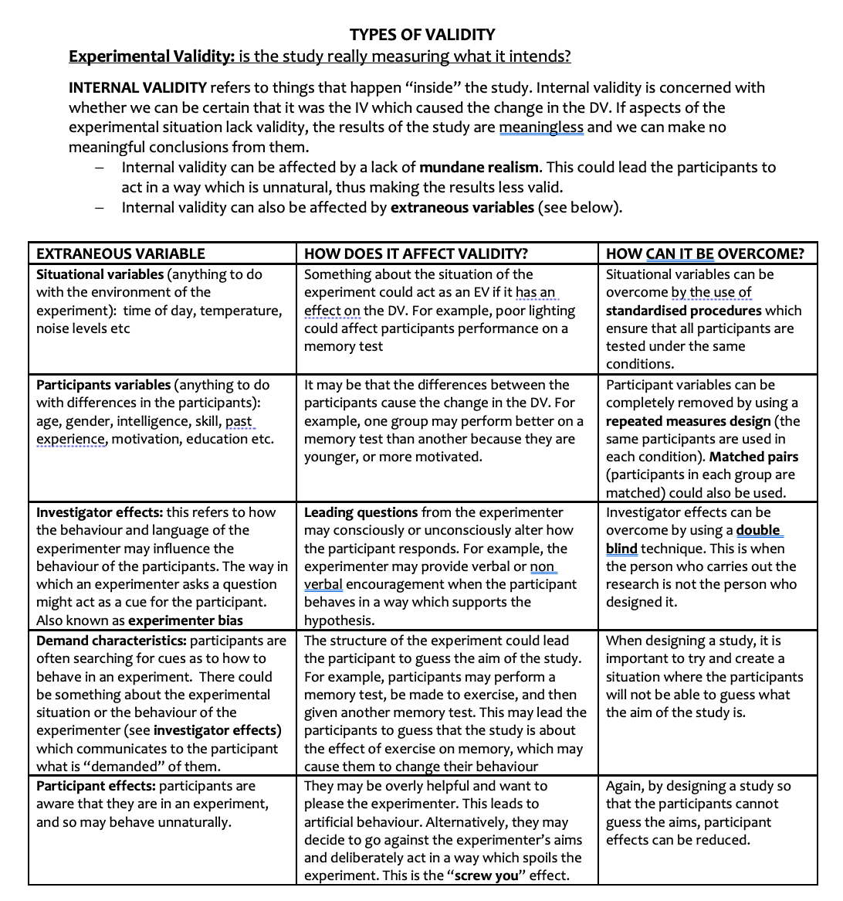
Discussion of Validity
Assumes: Intention

Slide 54
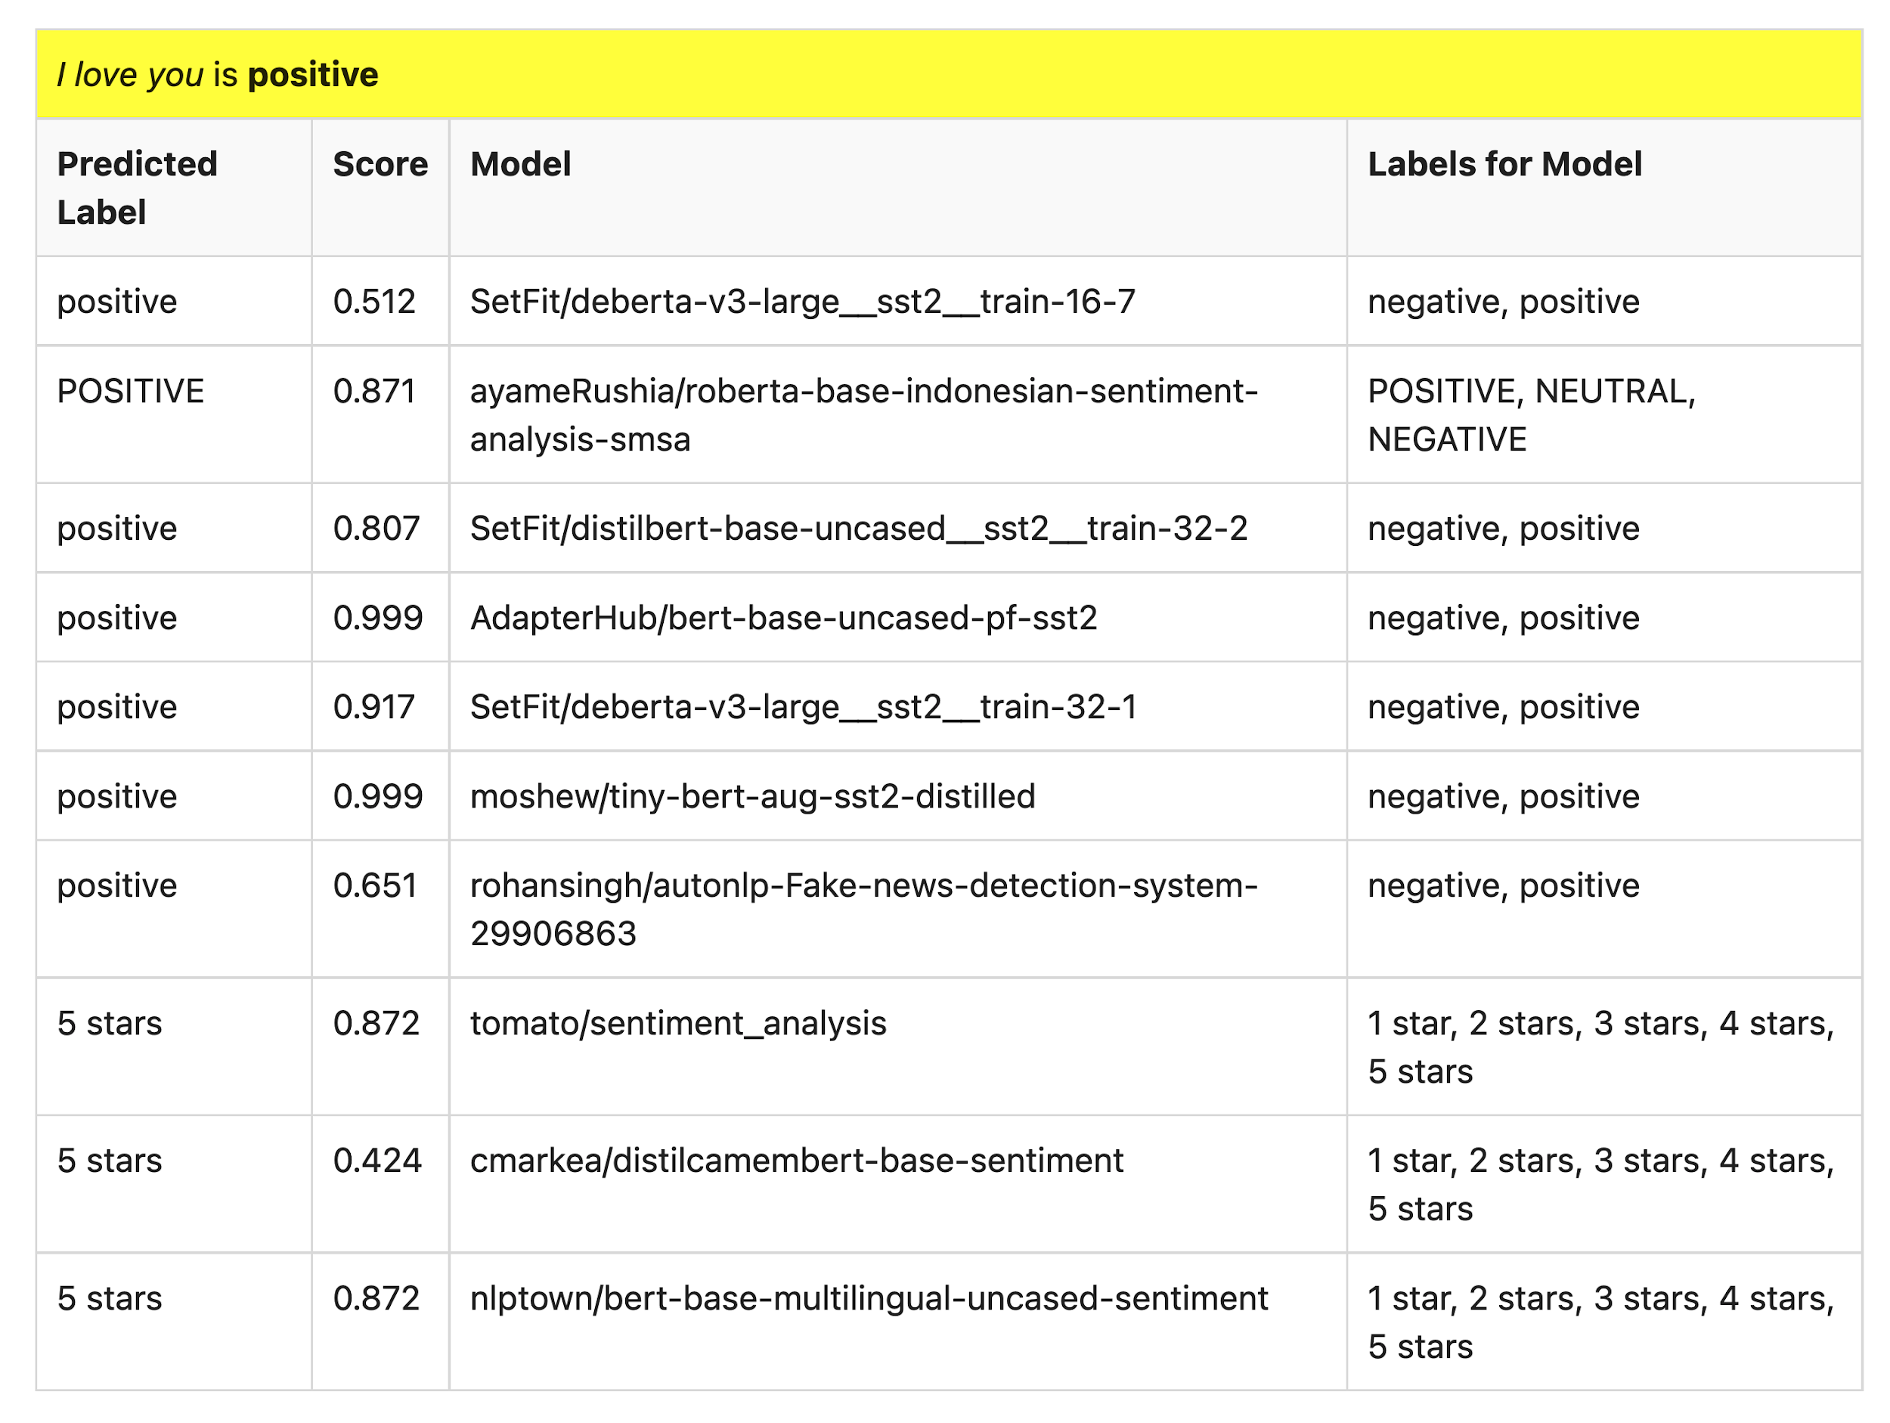
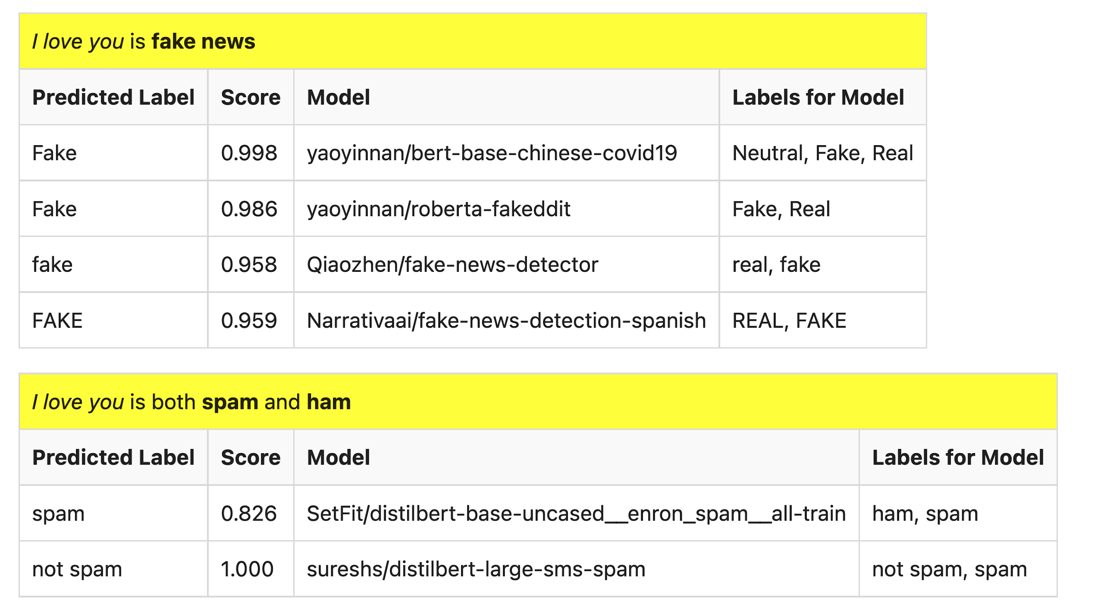
Many of these models produce reasonable results
Scores could be more confident

Slide 55
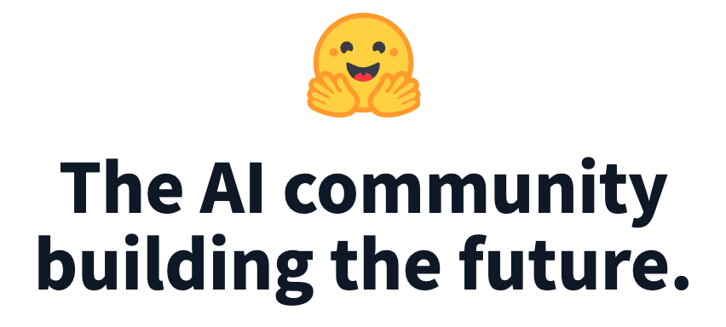
Lots of Models on Hubs (for lots of tasks)
Natural Language
  Classification
    Sentiment: positive/negative, 1-5 stars
    Emotion classification
    Hate speech classification
  Guess missing word (fill-mask; cloze task)
  Part of speech tagging
  NER (named entity recognition)
  Question Answering (SQUAD)
  Entailment (GLUE)
Image Classification
Speech recognition
Machine Translation
Examples of fill-mask
  echo … | gft_predict --task fill-mask
  I <mask> you
    miss|0.295
    love|0.174
    salute|0.158
  I love the <mask> guy
    pizza|0.035
    funny|0.016
    old|0.010
Examples of machine translation
  echo …| gft_predict --task translation \
    --model H:Helsinki-NLP/opus-mt-en-fr
  I love you
    Je t'aime.
2k translation models
on HuggingFace

