Slide 1
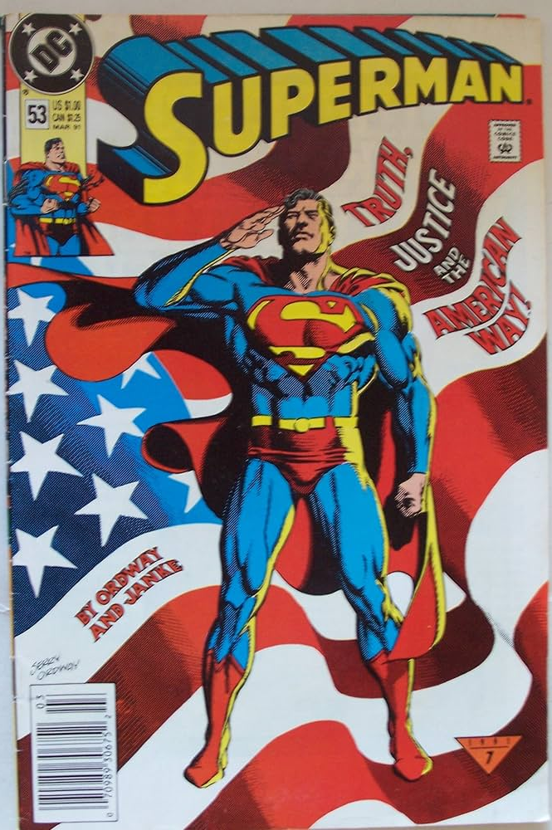
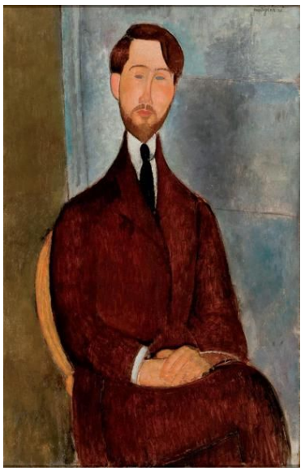
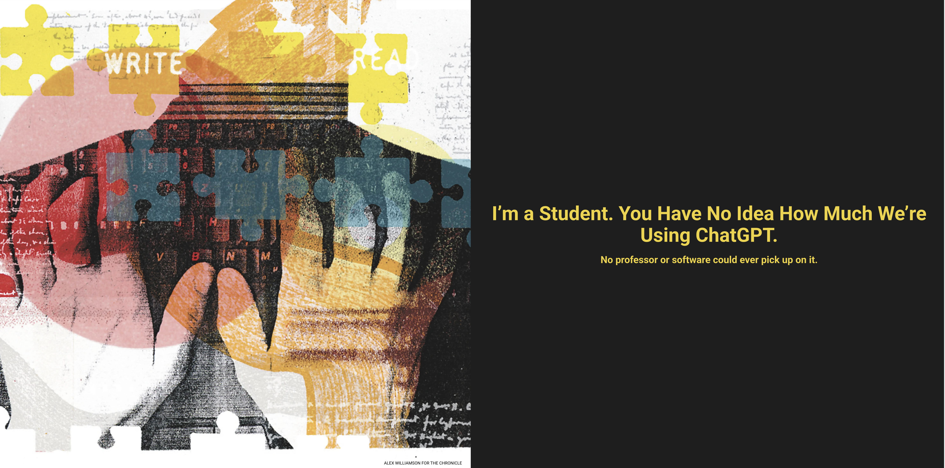
Comparable Corpora: Opportunities for New Research Directions
Kenneth Church
https://kwchurch.github.io/
Northeastern University
Jan 20, 2025
Including these slides

Slide 2
Setting Expectations
Most conference papers present new results
We won’t
This paper will focus more on opportunities
for the audience to make their own contributions
This paper is intended to challenge the community
to think more broadly about
what we can do with comparable corpora.

Slide 3
Agenda
Part 1: Current Status & Opportunities
Part 2: History
Part 3: Suggestions for future

Slide 4
Current Status: Where are we now?
The success of chat bots in many languages demonstrates
the power of comparable corpora (CC)
and pivoting via English
👍
👎

Slide 5
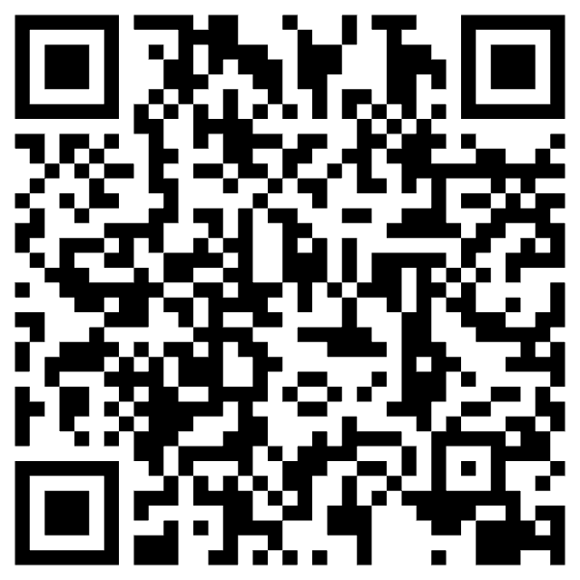
https://www.chronicle.com/article/im-a-student-you-have-no-idea-how-much-were-using-chatgpt

Slide 6
What’s wrong with pivoting via English?

Slide 7
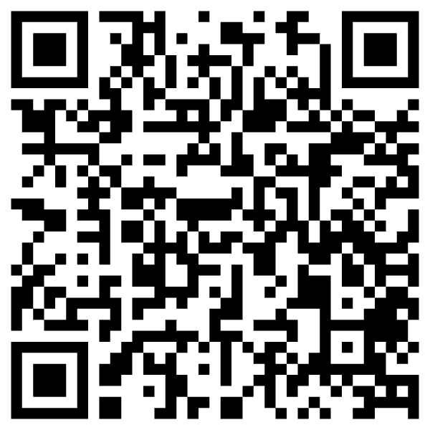
Criticism: ACL is too focused on English https://thegradient.pub/the-benderrule-on-naming-the-languages-we-study-and-why-it-matters/

Slide 8
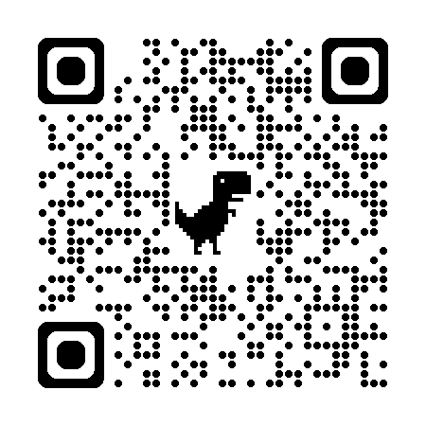
Weird = Western, Educated, Industrialized, Rich, and Democratic

Slide 9
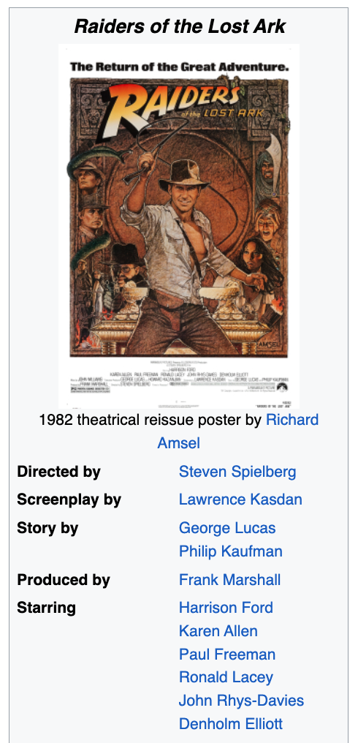
Filter Bubbles (Colonialism) Move Fast and Break Things
Irresponsible AI

Slide 10
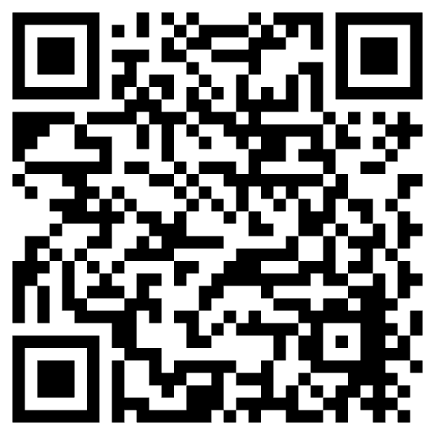
Truth, Justice and <fill-mask>
https://www.nytimes.com/2006/06/30/opinion/30iht-ederik.2093103.html?_r=0
WW II
2021

Slide 11
Better to Engage Local Expertise
NLLB
Quality control is relatively weak in 4 African Languages
“A significant part of the translations were suspected
to have been automatically generated”
“Unnatural” natural language
Not even grammatical

Slide 12
Deadly Consequences

Slide 13
Filter Bubble Hypothesis: Anglophones don’t know how bad it is elsewhere
In Nigeria
Tweets are more toxic in Hausa
than in English

Slide 14
Growth Languages

Slide 15
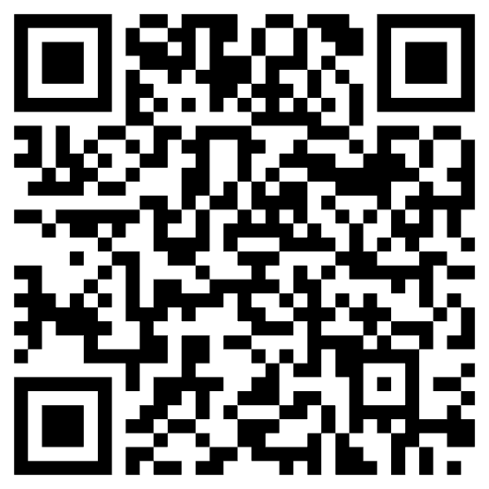
Low Resources & Growth Opportunities
Endangered Languages
https://en.wikipedia.org/wiki/List_of_languages_by_total_number_of_speakers
40 Million Speakers or more
English, Chinese, Hindi, Spanish, Arabic, French, Bengali, Portuguese, Russian, Urdu, Indonesian, German, Japanese, Nigerian Pidgin, Marathi, Telugu, Turkish, Hausa, Tamil, Swahili, Tagalog, Punjabi, Korean, Persian, Javanese, Italian, Gujarati, Thai, Amharic, Kannada, Bhojpuri
https://en.wikipedia.org/wiki/Endangered_language
Better Business Case

Slide 16
Good News: More resources than we had for English when we started EMNLP
Wikipedia
Joshi Classification
Semantic Scholar (S2)
ACL Anthology
HuggingFace (HF)
Speakers

Slide 17
Agenda
Part 1: Current Status & Opportunities
Part 2: History
Part 3: Suggestions for future

Slide 18
Agenda for Part 1: History
Parallel Corpora
Applications:
Machine Translation (MT)
Word Sense Disambiguation (WSD)
Inappropriate Uses of Translation → Biases
Bilingual Lexicon Induction (BLI)

Slide 19
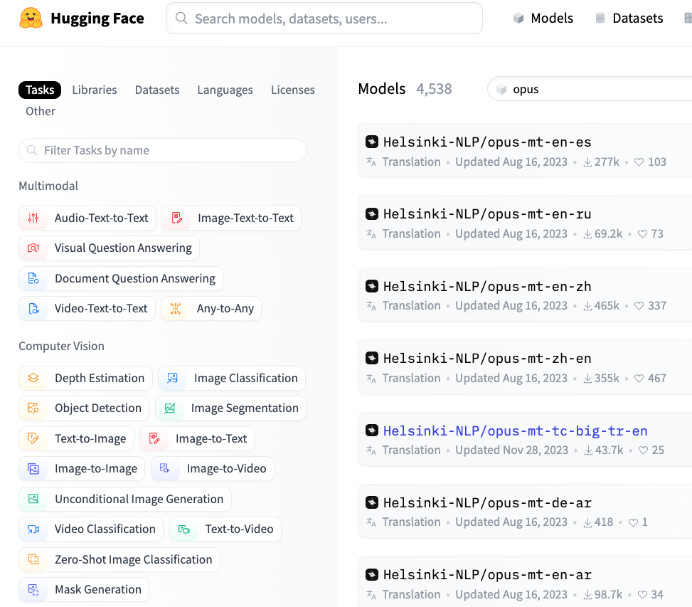
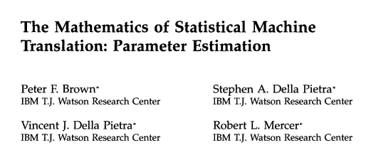
Historical Background: Parallel Corpora

Slide 20
Applications of Parallel Corpora
Machine Translation (MT)
Word Sense Disambiguation (WSD)
Bar-Hillel (1960)
MT depends on WSD
WSD is “AI-Complete”
Gale et al. (1992) flip this arg
Use translations to label senses
bank → banque ➔ “money” sense
bank → banc ➔ “river” sense
After labelling, throw out translations

Slide 21
Monolingual Senses $≠$ Bilingual Senses
Bilingual
Monolingual
Ambiguous in English
But not in French
bank → banque
bank → banc
Equally ambiguous in both languages
interest → intérêt

Slide 22
What’s Wrong with Parallel Corpora?
Availability
Limited genres:
Parliamentary Debates
Bible
Wikipedia:
Widely believed Wikipedia is a comparable corpus,
but there is more translation than people realize
Translationese
“Unnatural” natural language
Anglocentric Biases
Filter Bubbles

Slide 24
Agenda for Part 1: History
Parallel Corpora
Applications:
Machine Translation (MT)
Word Sense Disambiguation (WSD)
Inappropriate Uses of Translation → Biases
Bilingual Lexicon Induction (BLI)

Slide 25
Too Much Translation in Corpora/Resources (English is often used as a Pivot Language)
More recent
XNLI: translation of NLI
Wikipedia: more translation than one might have thought
Less recent
WordNet
NRC VAD

Slide 26
XNLI: label ~ premise + hypothesis Translated English NLI task to 15 Languages cream skimming → la crème de la crème ??

Slide 27
It is widely (and incorrectly) believed that Wikipedia is Translation-Free
https://ha.wikipedia.org/wiki/Harshen_Kx%CA%BCa
https://en.wikipedia.org/wiki/Kx%CA%BCa_languages

Slide 28
How much translation is there in Wikipedia? Answer: 90% of Hausa Pages

Slide 29
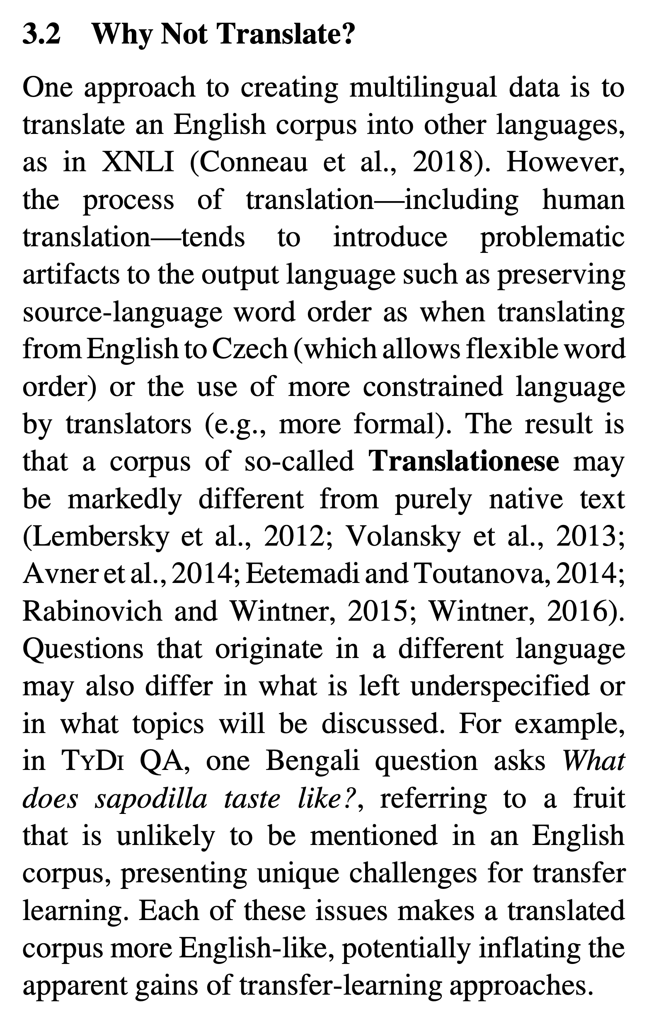

Slide 30
Too Much Translation in Corpora/Resources (English is often used as a Pivot Language)
More recent
XNLI: translation of NLI
Wikipedia: more translation than one might have thought
Less recent
WordNet
NRC VAD

Slide 31
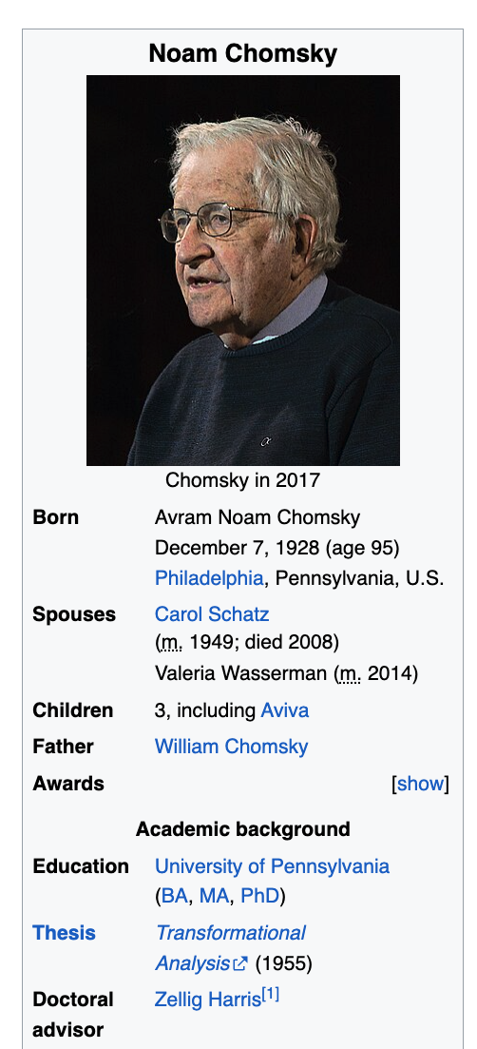

Slide 32
Avoid Translation (Pivoting via English)
WordNet
Word Sense Disambiguation (WSD)
wn.synset('dog.n.01').lemma_names('fra')
['canis_familiaris', 'chien']
wn.synset('cat.n.01').lemma_names('fra')
['chat']
wn.synset('house.n.01').lemma_names('fra')
['maison']
wn.synset('bank.n.01').lemma_names('fra')
['banque', 'rive’]
Assumes English ontology is universal
Ontology: is-a links between synsets, etc.
Supports 32 languages

Slide 33
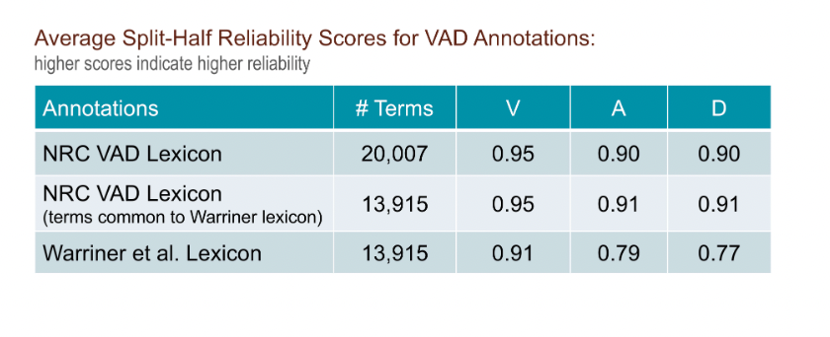
Avoid Translation (Pivoting via English) NRC-VAD (Uses Google Translate)
Hausa | English | Valence | Arousal | Dominance
aaaaaaa | aaaaaaah | 0.48 | 0.61 | 0.29
aaaah | aaaah | 0.52 | 0.64 | 0.28
ardvark | aardvark | 0.43 | 0.49 | 0.44
abin mamaki | aback | 0.39 | 0.41 | 0.29
abacus | abacus | 0.51 | 0.28 | 0.49
abalone | abalone | 0.50 | 0.48 | 0.41
Assumes English ontology is universal

Slide 34
Agenda for Part 1: History
Parallel Corpora
Applications:
Machine Translation (MT)
Word Sense Disambiguation (WSD)
Inappropriate Uses of Translation → Biases
Bilingual Lexicon Induction (BLI)

Slide 35
BLI (Bilingual Lexicon Induction) MUSE Task: An Application of Comparable Corpora
Inputs
Embeddings, $X$, for 30 languages:
$X$maps words to vectors
Gold set of bilingual dict, $D$,
for 110 language pairs
$D$ maps words in one language to their equivalent in another language
$D$are split into test and train
Training
Learn a rotation, $R$
Inference
Given word w in source lang
Find closest word in target lang

Slide 36
MUSE Task
MUSE Gold Dictionary
Inputs
Embeddings, $X$, for 30 languages:
$X$maps words to vectors
Gold set of bilingual dict, $D$,
for 110 language pairs
$D$ maps words in one language to their equivalent in another language
$D$are split into test and train
Training
Learn a rotation, $R$
Inference
Given word w in source lang
Find closest word in target lang

Slide 37
MUSE Task $≠$ Word Sense Disambiguation
WSD (Gale et al.,1992)
MUSE (Gold)
SRC=TGT

Slide 38
$97,021 – 73,471 = 23,550$
Gem dict has 20k words
SRC=TGT
FastText embeddings use spelling

Slide 39
Agenda for Part 1: History
Parallel Corpora
Applications:
Machine Translation (MT)
Word Sense Disambiguation (WSD)
Inappropriate Uses of Translation → Biases
Bilingual Lexicon Induction (BLI)

Slide 40
Agenda
Part 1: Current Status & Opportunities
Part 2: History
Part 3: Suggestions for future

Slide 41
Challenges for the Future
Lexical Semantics
Comparisons at word level
Compare and Contrast
Comparisons at document level
Contrasts in addition to comparisons
More Modalities
Words, Documents → Pictures, Audio, Video, etc.
Filter Bubbles
Comparable Corpora can help us get beyond Anglocentric Biases

Slide 42
BLI (Over)-Simplifies Lexicon
BLI assumes word-for-word translations (no phrases)
ask for
request
Distributional hypothesis
Corpora are all we need
You shall know a word by the company it keeps – Firth (1957)
No semantics, etymology, etc.
History has implications for contemporary language
But may be hard
to infer history from a corpus
of contemporary language
Etymology
1066 Norman Conquest
For a few hundred years
Peasants spoke Anglo-Saxon
Aristocracy spoke French
English → Anglo-Saxon + French
Word from French: higher register
Peasants raise
cows, calf, swine (Anglo-Saxon)
So aristocracy can eat
beef, veal, pork (French)

Slide 43
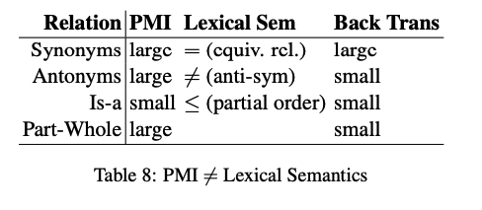
Lexical Semantics
Distributional hypothesis
Corpora are all we need
You shall know a word by the company it keeps – Firth (1957)
No semantics, etymology, etc.
PMI (pointwise mutual info)
Church & Hanks (1990)
PMI → Word2Vec → BERT/LLMs
PMI estimates collocations
Prob that two words appear near one another, normalized by chance
good / OK / bad
Back Translation
Random Walk over Translations
Good → Bien → OK → Tout marche bien → Everything works fine
But not, good → … → bad
Large PMI
Collocations:
Truth, Justice & American Way
Red, White and Blue
Synonyms: true / correct
Antonyms: true / false
Part-Whole: window /house

Slide 44
Lexical Semantics Challenges
Can we capture the following with vector space models?
Etymology
Register
More than symmetry (cos)
equivalence relations: $=$
partial orders:$≤$ (is-a)
anti-symmetric: $≠$ (not)
Diff between collocation & BT
Collocations (within language)
BT: Backtrans (across languages)

Slide 45
Challenges for the Future
Lexical Semantics
Comparisons at word level
Compare and Contrast
Comparisons at document level
Contrasts in addition to comparisons
More Modalities
Words, Documents → Pictures, Audio, Video, etc.
Filter Bubbles
Comparable Corpora can help us get beyond Anglocentric Biases

Slide 46
Compare and Contrast Task
Input two papers
maybe in the same language
(and maybe not)
Output snippets
summaries of each paper
as well as
similarities and
differences
Chatbots are ok
at summarization
though not as good as tldr
Chatbots are not ok
on similarities and
differences

Slide 47
Transfer Learning: Bootstrap LLMs to more languages
Good News
There are lots of papers in Semantic Scholar (S2)
in many languages
mostly translation-free
Challenge
Find comparable papers in high-resource languages

Slide 48
Tasks:
Find Comparable Papers
Compare and Contrast
Input: paper id
Output: Similar papers
Similar to recommendations
Input: two paper ids
Outputs:
Similarities
Differences
(and summaries of both papers)
Variations
Monolingual
Multilingual

Slide 49
Snippet from Semantic Scholar
tldr
chat

Slide 50
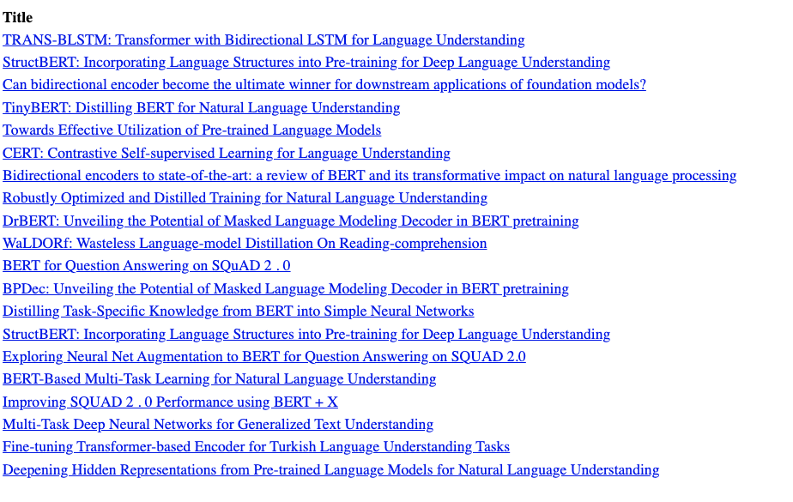
Recommendations: Query: BERT paper

Slide 51
Summaries of Two Papers

Slide 52
What do I really want to ask this paper?
How does this paper compare with that paper?
What do they have in common?
How do they differ?
Similarities
Both BERT and TinyBERT use similar methods (transformers)
to encode text as vectors
Differences
TinyBERT is smaller, faster, cheaper
and almost as good

Slide 53
How does BERT compare with TinyBERT?
Source: S2
Similarities
Both BERT and TinyBERT use similar methods (transformers) to encode text as vectors
Differences
TinyBERT is smaller, faster, cheaper and almost as good
Target

Slide 54
Multilingual Version: Please compare and contrast these two papers

Slide 55
Multilingual Version (translation of previous slide) Please compare and contrast these two papers

Slide 56
tldr: Better in English than Chinese

Slide 57
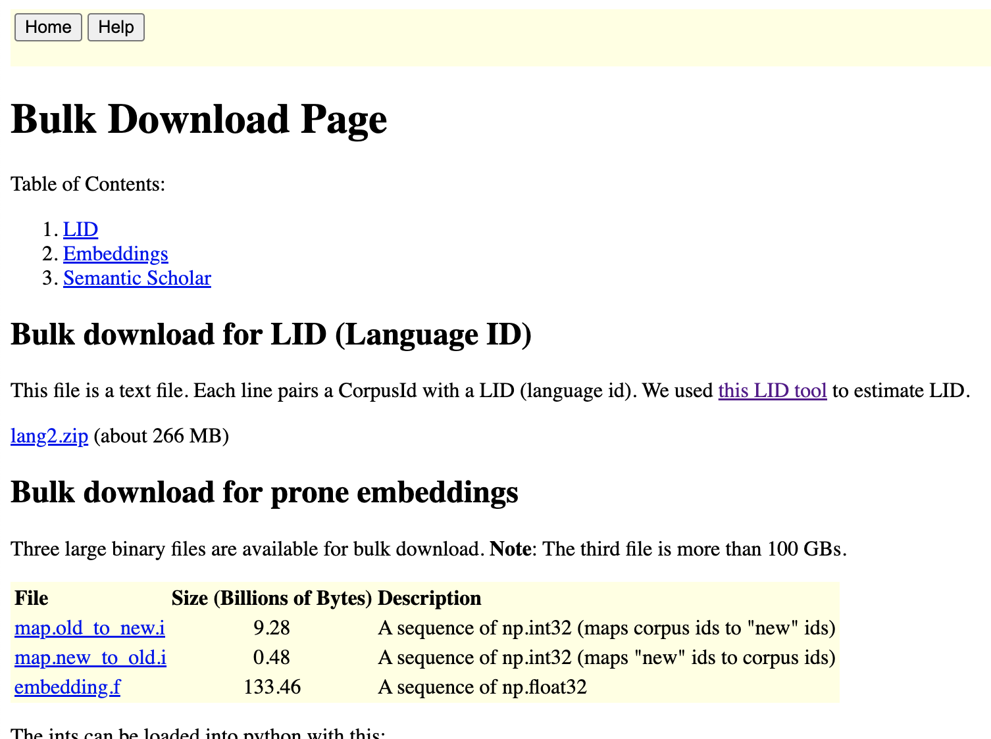
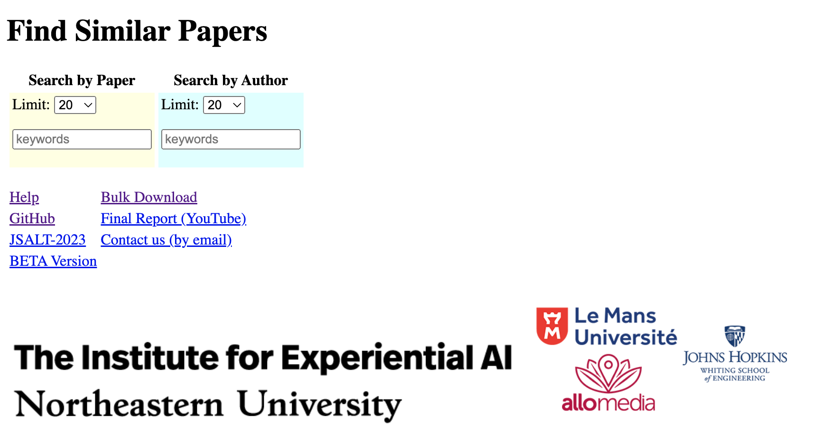
Shameless Plug: http://recommendpapers.xyz

Slide 58
Challenges for the Future
Lexical Semantics
Comparisons at word level
Compare and Contrast
Comparisons at document level
Contrasts in addition to comparisons
More Modalities
Words, Documents → Pictures, Audio, Video, etc.
Filter Bubbles
Comparable Corpora can help us get beyond Anglocentric Biases

Slide 59
Multimodal Corpora: Text, Audio, Pictures, Video, etc.
A Multimodal Parallel Corpus
A Multimodal Comparable Corpus
Now that everything is a vector,
represent everything as vectors
answer all questions with ANN

Slide 60
Computational Linguistics & Vision Words, Documents → Pictures, Audio, Video, etc.
Perspective: Comparable Corpora
Perspective: Linguistics in Pictures
Now that everything is a vector,
represent everything as vectors
answer all questions with ANN
Data is data
English/French/Audio/Pictures
Communication is communication
Bias/Filter-Bubbles
Translation-Free
Perspective/Sentiment/Stance/Culture
COCO (facts) 👎
ArteLingo (opinions) 👍
Vocabulary
COCO (nouns you can see)
ArteLingo (richer vocab)

Slide 61
Pragmatics
Candidate labels: baseball cap, cap, green hat, hat, head.
Can you guess which one is in the gold standard?
Visual Genome
Head is weird
Because it serves no useful purpose to mention that.
(You might mention that if one of the girls were headless)
Purposes of modification (Grice)
Descriptive
Discrimination
Green vs. White
Hat vs. No Hat
Offense vs. Defense
One Bounding Box vs. Two?
One: describe what is inside the box
Two: compare and contrast

Slide 62
A More Modern View of Vision Research Task: End-to-End Image Captioning
###Human: <img> </img>
Could you describe the contents of this image for me?
Use <lang> words to describe the image
###Assistant:
No Boundng Boxes

Slide 63
A Translation-Free Benchmark (To avoid Anglo-Centric Biases)
Input:
Picture from WikiArt
Language (one of 28 languages)
Output Annotations:
9 Emotion Labels
4 Positive:
Contentment, Awe, Excitement, Amusement
4 Negative:
Sadness, Anger, Fear, Disgust
1 Neutral
Caption (in your language)
EMNLP-2024

Slide 64
Embrace Diversity & Multiple Perspectives
emotion labels:
disgust (Burmese)
awe (Malay)
captions focus
on chest
Burmese & Malay
on face and hair
Korean & Setswana
Hypothesis:
Predictable
Ethics Review

Slide 65
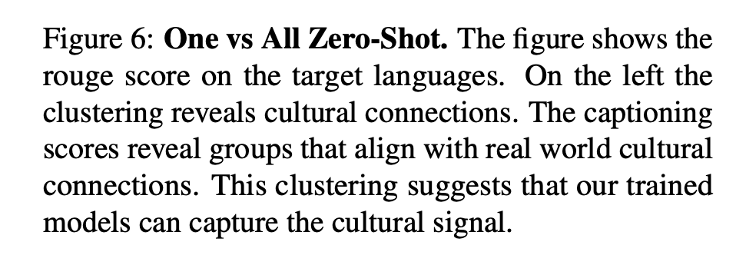
Evidence:
Predictable

Slide 66
Vision: More than Pixels Communication (Shannon): Audience Matters
Art is a form of communication
between artist and audience
Background matters
Language
Culture
Task: Art, Lang → Caption
English pivot baseline:
Translate caption from English
Can we beat that?

Slide 67
Website: Benchmark, Code, Paper & Video

Slide 68
Adding Perspective to Speech/Vision Research COCO (Objective) → ArtEmis (Subjective)
Subjective Emotion
Objective
Facts
More room for Audience Background:
Culture/Language
Nouns: man, woman, kid, table
Modifiers: love, interacting, family

Slide 69
Challenges for the Future
Lexical Semantics
Comparisons at word level
Compare and Contrast
Comparisons at document level
Contrasts in addition to comparisons
More Modalities
Words, Documents → Pictures, Audio, Video, etc.
Filter Bubbles
Comparable Corpora can help us get beyond Anglocentric Biases

Slide 70
Emerging trends: When can users trust GPT, and when should they intervene?
Usage of LLMs and chat bots will continue to grow,
since they are so easy to use,
and so (incredibly) credible.
This article describes a homework assignment,
where I asked my students to use bots to write essays.
Too many essays
should have been fact-checked.
Factchecking is
too much trouble.

Slide 72
Amazingly Good: Metaphor
cover all the bases
drop the ball
dunk
fumble
get on base
hit a home run
out in left field
punt (as a verb)
ragging the puck
run out the clock
sticky wicket
strike out

Slide 73
Amazingly Good: Metaphor
cover all the bases
drop the ball
dunk
fumble
get on base
hit a home run
out in left field
punt (as a verb)
ragging the puck
run out the clock
sticky wicket
strike out

Slide 74
Amazingly Bad: Anglo-Centric Biases
Homework assignment
Write essays on Opium Wars
from six perspectives
including East and West
Chatbots view everything
from a single (American) perspective
Hope: international students would rewrite output from bots
But that was too much work
All essays reflect Western perspective
Bots made in America do not mention
“Century of Humiliation”
A view that is motivating efforts
to compete with West in AI
When bots over-simplify the truth,
and take our side of a conflict,
that could be dangerous
and could lead to a trade war,
or worse

Slide 75
Ambitious Goal for Bots
Bots should be
competitive with historians
Appreciate history from multiple perspectives
as well as implementations for contemporary audience
Blurb:
“but also for anyone
seeking to understand the explosive intersection
between trade and politics today”

Slide 76
Conclusions: Challenges for the Future
Lexical Semantics
Comparisons at word level
Compare and Contrast
Comparisons at document level
Contrasts in addition to comparisons
More Modalities
Words, Documents → Pictures, Audio, Video, etc.
Filter Bubbles
Comparable Corpora can help us get beyond Anglocentric Biases

