Slide 1
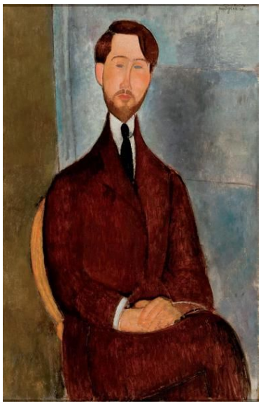
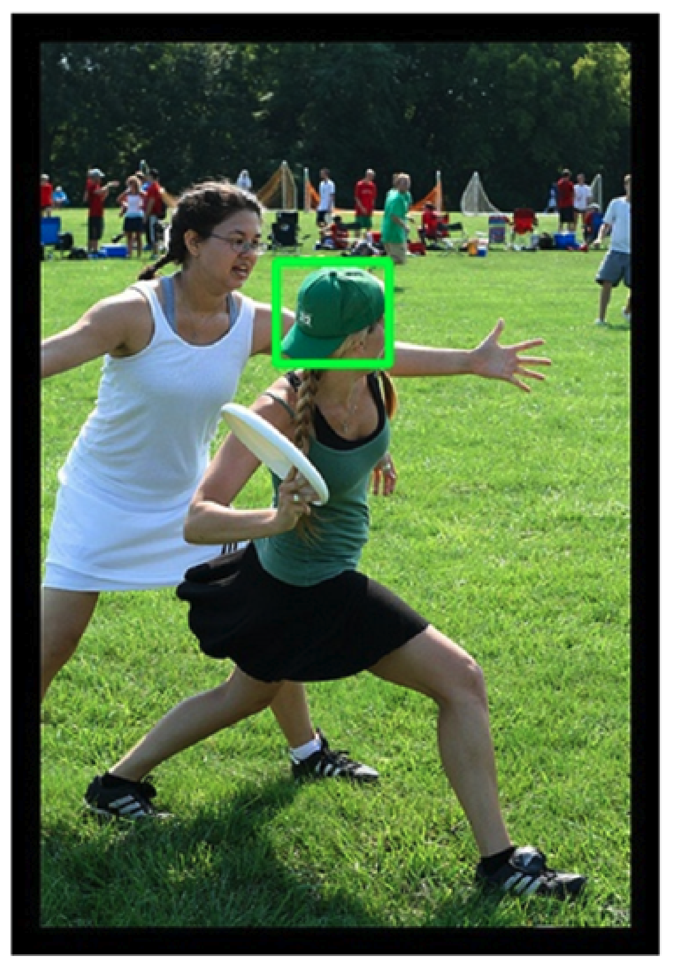
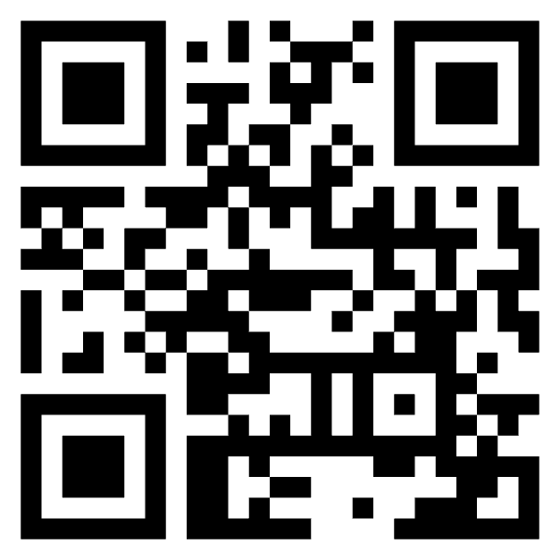
Shameless Plug for BUCC Talk on Comparable Corpora
Including these slides
(and video)
Kenneth Church
https://kwchurch.github.io/
Northeastern University
Jan 20, 2025

Slide 2
Agenda
$$\frac{Parallel Corpora}{Comparable Corpora}\sim \frac{Alignment}{Gestalt}$$
Part 1: Current Status & Opportunities
Part 2: History
Part 3: Suggestions for future
Simplifying Assumptions
Distributional Hypothesis
Compositionality
Associationism (not Gestalt)
Word Associations (PMI)
Alignment
Aligned parallel corpora
Translation
Aligned speech corpora
Bounding Boxes (Vision)

Slide 3
Current Status: Where are we now?
The success of chat bots in many languages demonstrates
the power of comparable corpora (CC)
and pivoting via English
👍
👎

Slide 4
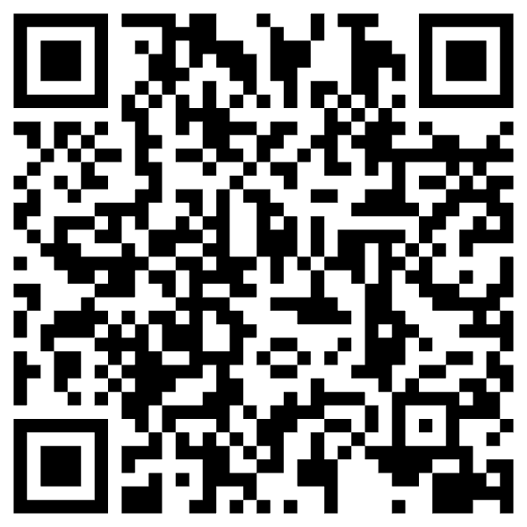
https://www.chronicle.com/article/im-a-student-you-have-no-idea-how-much-were-using-chatgpt

Slide 5
Current Status: Where are we now?
The success of chat bots in many languages demonstrates
the power of comparable corpora (CC)
and pivoting via English
What’s wrong with pivoting via English?

Slide 6
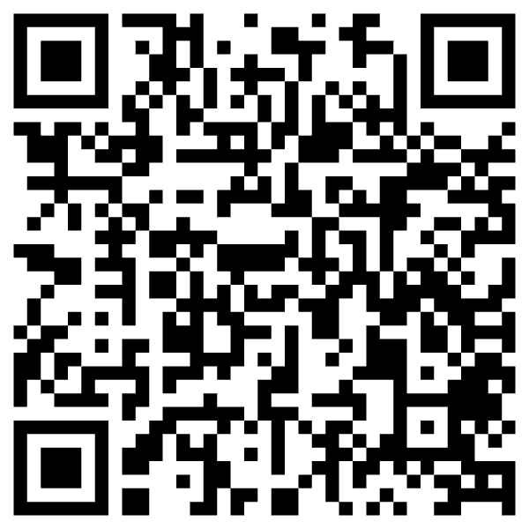
Criticism: ACL is too focused on English https://thegradient.pub/the-benderrule-on-naming-the-languages-we-study-and-why-it-matters/

Slide 7
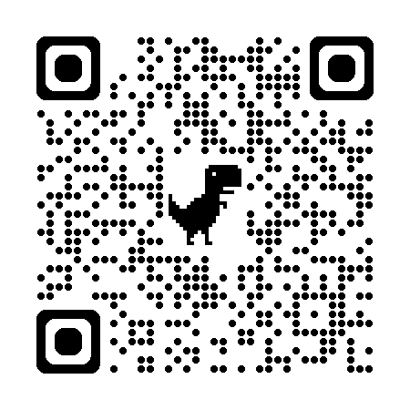
Weird = Western, Educated, Industrialized, Rich, and Democratic

Slide 8
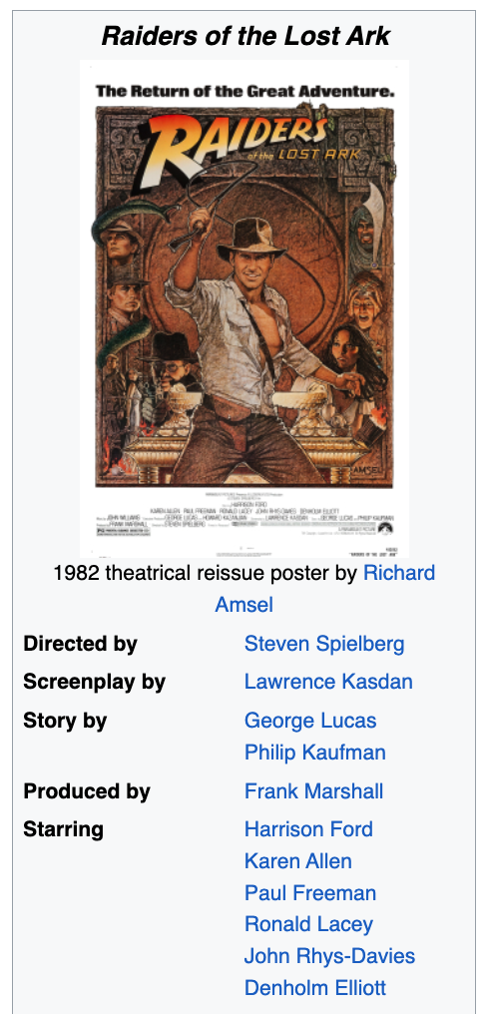
Filter Bubbles (Colonialism) Move Fast and Break Things
Irresponsible AI

Slide 9
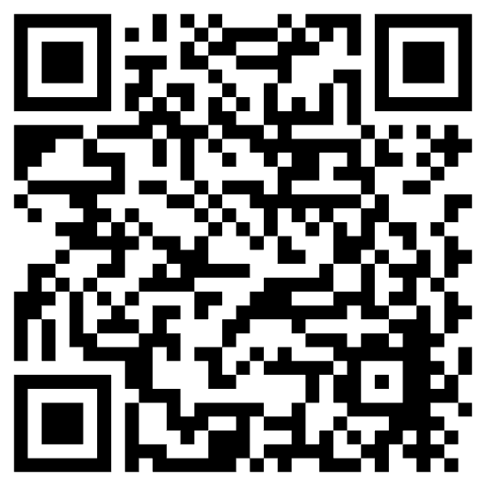
Truth, Justice and <fill-mask>
https://www.nytimes.com/2006/06/30/opinion/30iht-ederik.2093103.html?_r=0
WW II
2021

Slide 10
Better to Engage Local Expertise
NLLB
Quality control is relatively weak in 4 African Languages
“A significant part of the translations were suspected
to have been automatically generated”
“Unnatural” natural language
Not even grammatical

Slide 11
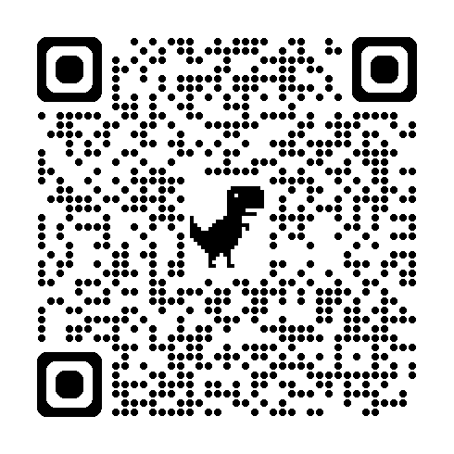
Deadly Consequences

Slide 12
Filter Bubble Hypothesis: Anglophones don’t know how bad it is elsewhere
In Nigeria
Tweets are more toxic in Hausa
than in English

Slide 13
Growth Languages

Slide 14
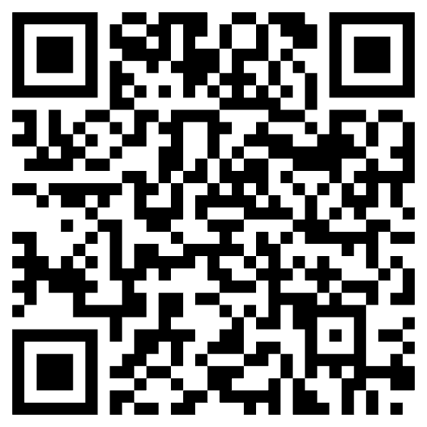
Low Resources & Growth Opportunities
Endangered Languages
https://en.wikipedia.org/wiki/List_of_languages_by_total_number_of_speakers
40 Million Speakers or more
English, Chinese, Hindi, Spanish, Arabic, French, Bengali, Portuguese, Russian, Urdu, Indonesian, German, Japanese, Nigerian Pidgin, Marathi, Telugu, Turkish, Hausa, Tamil, Swahili, Tagalog, Punjabi, Korean, Persian, Javanese, Italian, Gujarati, Thai, Amharic, Kannada, Bhojpuri
https://en.wikipedia.org/wiki/Endangered_language
Better Business Case

Slide 15
Good News: More resources than we had for English when we started EMNLP
Wikipedia
Joshi Classification
Semantic Scholar (S2)
ACL Anthology
HuggingFace (HF)
Speakers

Slide 16
A Translation-Free Benchmark (To avoid Anglo-Centric Biases)
No Bounding Boxes
Input:
Picture from WikiArt
Language (one of 28 languages)
Output Annotations:
9 Emotion Labels
4 Positive:
Contentment, Awe, Excitement, Amusement
4 Negative:
Sadness, Anger, Fear, Disgust
1 Neutral
Caption (in your language)
EMNLP-2024

Slide 17
Embrace Diversity & Multiple Perspectives
emotion labels:
disgust (Burmese)
awe (Malay)
captions focus
on chest
Burmese & Malay
on face and hair
Korean & Setswana
Hypothesis:
Predictable
Ethics Review

Slide 18
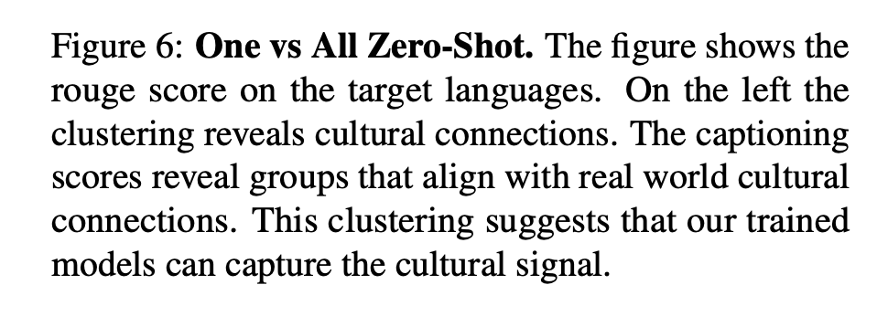
Evidence:
Predictable

Slide 19
Vision: More than Pixels Communication (Shannon): Audience Matters
Art is a form of communication
between artist and audience
Background matters
Language
Culture
Task: Art, Lang → Caption
English pivot baseline:
Translate caption from English
Can we beat that?

Slide 20
Website: Benchmark, Code, Paper & Video

Slide 21
Emerging trends: When can users trust GPT, and when should they intervene?
Usage of LLMs and chat bots will continue to grow,
since they are so easy to use,
and so (incredibly) credible.
This article describes a homework assignment,
where I asked my students to use bots to write essays.
Student essays
should have been fact-checked.
But fact-checking is
too much trouble.

Slide 22
Amazingly Bad: Anglo-Centric Biases
Bots made in America
do not mention
“Century of Humiliation”
A view that is motivating efforts
to compete with West in AI
Homework assignment
Write essays on Opium Wars
from six perspectives
including East and West
Chatbots view everything
from a single (American) perspective
Hope: international students would rewrite output from bots
But that was too much work
All essays reflect Western perspective
When bots over-simplify the truth,
and take our side of a conflict,
that could be dangerous
and could lead to a trade war,
or worse

Slide 23
Ambitious Goal for Bots
Bots should be
competitive with historians
Appreciate history from multiple perspectives
as well as implications for contemporary audience
Blurb:
“but also for anyone
seeking to understand the explosive intersection
between trade and politics today”

Slide 24
Conclusions
Too much English
Too much pivoting via English
Too much translation
Consequences
Anglocentric biases/WEIRD
Filter Bubbles
Do not impose our views on the rest of the world
Bots made in America
Live in an American Filter Bubble
Embracing diversity is better than de-biasing

